Slide 1





Warren County Department of Planning
and Community Development
Adirondack Planning Forum
May 7, 2026

Slide 2

Why Focus
on Hamlets?

Slide 3
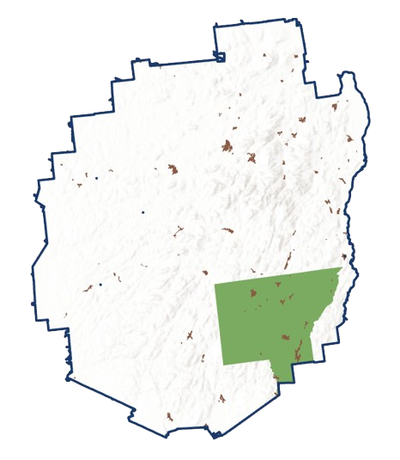
2%
of land area of Warren County (within the park)

Slide 4



From Housing Need to Local Action
Housing
Need
(2023)
Availability
Affordability
Housing Strategy
(2025)
Defined County Role
Prioritized Actions
Thriving
Hamlets
(ongoing)
Technical Support
Zoning & Infrastructure

Slide 5

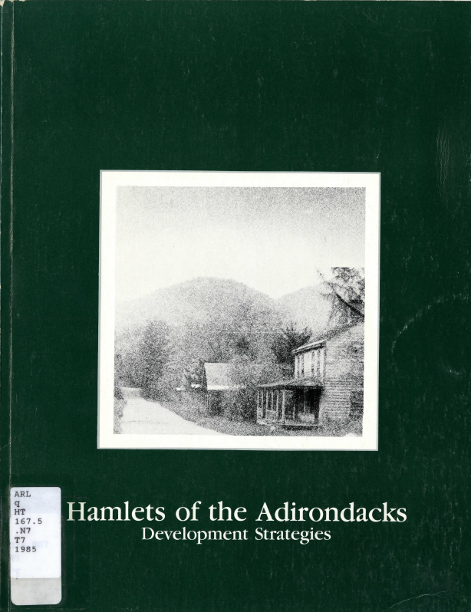
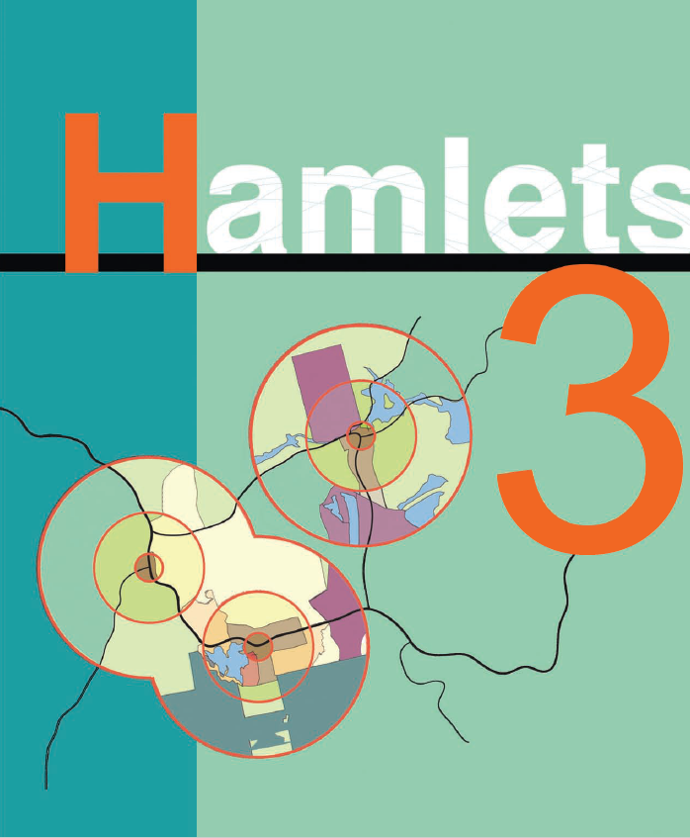
Built on Decades of Work
1983
1985
2010

Slide 6
Same Goals, Limited Outcomes
what we’ve always wanted:
more families
more local businesses
year-round communities
vibrant hamlets
what we’re seeing:
aging population
fewer school-age children
housing mismatch
limited new development
The vision hasn’t changed- but the outcomes
haven’t matched the vision

Slide 7
New Tools for Local Action
Infrastructure Investment:
Water and sewer funding
Supports housing and growth
Enables higher density development
Planning and Zoning Support:
Funding for zoning updates
Support for local planning
Aligns regs with goals
The tools are catching up to the vision

Slide 8
What Can We Control?
NOT in local control:
Regional demographics
Housing market forces
APA regulations
Funding cycles
WITHIN local control:
Zoning regulations
Infrastructure planning
Development standards
Thriving Hamlets focuses on the levers communities can control.
Investment and infrastructure alone do not guarantee a thriving community.

Slide 9

How this Work is Made Possible
Funding
NYSDEC Smart Growth Grant
County Investment
Tools
ArcGIS Pro
ArcGIS Urban
CityEngine
Sketchup
Data
Partners
Town Govt
Engineering Support

Slide 10
Thriving Hamlets Process
What exists What’s possible What can change
Hamlet conditions
Development potential
Zoning and infrastructure scenarios
Goal: informed local decisions

Slide 11
Developed detailed hamlet profiles using:
Population + housing characteristics
Parcel patterns + land use mix
Business activity + services
Infrastructure + access
Vacancy + development patterns
Phase 1:
Understanding
Hamlet Conditions
Investment and infrastructure
alone do not guarantee
a thriving community

Slide 12
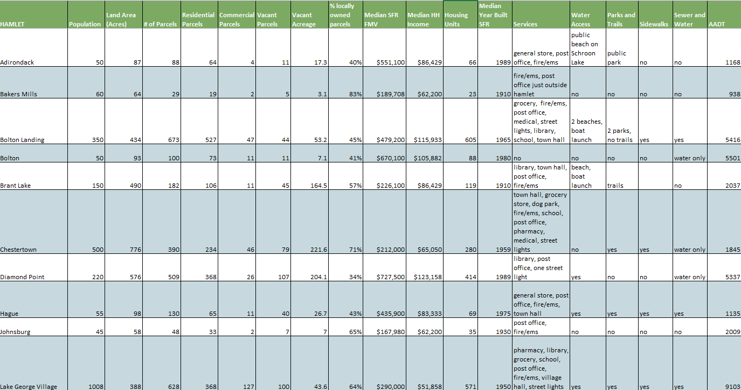
Phase 1: Understanding
Hamlet Conditions

Slide 13
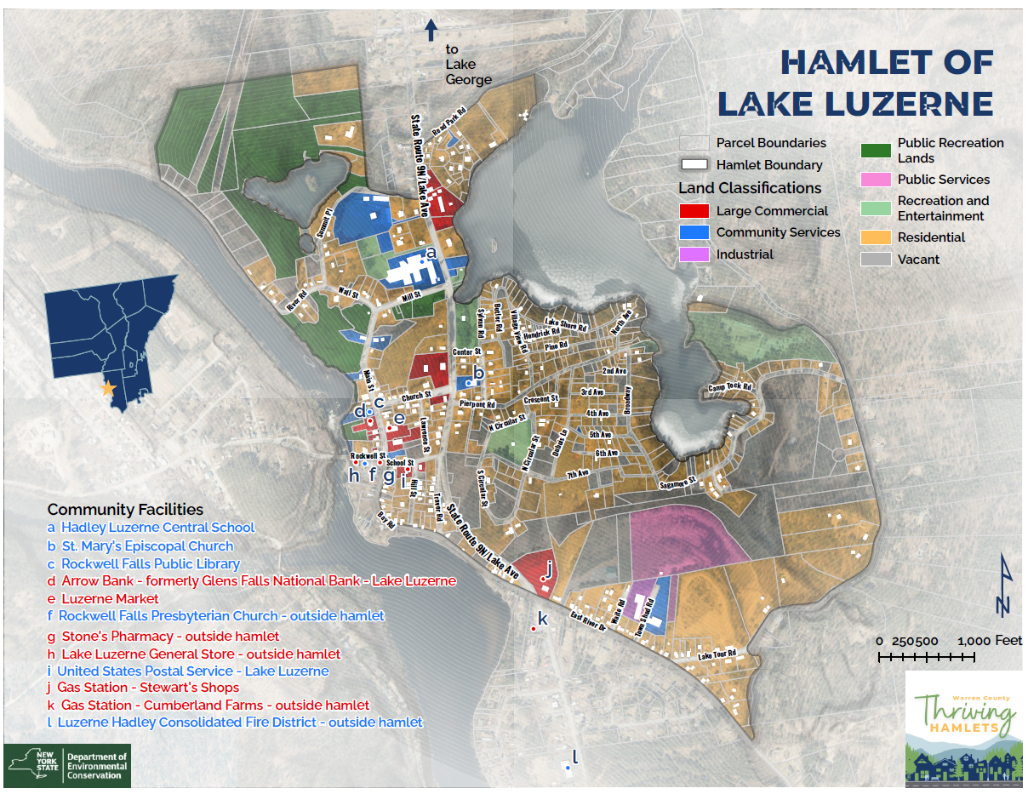

Slide 14
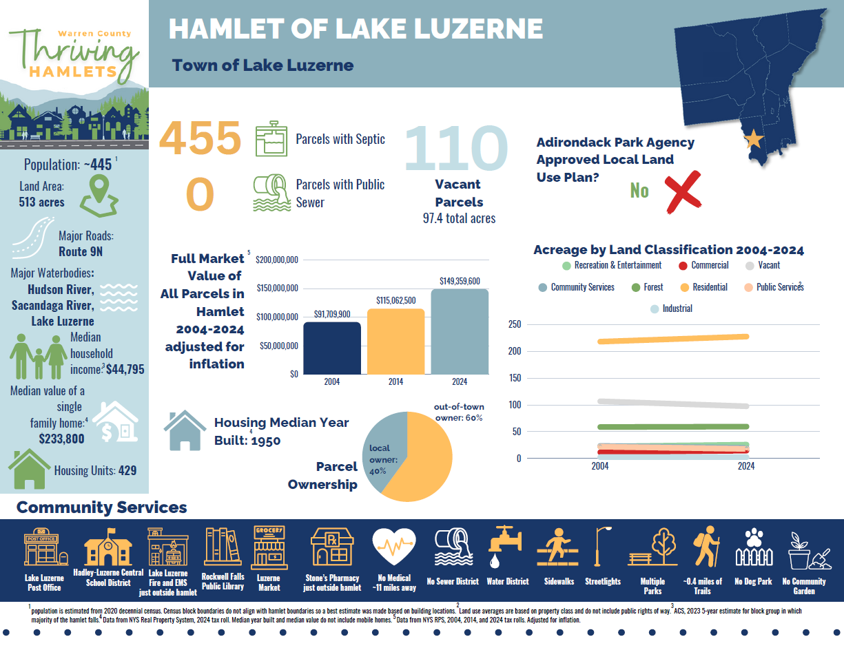

Slide 15
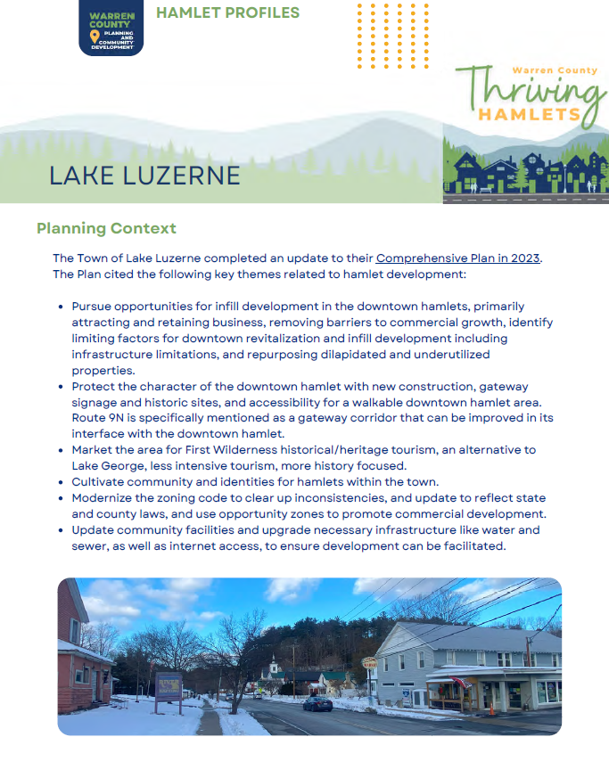
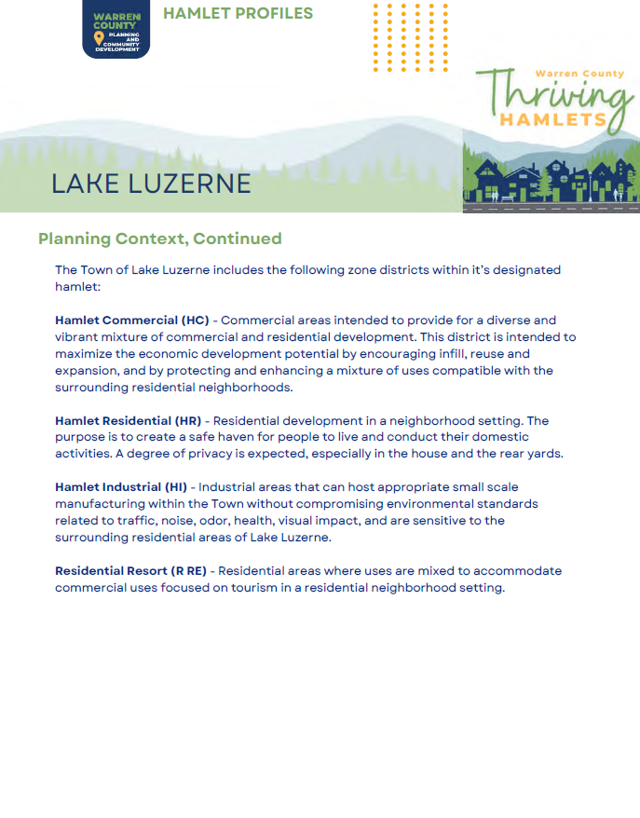

Slide 16
Phase 2:
Understanding
Development Potential
Completed a “traditional” 2D build-out using ArcGIS Pro:
Wetland and waterbody buffers
Steep slopes
Flood zones
Existing land use
Focus: What is possible under existing
physical conditions

Slide 17
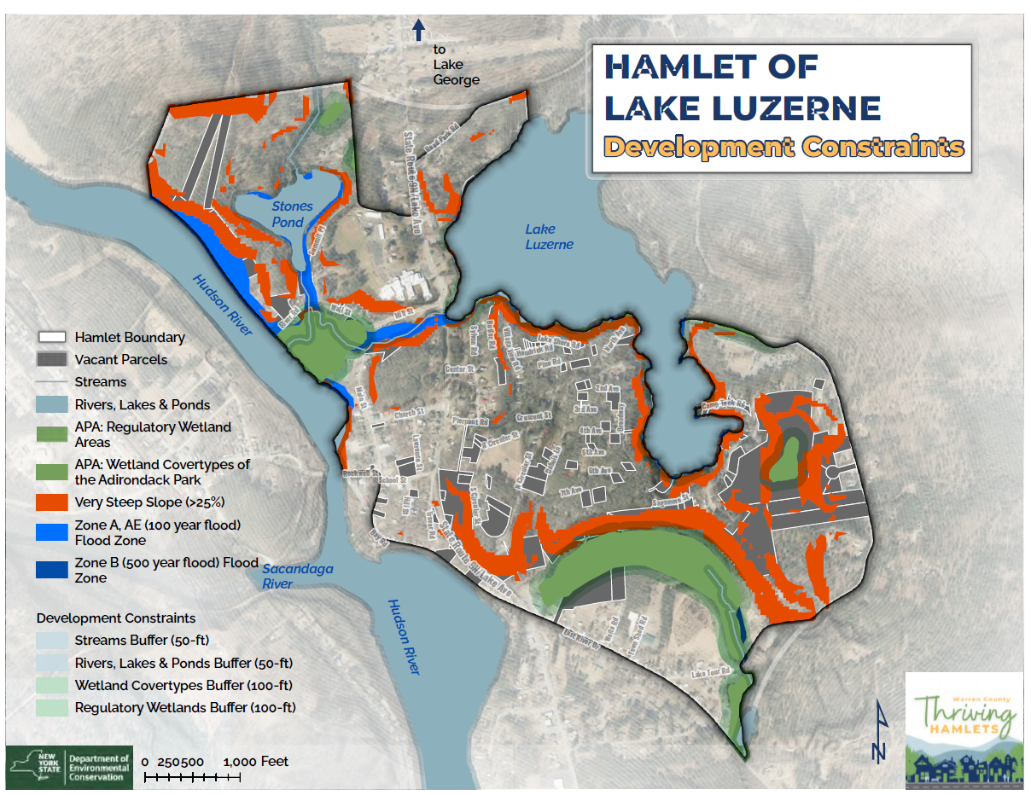

Slide 18
Zoning analysis – how does existing lot usage compare to zoning regulations? Can changes be made to improve potential?
Infrastructure analysis -
how does infrastructure impact development potential?
Infill scenarios –
3D modeling: development intensity and form
Phase 3:
Expanding
Development
Potential

Slide 19
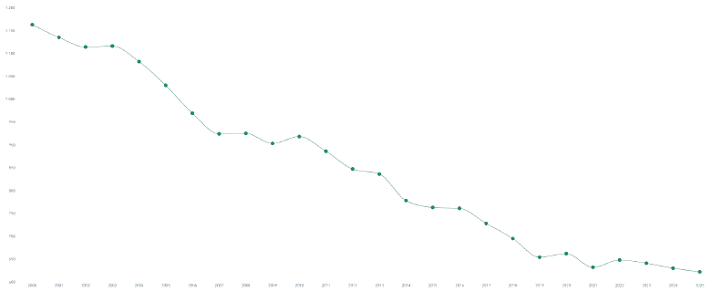
    Demographic shifts:
    steep decline in school enrollment and increasing population age
    Loss of businesses
    Lack of affordable, year-round housing and conversion to short-term rentals
    Infrastructure concerns (water, stormwater, wastewater)
Lake Luzerne Challenges
School Enrollment
2000: 1,166
-46%
2025: 625

Slide 20
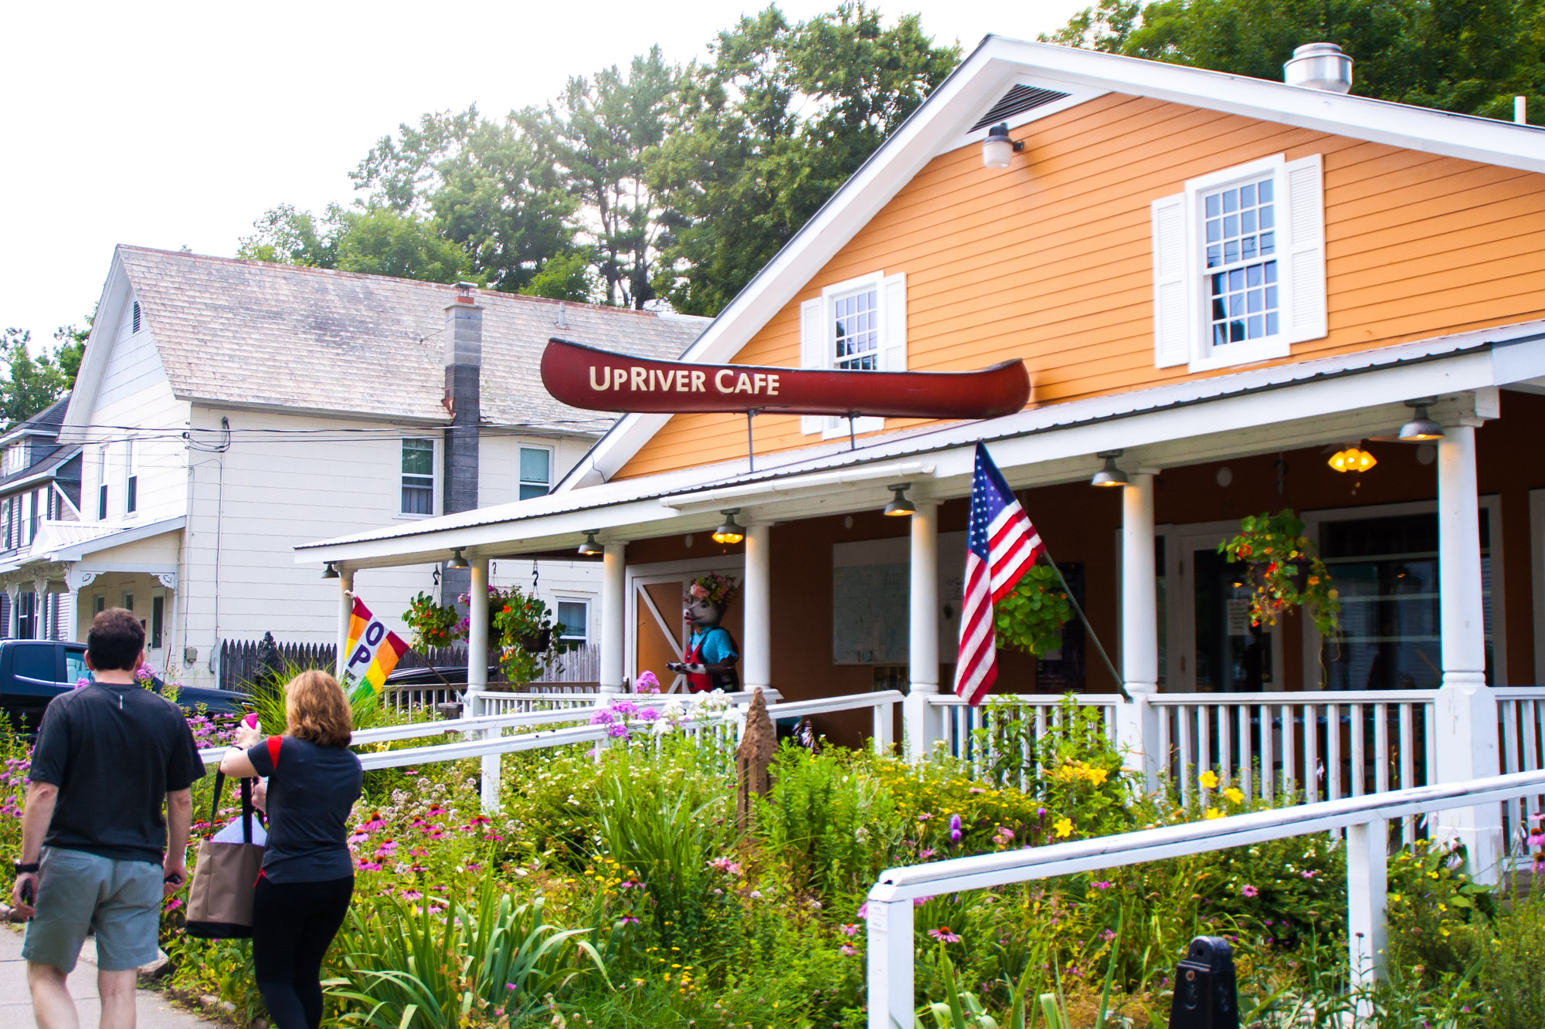
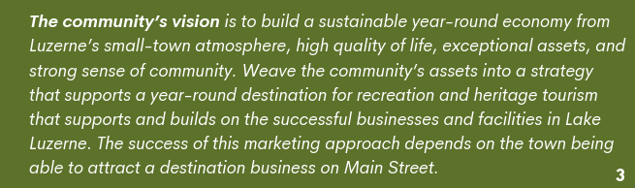
Lake Luzerne Vision
2023 Comprehensive Plan

Slide 21
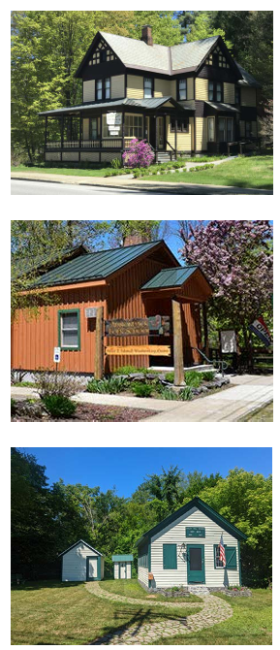
Lake Luzerne Priority Goals
2023 Comprehensive Plan
Comprehensive Plan Implementation – underway
New Community Playground – complete
Application for permits to treat aquatic invasive species in Lake Luzerne – complete
Lake Luzerne Water District System Rehab – grant funding application submitted
Updated zoning ordinance, zoning map, and subdivision regulations – underway
Business attraction and retention plan
Route 9N Corridor study
Branding and Marketing Plan
Historic and Cultural Interpretive Strategy
Community Housing Needs Assessment

Slide 22
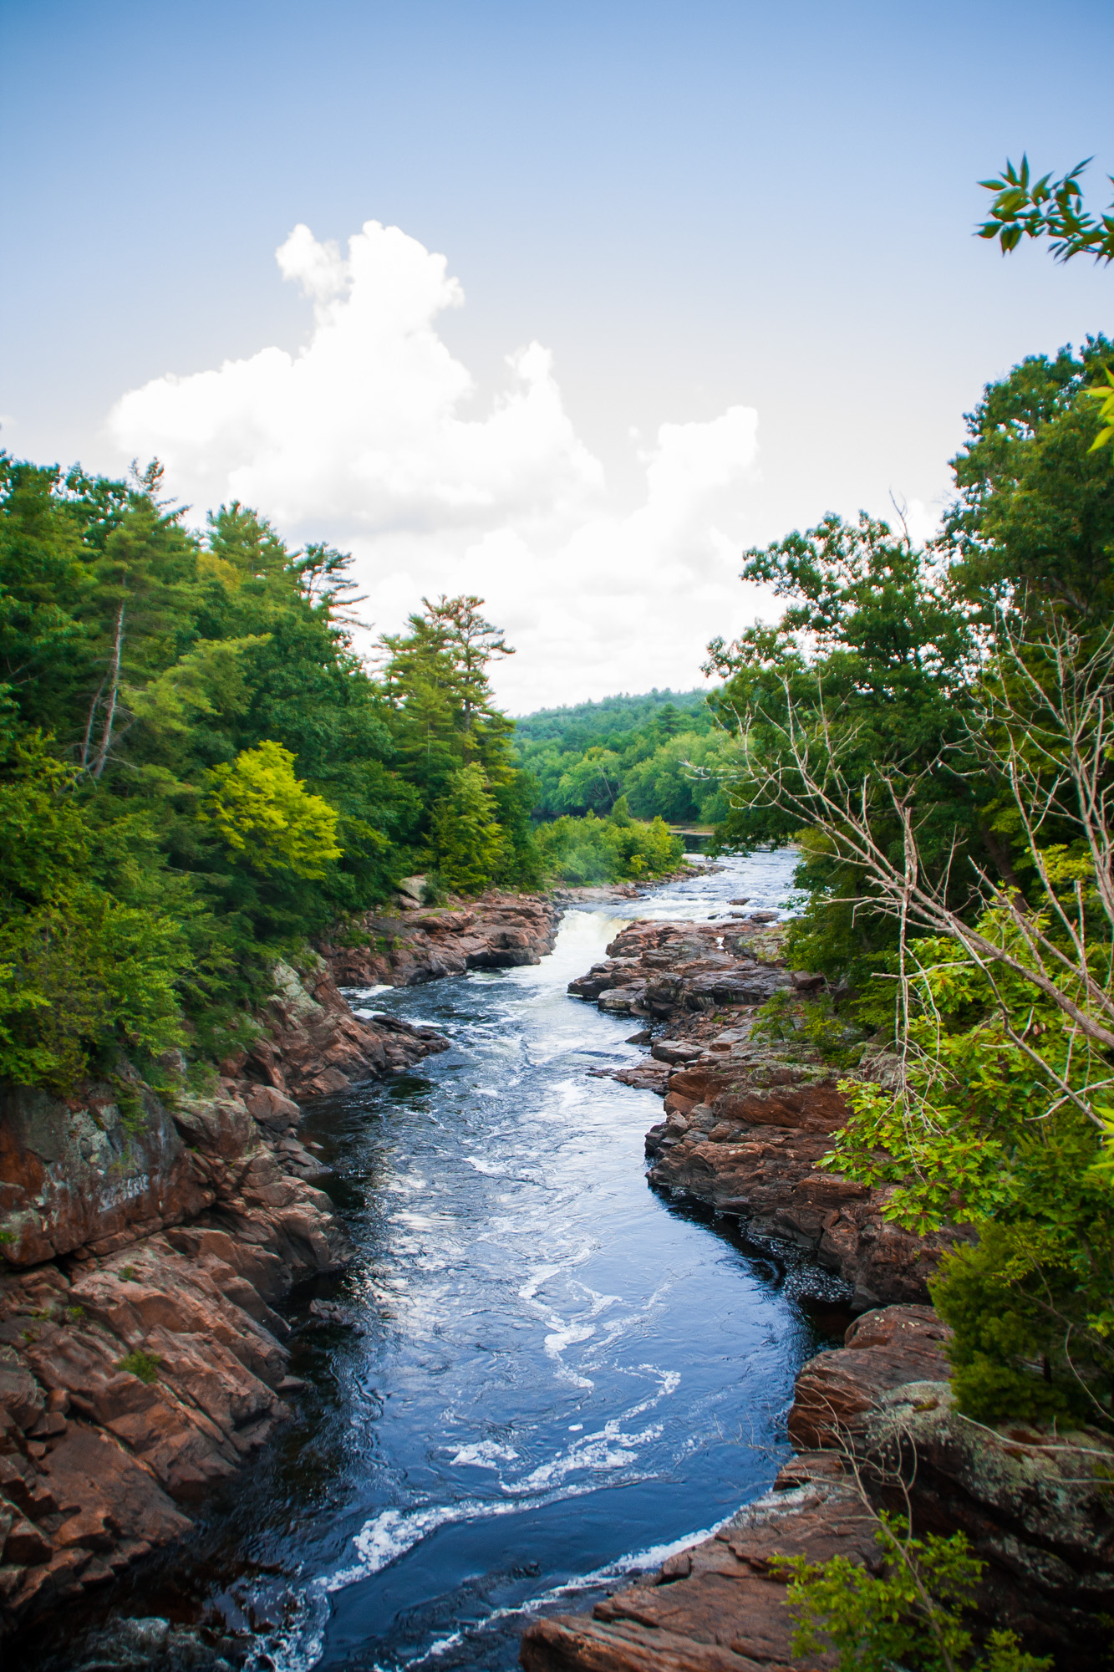
Lake Luzerne Goals
2023 Comprehensive Plan
Goal 5. Updated zoning ordinance, zoning map and subdivision regulations
“review, identify, evaluate, and correct barriers to commercial growth, including planning, zoning, and APA compliance. Address zoning inconsistencies between the APA and the Town including density and shoreline setbacks…”

Slide 23
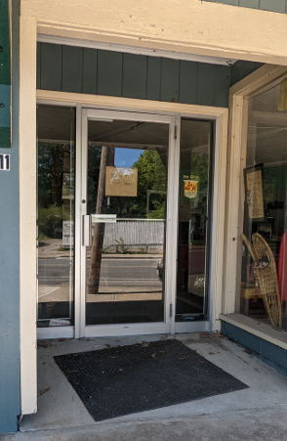
Lake Luzerne Goals
2023 Comprehensive Plan
Goal 6. Business attraction and retention plan
“the plan should include actions the Town can take to actively recruit a small-scale mix of retail, restaurants, and services for the downtown business district…prospecting efforts should include
  Coffee shop/bakery
  Small retail and office space
  Food trucks
  Outdoor goods, equipment and services
  Craft brewery
  Regional arts and crafts store
Identify alternatives for the development of dilapidated, underutilized, and vacant properties on Main St. and Bridge St.”

Slide 24
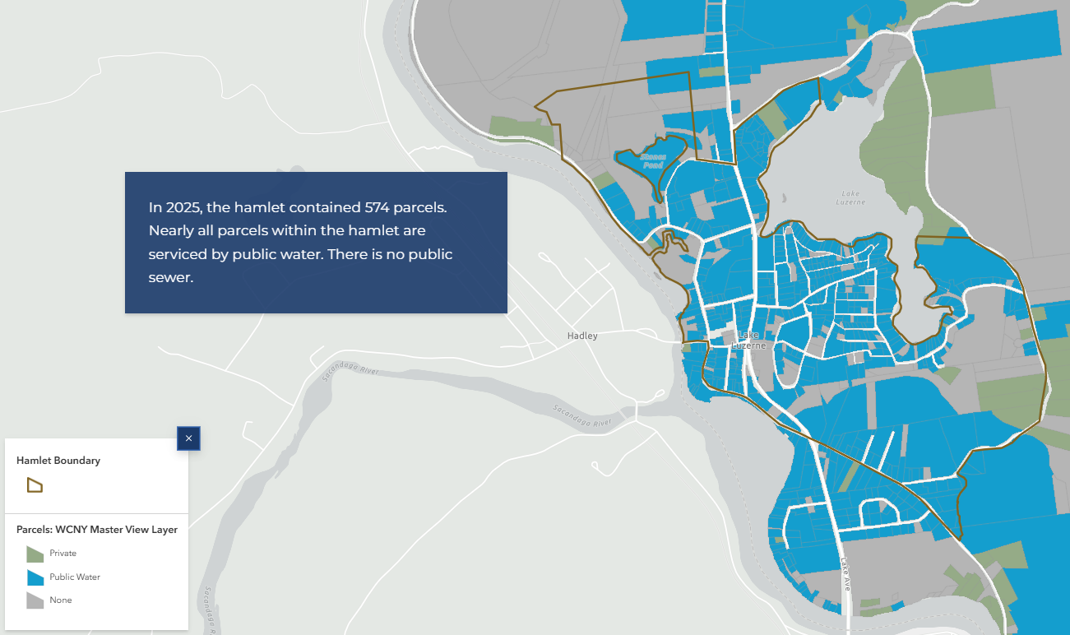

Slide 25
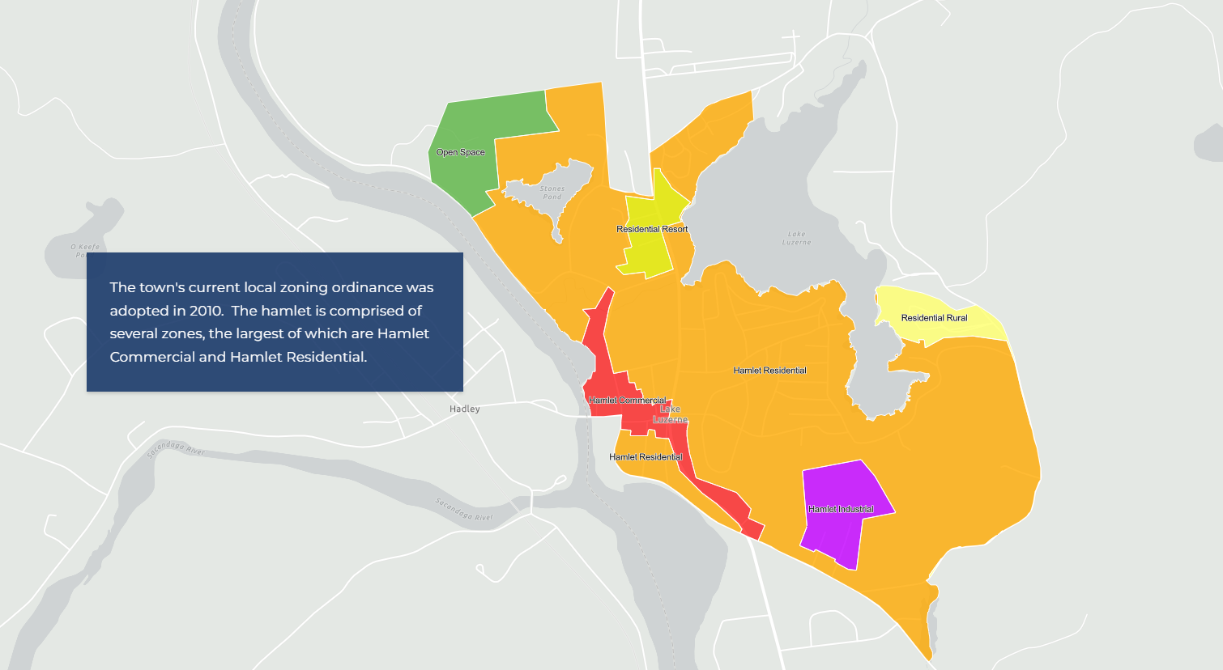

Slide 26
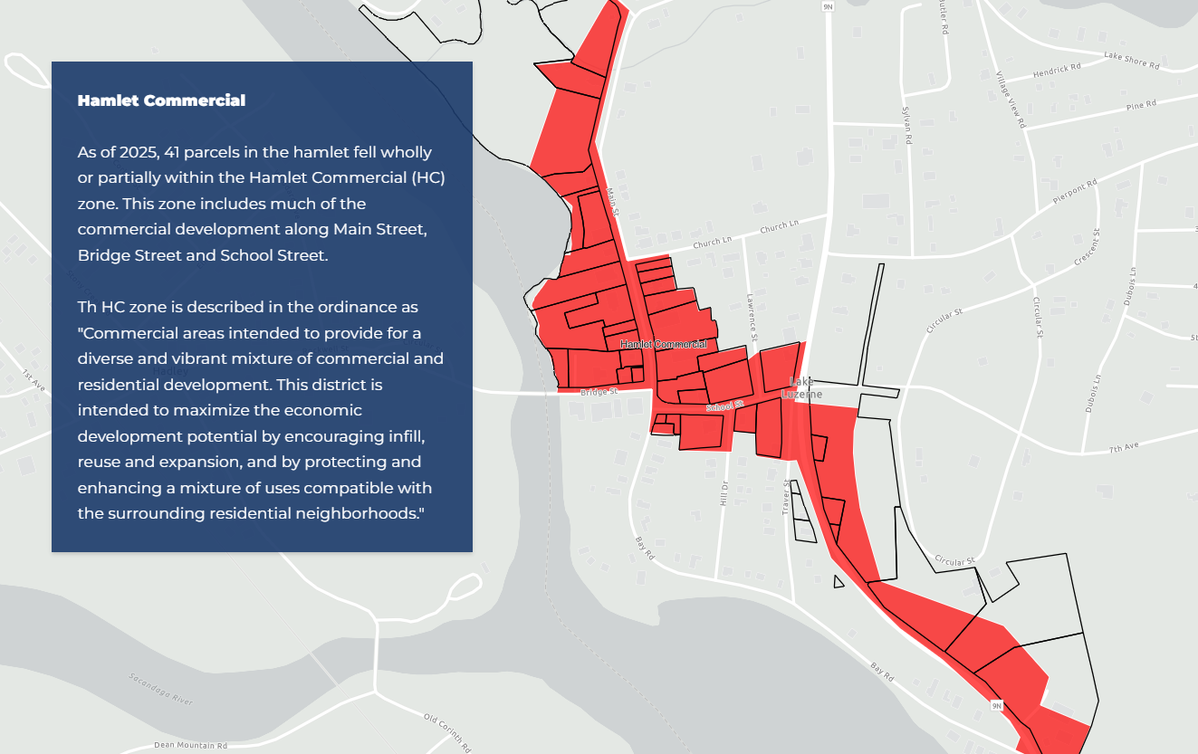

Slide 27
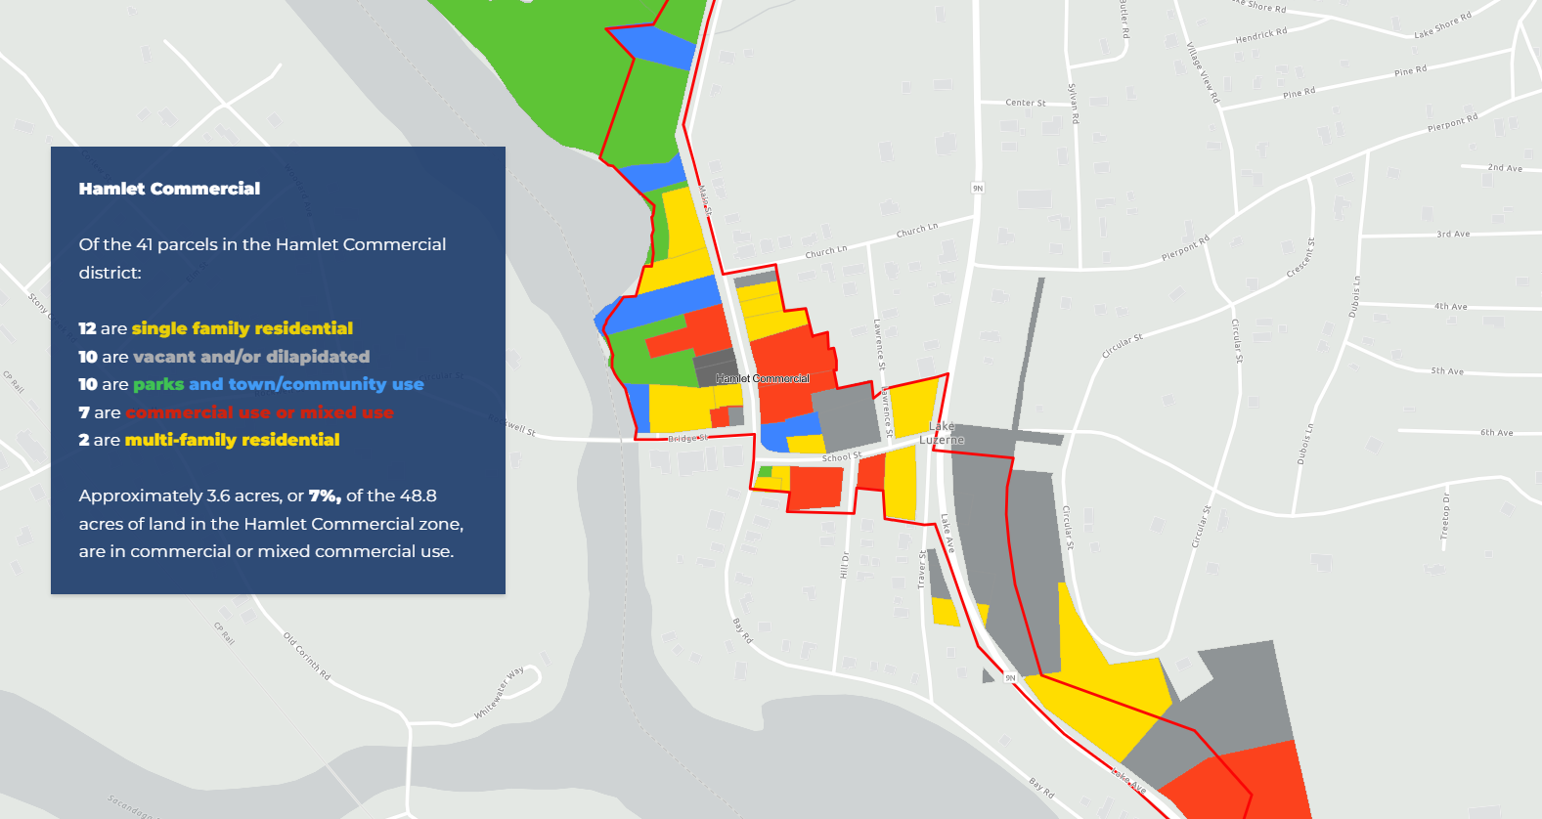

Slide 28
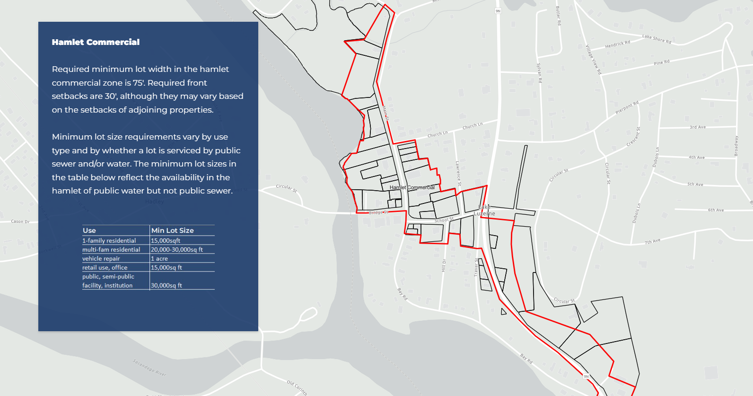

Slide 29
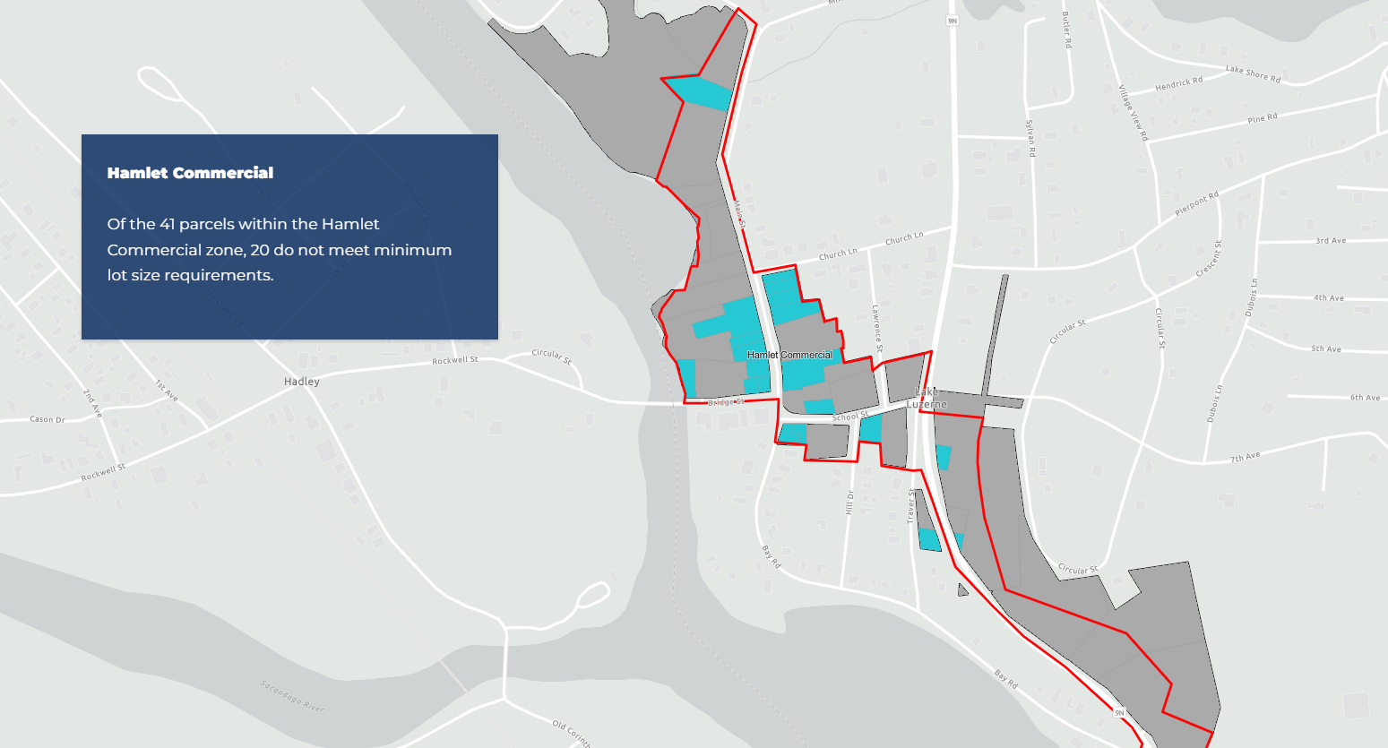

Slide 30
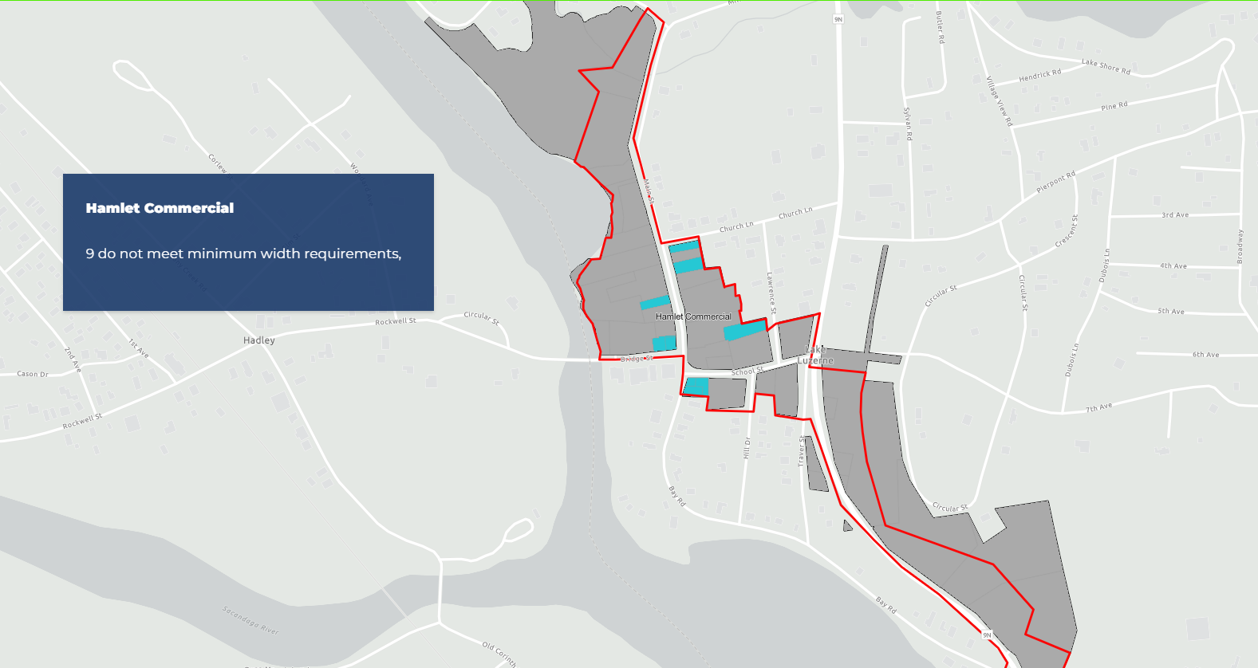

Slide 31
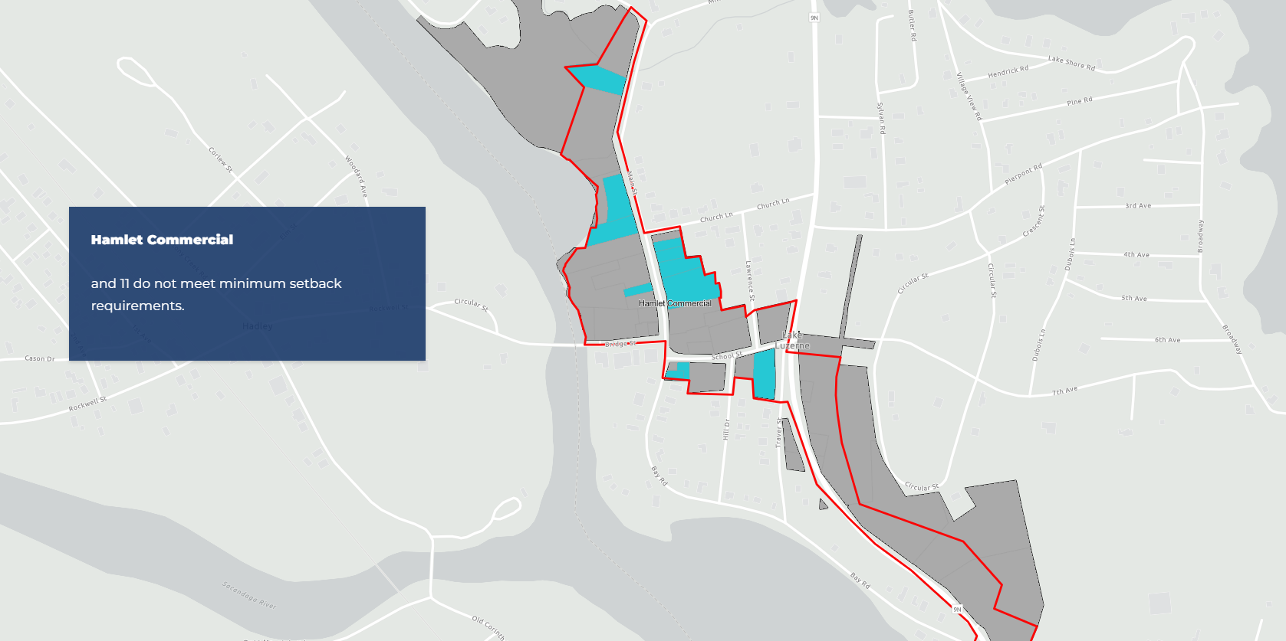

Slide 32
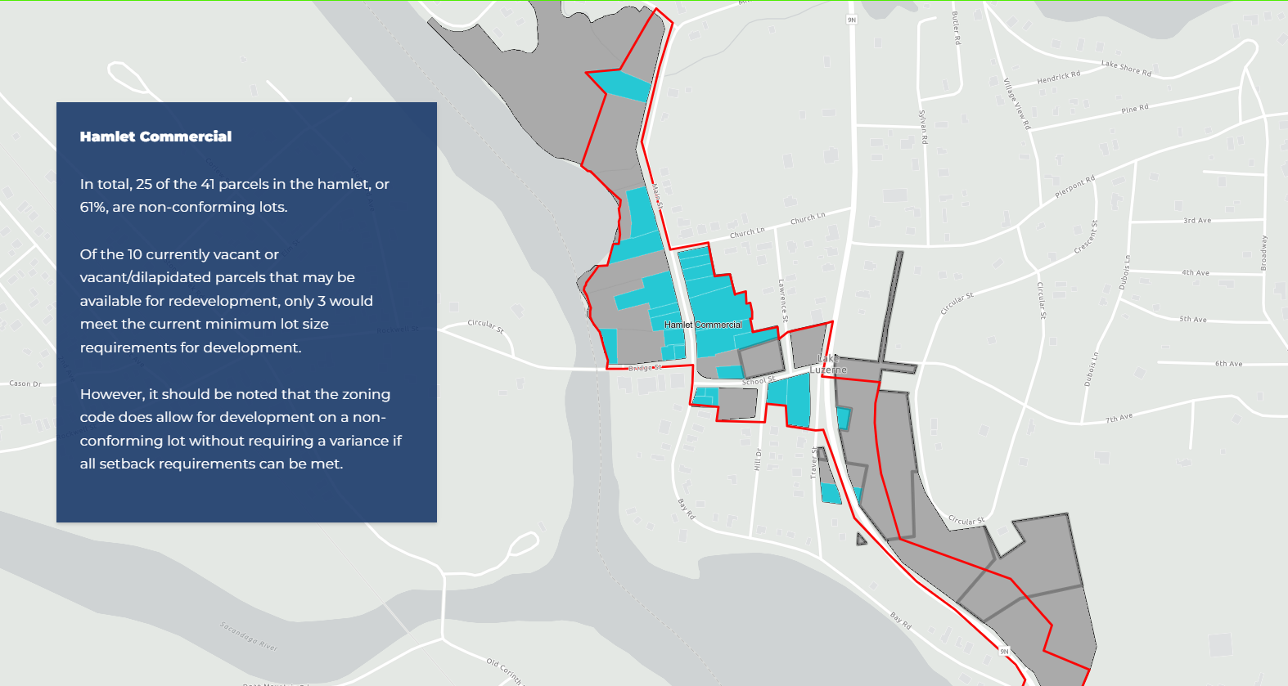

Slide 33
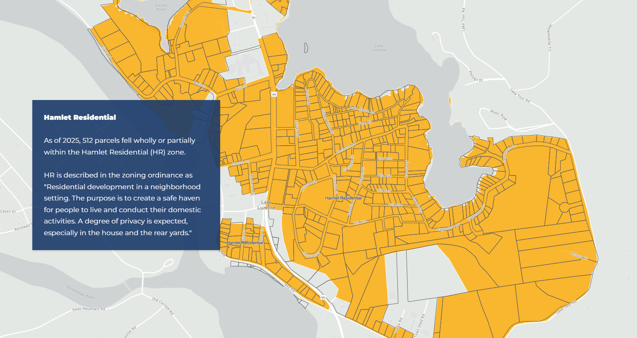

Slide 34
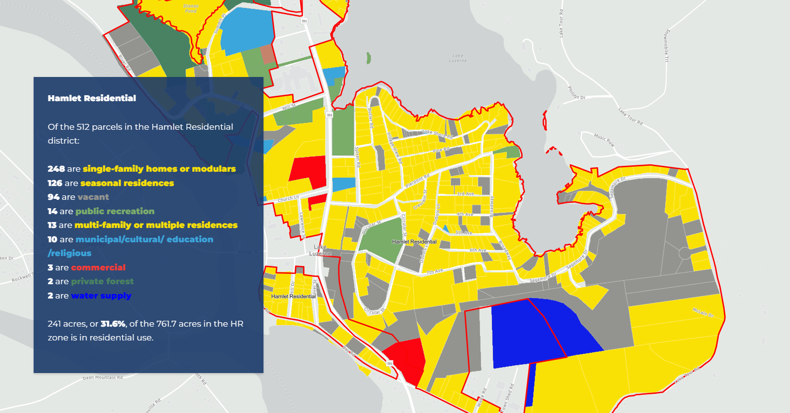

Slide 35
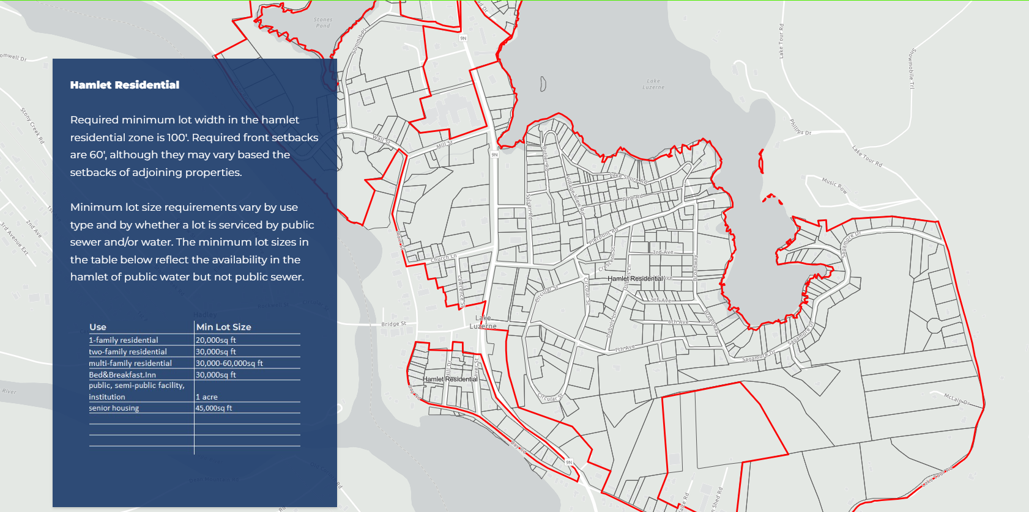

Slide 36
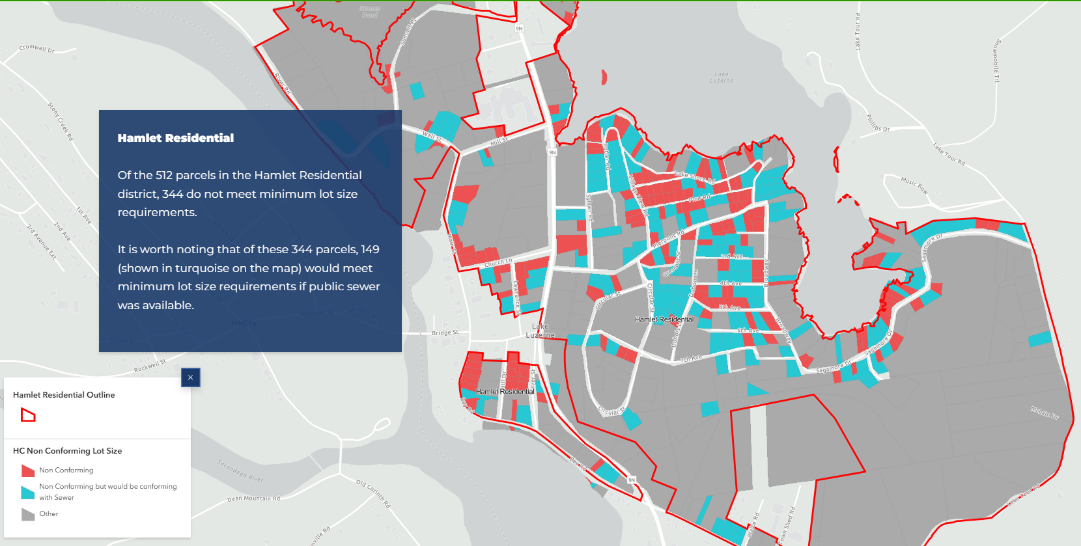

Slide 37
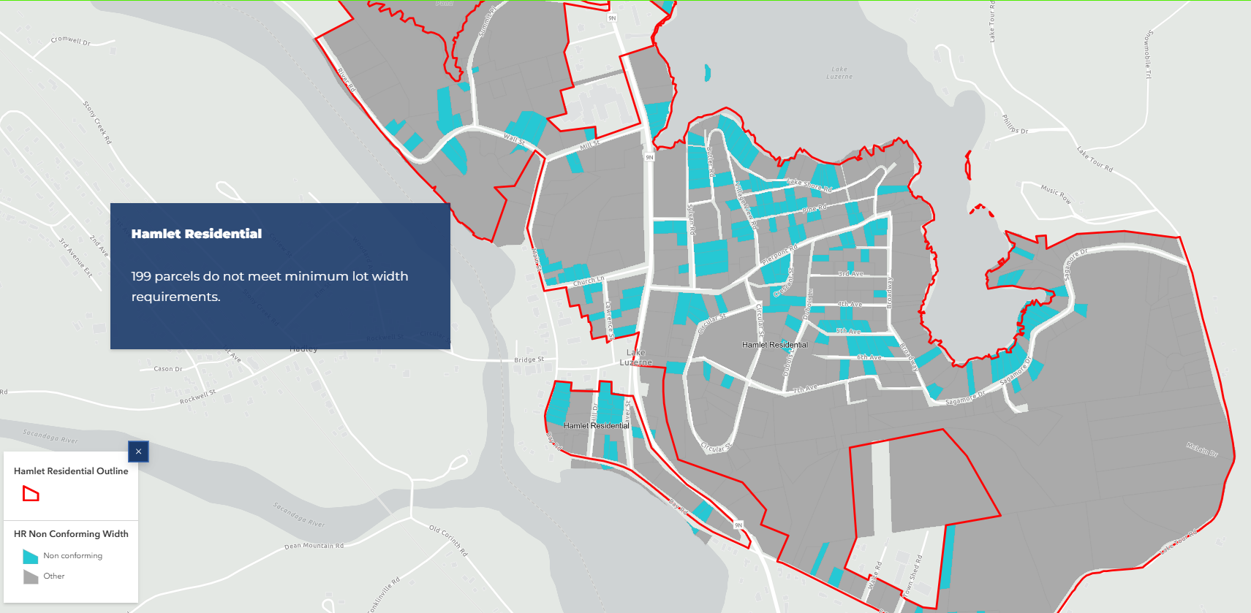

Slide 38
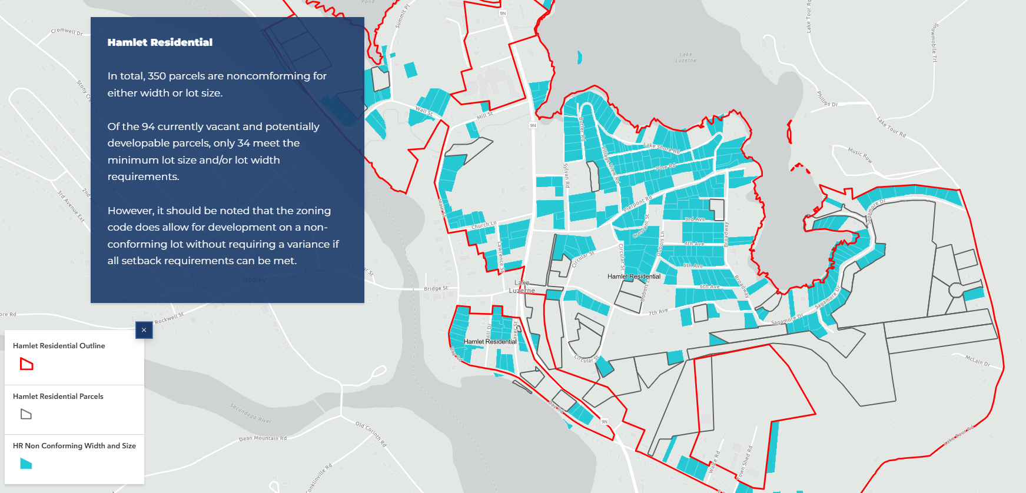

Slide 39
Existing Zoning Analysis Takeaways
There is a remarkable percentage of non-conforming lots – 68%
It would be illegal to build the hamlet to look like it did historically. Existing zoning regulations do not support the town’s goals as outlined in their comp plan.
Next question: can lot size minimums be lowered and still accommodate septic requirements?

Slide 40
Infrastructure Analysis
Hired engineer to complete a desktop analysis of existing conditions and propose minimum lot sizes required to accommodate septic for various use types
Engineer confirmed that generally existing lot size minimums cannot be reduced and still accommodate septic

Slide 41
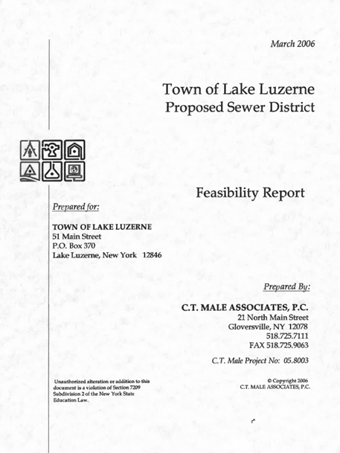
Infill Analysis:
Two Scenarios
Onsite Septic
New Sewer System
(potential connection to
Hadley?)
Multi-family (8BR)

Slide 42
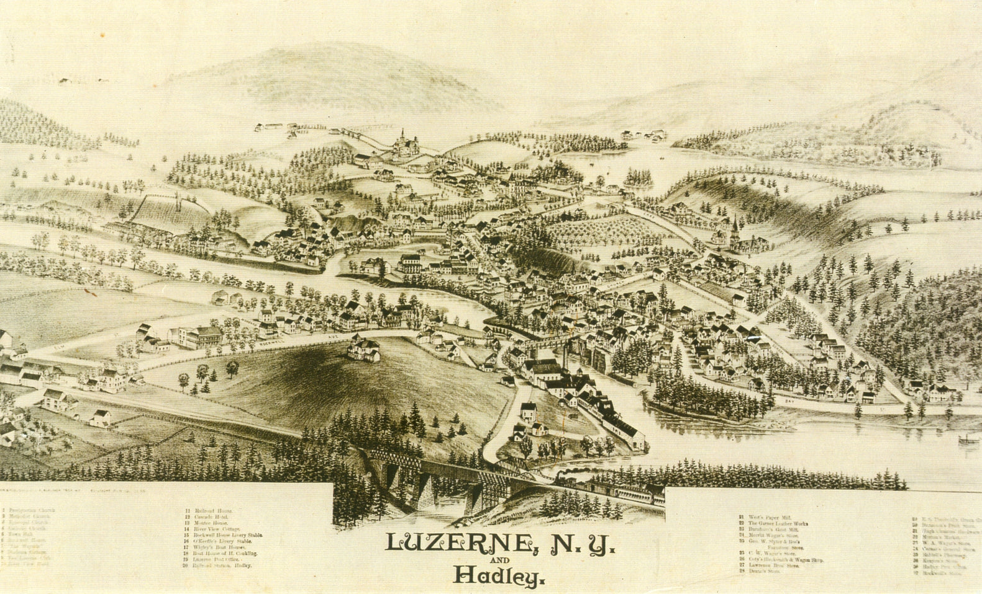
1888

Slide 43
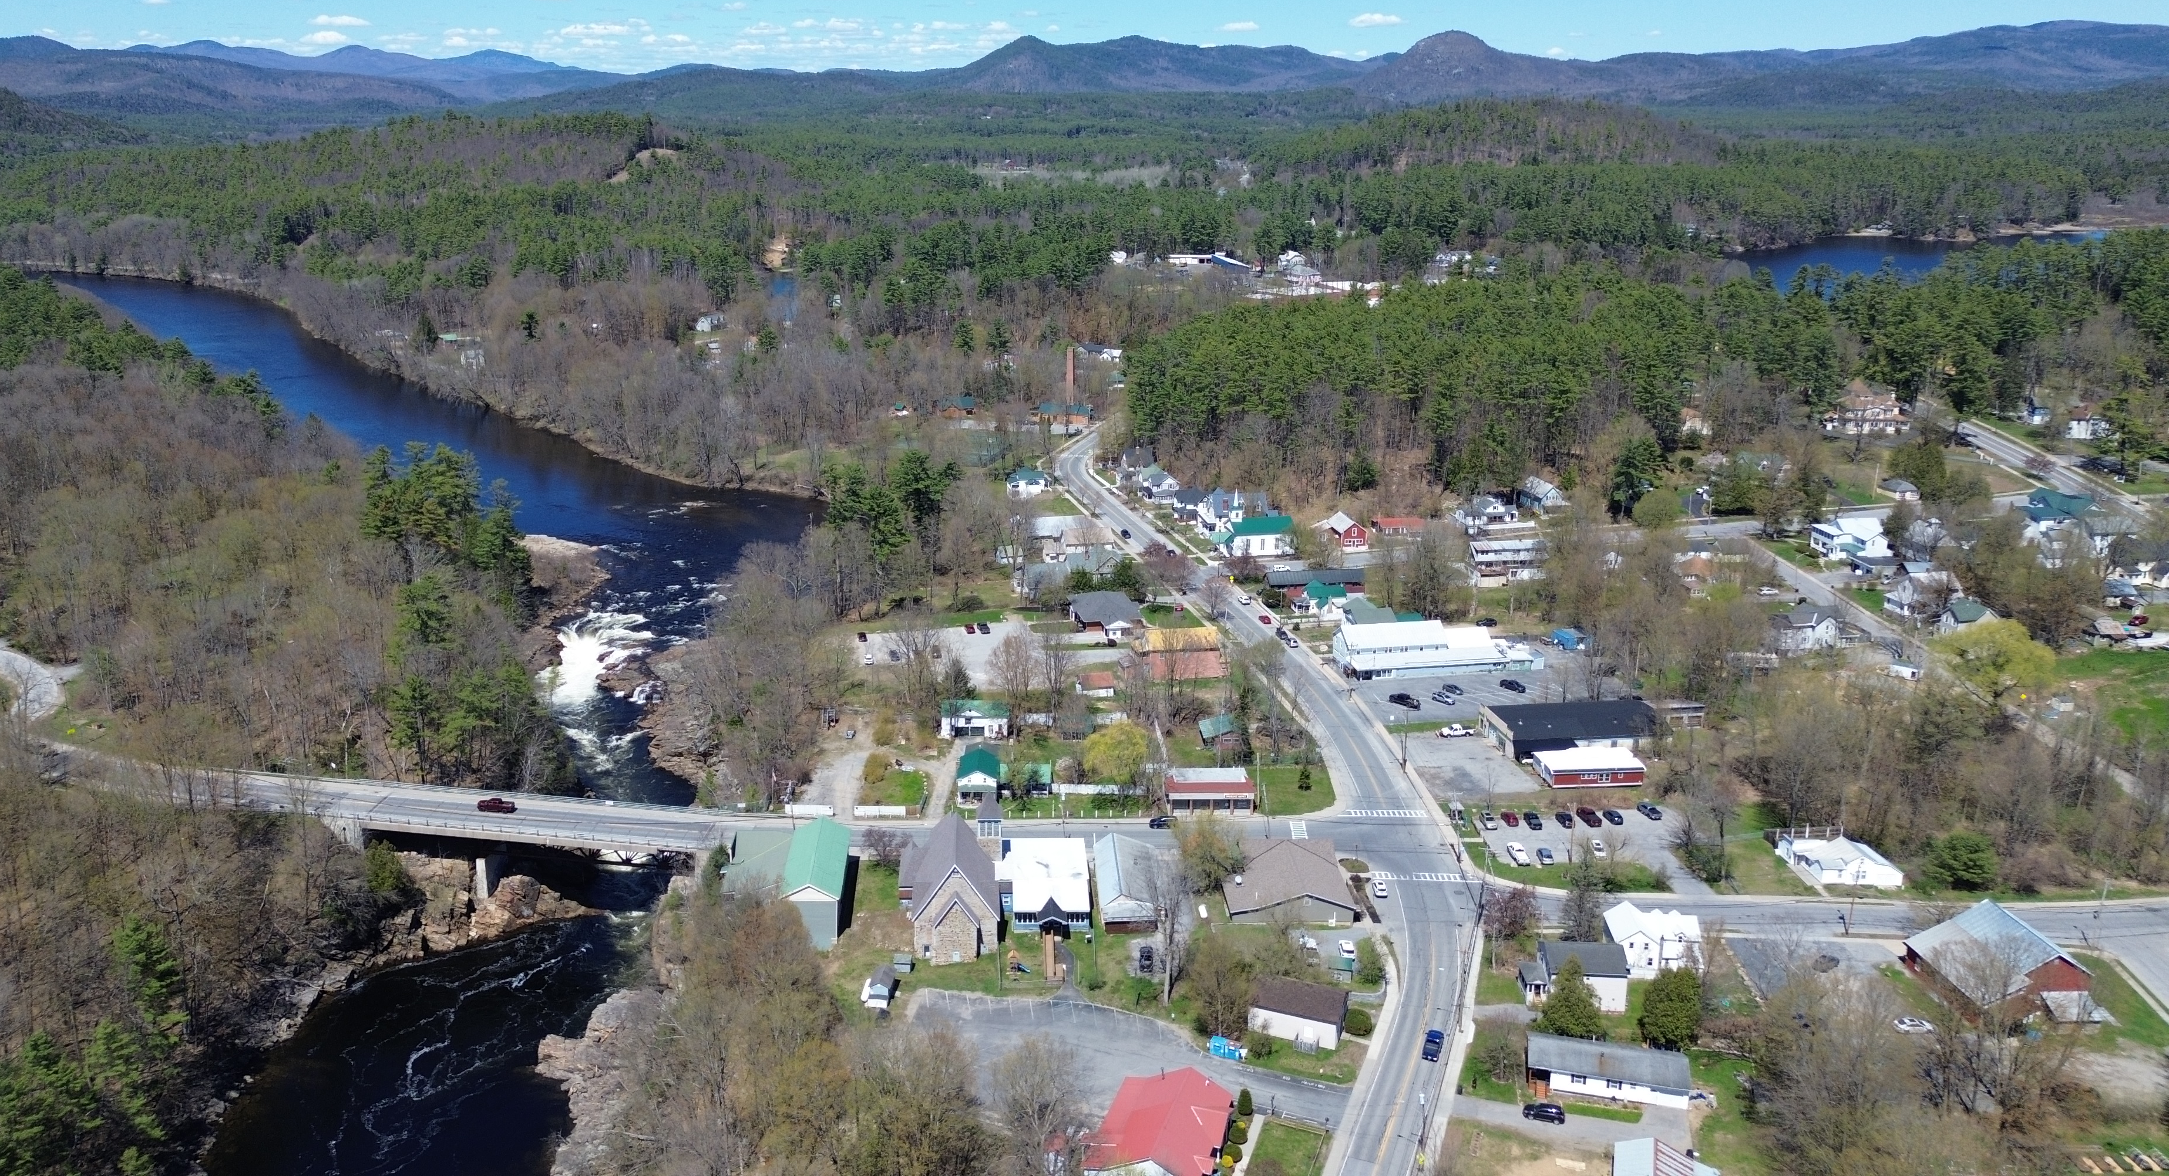
BRIDGE
MAIN

Slide 44
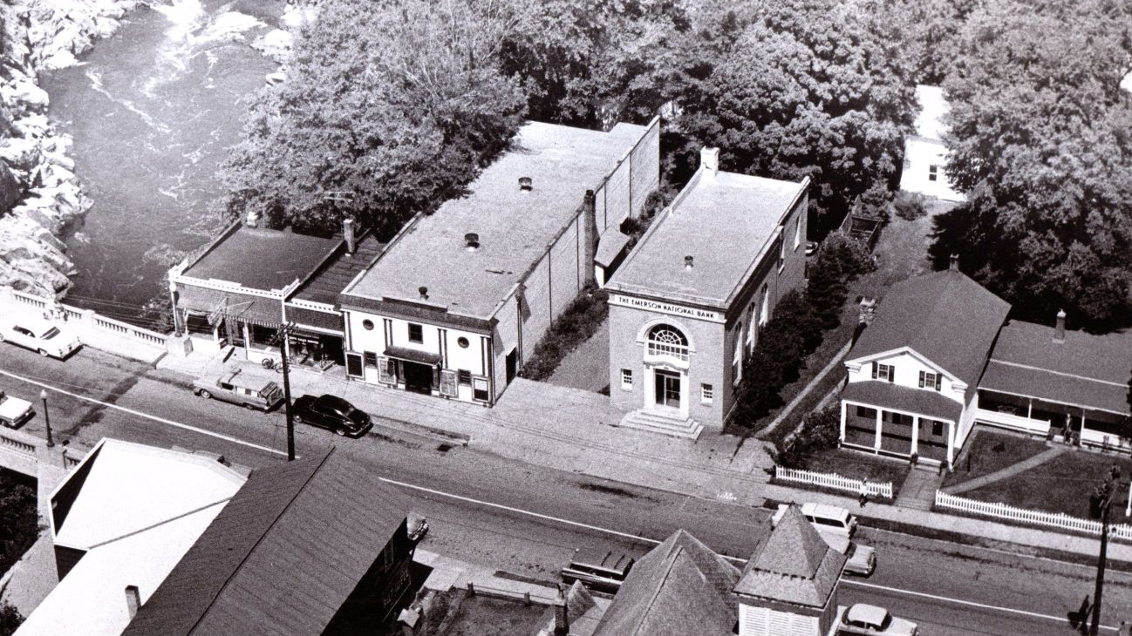

Slide 45
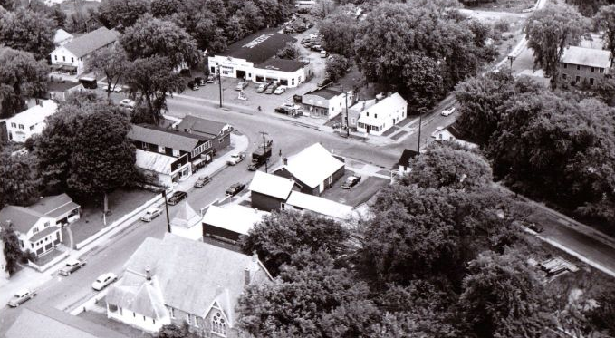
MAIN
BRIDGE

Slide 46
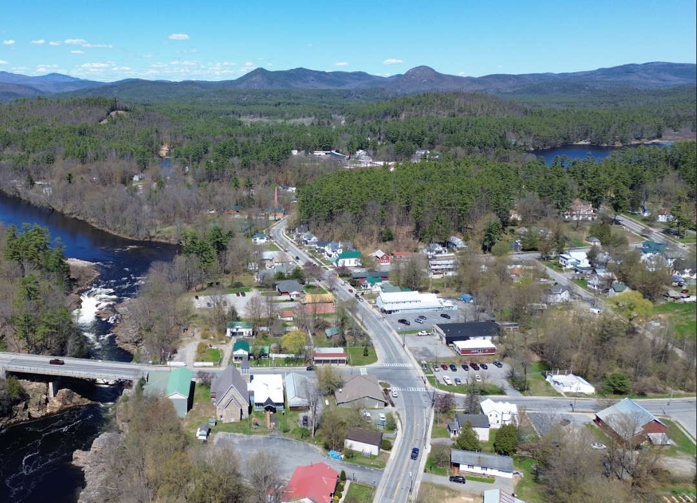
Infill Analysis
Site 1:
Bridge St/Main St
Comp Plan Goal 6:
“Identify alternatives for the development of dilapidated, underutilized, and vacant properties on Main St. and Bridge St.”
MAIN ST
BRIDGE ST
SCHOOL ST
BAY ST

Slide 47
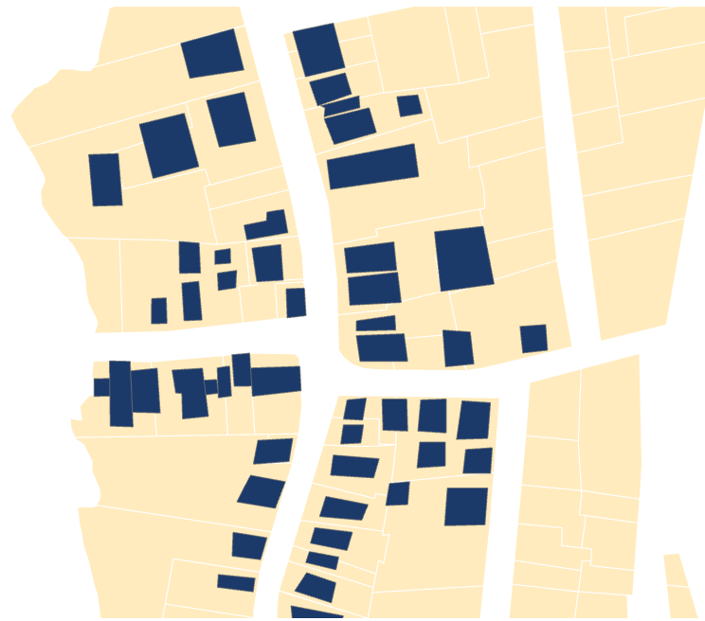
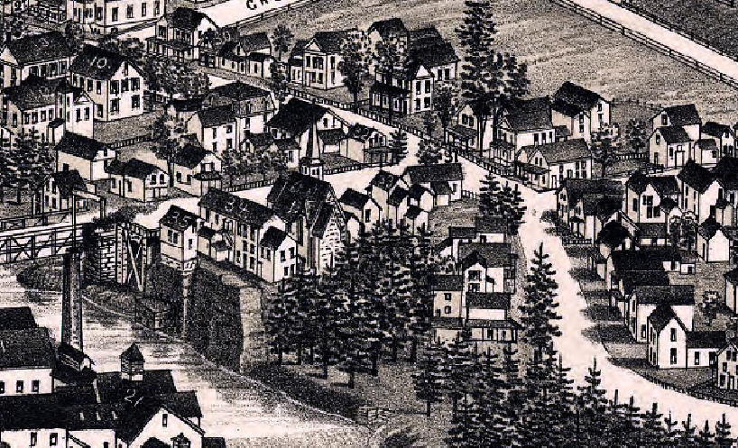
Infill Site 1:
Bridge St/Main St
MAIN ST
Main St
1881
BRIDGE ST
Bridge St
SCHOOL ST
School St
BAY ST

Slide 48
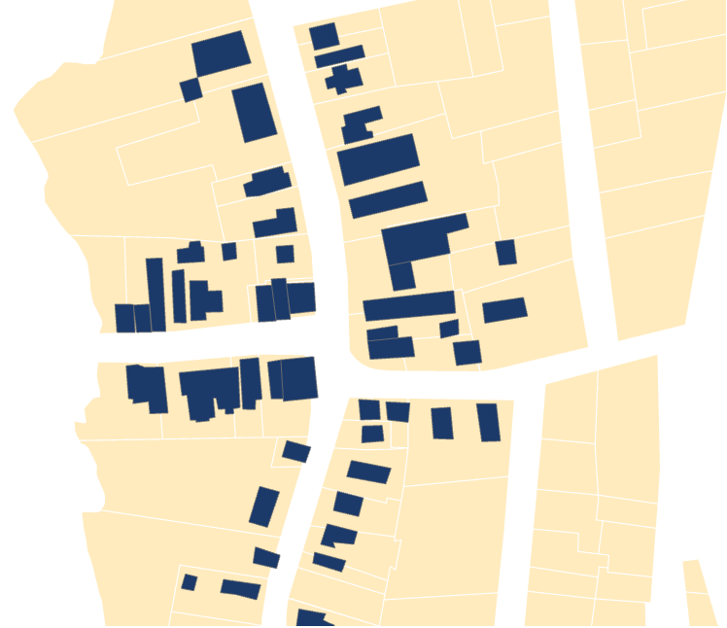
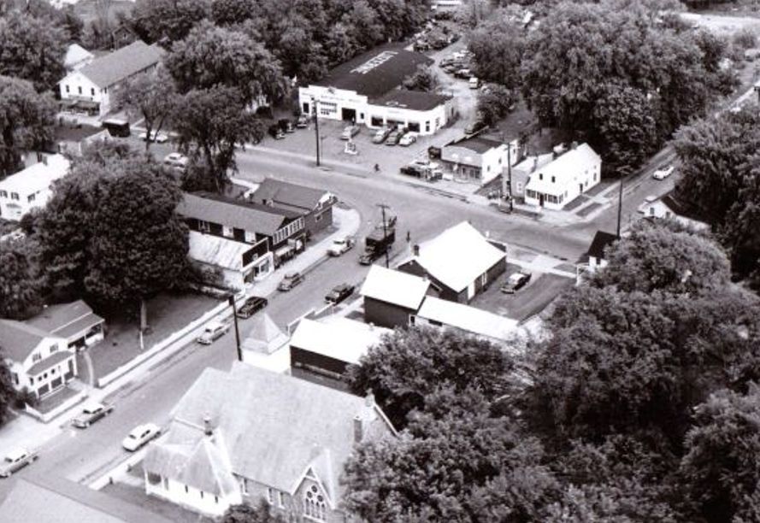
Infill Site 1:
Bridge St/Main St
MAIN ST
Main St
1950s
BRIDGE ST
Bridge St
SCHOOL ST
School St
BAY ST

Slide 49
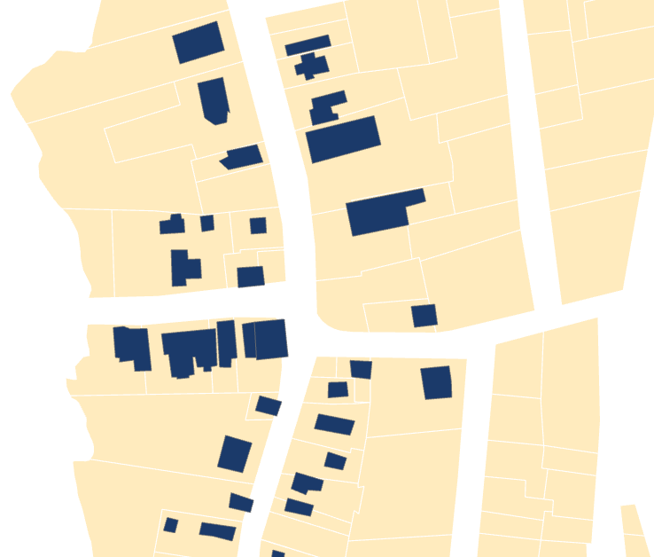
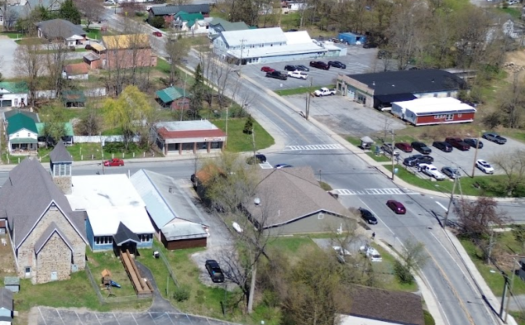
Infill Site 1:
Bridge St/Main St
MAIN ST
Main St
2026
BRIDGE ST
Bridge St
SCHOOL ST
School St
BAY ST

Slide 50
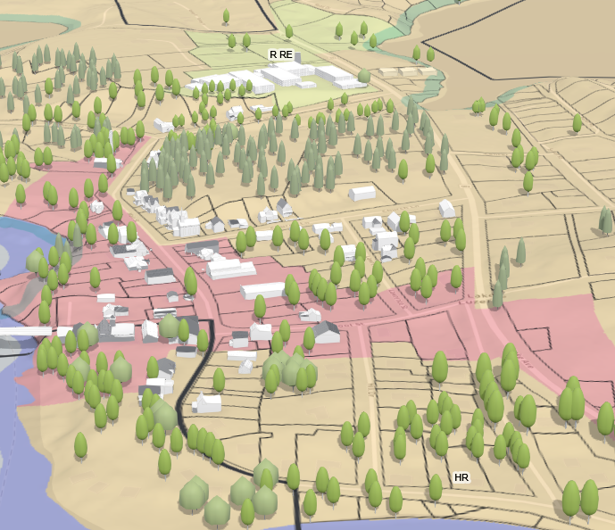
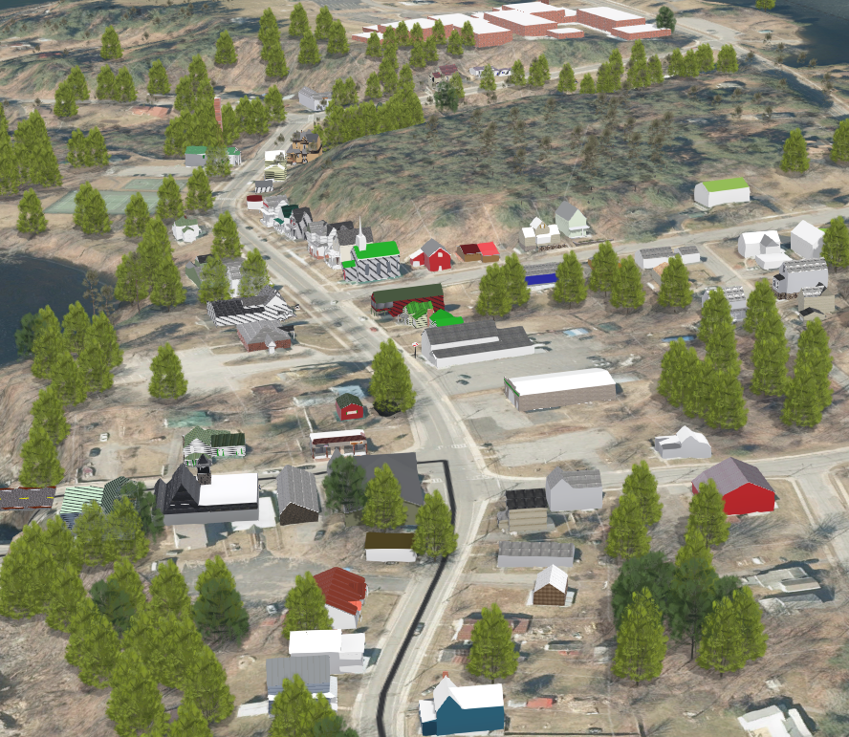
Infill Site 1:
Bridge St/Main St
Created a partial “digital twin” using ArcGIS Pro, ArcGIS Urban, SketchUp, and ESRI CityEngine

Slide 51
Infill Site 1:
Bridge St/Main St
Created a partial “digital twin” using ArcGIS Pro, ArcGIS Urban, SketchUp, and ESRI CityEngine

Slide 52
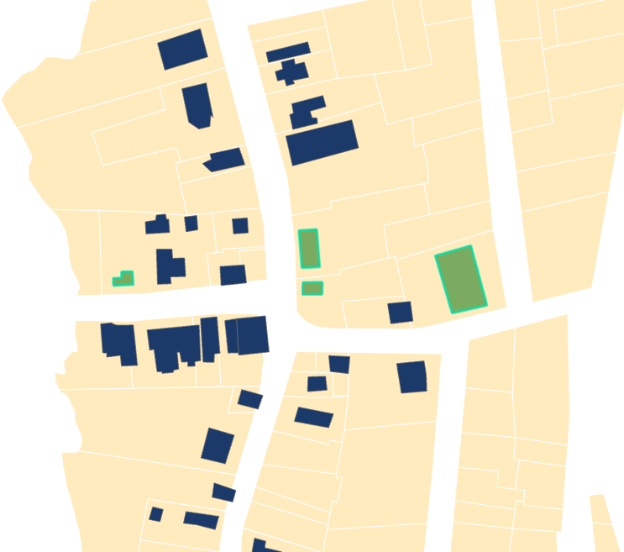
Infill Site 1:
Bridge St/Main St
MAIN ST
SCENARIO 1:
Modeled potential infill using existing lot size and coverage minimums to accommodate septic
BRIDGE ST
SCHOOL ST
BAY ST

Slide 53
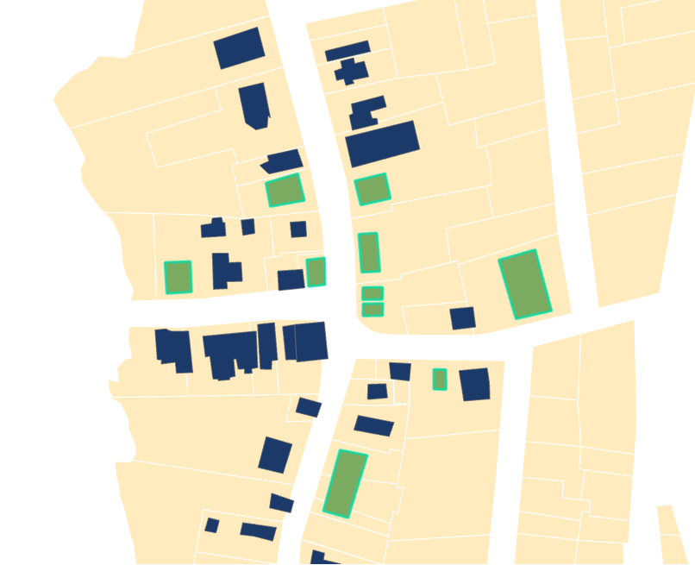
Infill Site 1:
Bridge St/Main St
MAIN ST
SCENARIO 2:
New sewer system enabling density more in keeping with historic development patterns
BRIDGE ST
SCHOOL ST
BAY ST

Slide 54
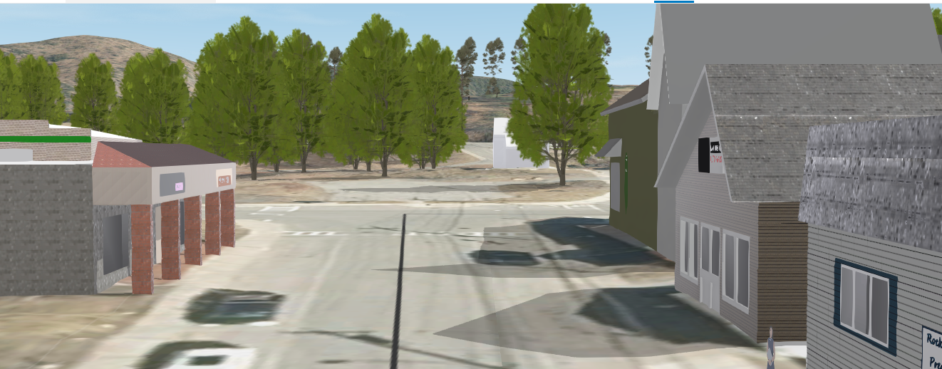

Slide 55
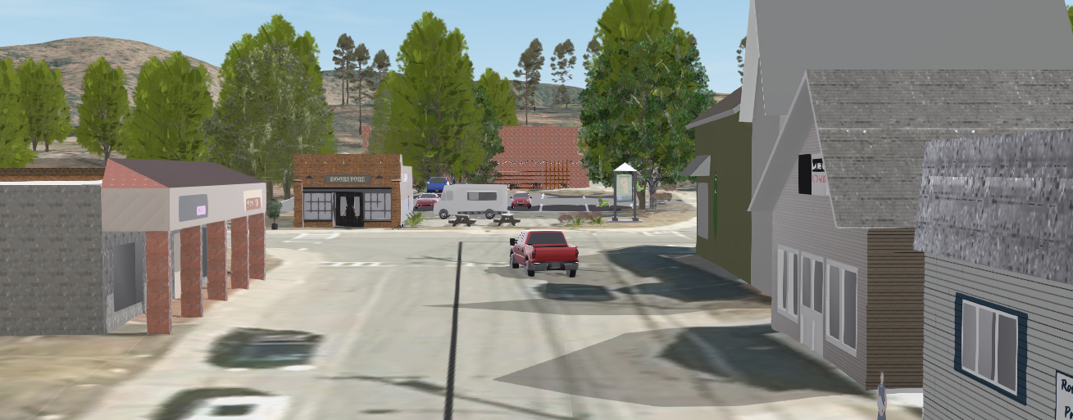

Slide 56
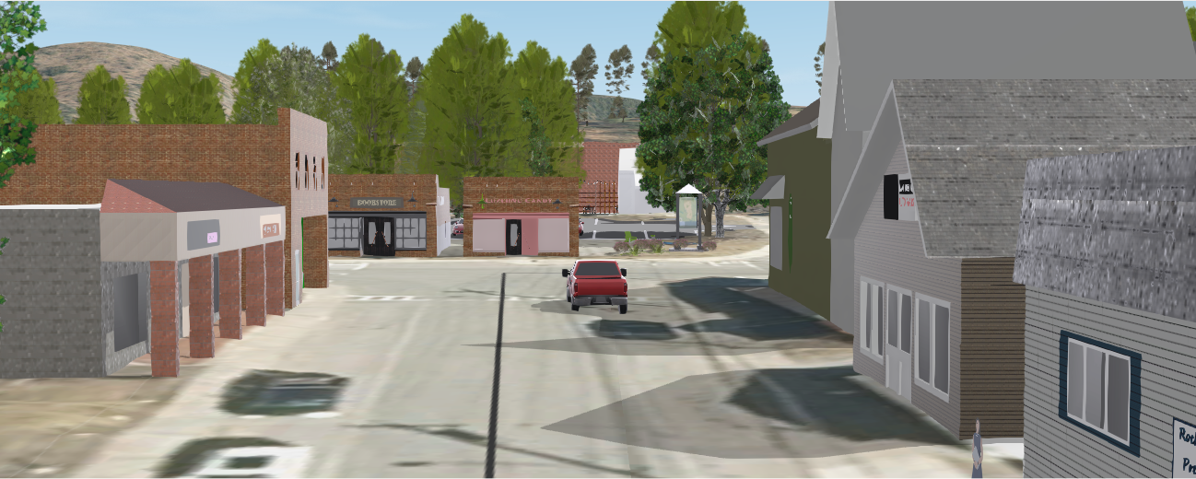

Slide 57
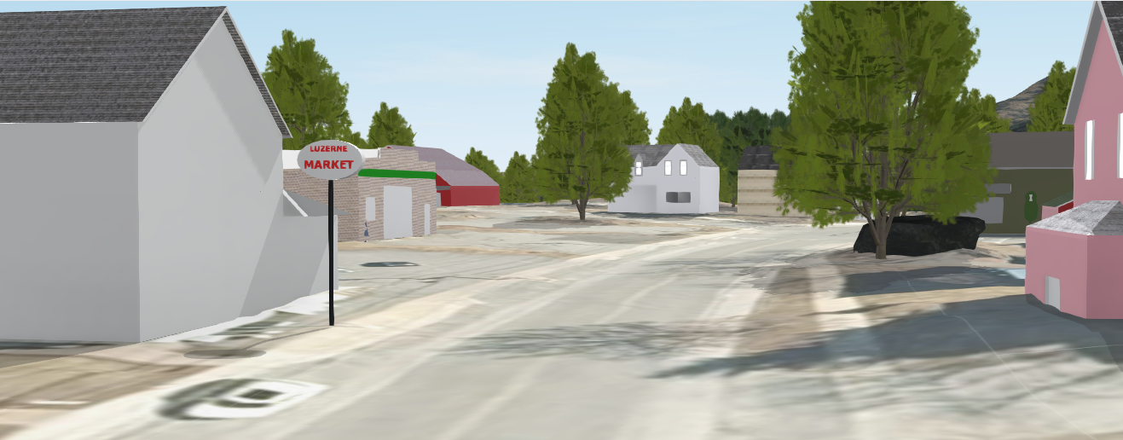

Slide 58


Slide 59


Slide 60


Slide 61


Slide 62


Slide 63


Slide 64


Slide 65


Slide 66


Slide 68


Slide 69


Slide 70


Infill Site 2:
Mill St
Lake Ave
Lake Ave
Comp Plan Goals:
“Encourage Young Families to Become Residents – Identify opportunities for the development of additional residential and mixed-use rental units”
“Encourage the development of attainable working-class family housing”
Main St
Church St

Slide 71

Infill Site 2:
Lake Ave
Lake Ave
Historic subdivision from 1930’s, never built
Right across the street from the school, the park and the beach
Walking distance to hamlet commercial
In line with comp plan goals for walkable, affordable starter homes for families and workers

Slide 72

Infill Site 2:
Lake Ave
Existing

Slide 73


Infill Site 2:
Lake Ave
With existing lot minimums (20,000sq ft for single family residential)

Slide 74


Infill Site 2:
Lake Ave
With lots as originally planned (assuming sewer)

Slide 75
North Creek: A Different Challenge
Lake Luzerne
Small lots
Septic constraints
Limited land
Challenge:
How to enable development?
North Creek
New sewer
Growth center
Clear policy direction
Challenge:
Is zoning ready to support this growth?
Different conditions → Different planning questions

Slide 76


Slide 77
Takeaways
We’ve had the vision, now we need implementation.
New tools make action more possible than ever before.
Zoning and infrastructure are the key local levers.
Better information leads to better conversations—and better decisions.

Slide 78
Thank You
Ethan Gaddy, AICP, County Planner
Sara Frankenfeld, GIS Administrator

