Slide 1
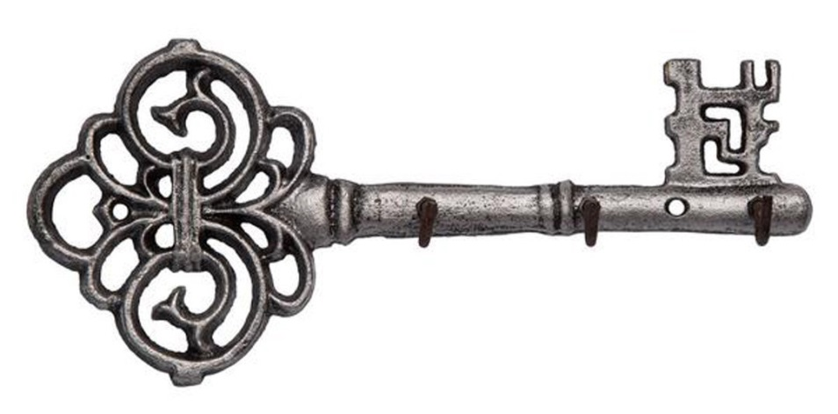
About the Tour
Length: 1.5 miles
Time to Complete: approximately 1 hour
The community of Glens Falls has a rich cultural and industrial past stemming in part from its location along the Hudson River and the Feeder Canal.
Savvy business entrepreneurs spawned local industries – sawmills, paper mills, lime and marble quarries and many textile mills to name a few – during the last half of the 19th century and into the beginning of the 20th. The area was proudly claimed home by many multi-millionaires and, as a result, has a profusion of wonderful old homes and business locales.
All historical/architectural information was compiled and provided by Bob Bayle, Gwen Palmer and Kim Harvish of the Chapman Museum, and Bob Joy, JMZ Architects and Planners, P.C., Glens Falls. The digital version of the tour was compiled by Warren County GIS.
To learn more about the history of Glens Falls, visit www.champanmuseum.org

Slide 2
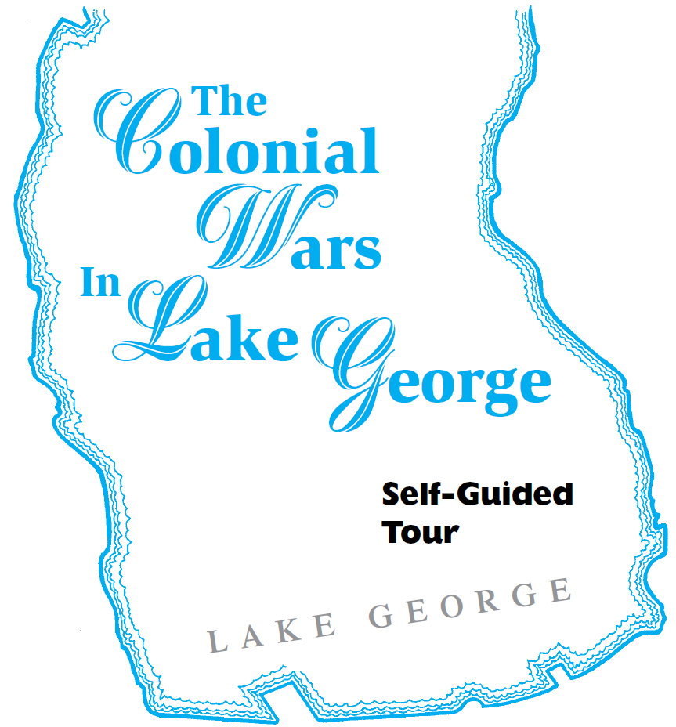
About the Tour
Length: 3.3 miles
Time to Complete: approximately 2 hours
Lake George played a pivotal role during the early history of this country and has many historic sites, monuments, and markers which tell this history. Home to Native Americans for 10,000 years, the lake became a bloody arena during the clashes between the
French and English empires, was the scene of
Military action as American patriots wrested the 13 colonies from the British, and later was a commercial “highway” where various watercraft plied its pristine waters. Experience this history through the Colonial Wars in Lake George Self-Guided tour.
All historical/architectural information was compiled and provided by Dr. Russell P. Bellico, Bob Benway, Tim Cordell, John Farrell, Scott Padeni and Joseph W. Zarynski. The digital version of the tour was compiled by Warren County GIS. Used with permission from the Lake George Battlefield Park (Fort George) Alliance and Bateaux Below, Inc.

Slide 3
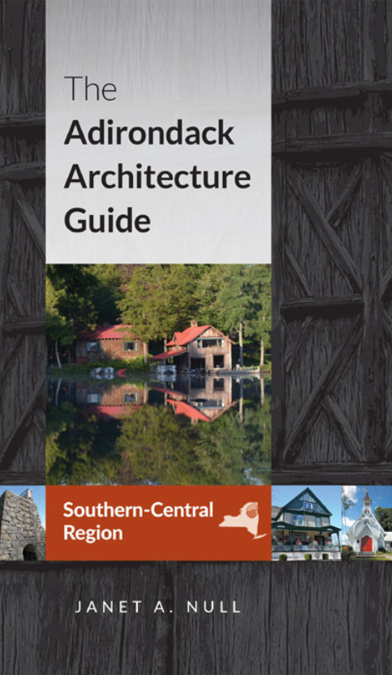
About the Tour
Length: 3.2 miles
Time to Complete: 1-2 hours
The settlement of “Chester Four Corners” began in the early 1800s as a way station on the stage route from Albany to Montreal, which is now US Route 9/Main Street. It was named Chestertown with the opening of the first post office in 1809. Lumbering and farming were the earliest occupations in the area, and by mid- 1800s, Chestertown was the center for the tanning industry in the area. Chestertown’s Faxon Tannery (1849-98) was the longest run- ning tannery in the Adirondacks. From its mid-1800s economic boom, Chestertown still retains one of its historic hotels as well as an impressive heritage of Greek Revival buildings for the interior of the Adirondacks, even considering that a number are altered. Adding tourism to the economy, the town prospered in the late 1800s and early 1900s with buildings on Main Street approaching the scale of an urban center. Notable buildings of that era, in Romantic and Neoclassical architectural styles, mix comfortably with the earlier buildings to form an architecturally diverse, yet physically cohesive, community, of which the “four corners” is still the focus.
Historic and architectural information courtesy of The Adirondack Architecture Guide, South-Central Region, by Janet A. Null. Copyright 2017 Janet A. Null. Used by permission of State University of New York Press. All Rights Reserved. http://www.sunypress.edu/p-6490-the-adirondack-architecture-gui.aspx
For more information and downloads from The Adirondack Architecture Guide, also visit www.adirondackarchitectureguide.com

Slide 4
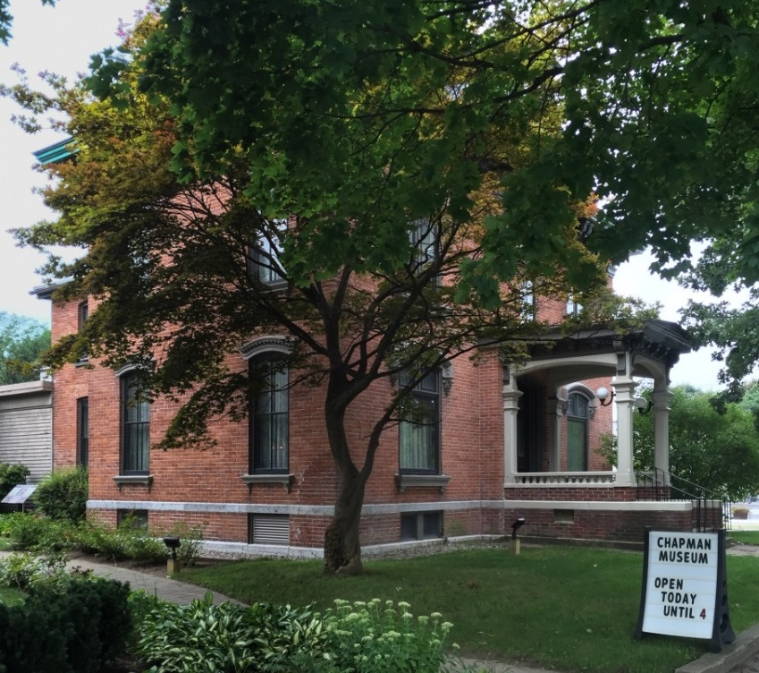
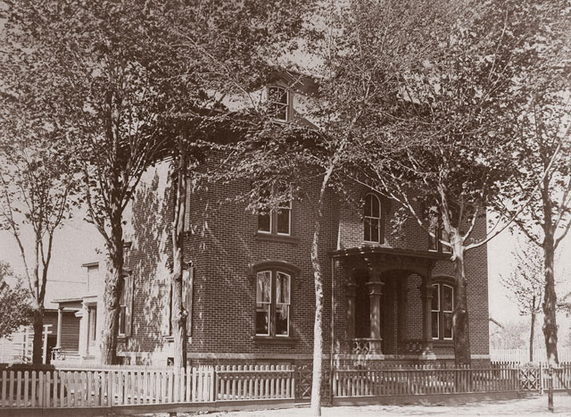
348 Glen Street
Tours of the Chapman Museum’s historic DeLong House introduce
Photo credit: Chapman Museum
visitors to domestic life in the late 19th century. First built as a small wood frame house, the building was purchased in the 1860’s by hardware merchant Zopher DeLong and expanded and remodeled in 1867 in Second Empire style.
The museum also features changing exhibits about local history and 19th century photographer, Seneca Ray Stoddard. Reproductions of his photos can be purchased in the gift shop, along with regional books and prints.

Slide 5
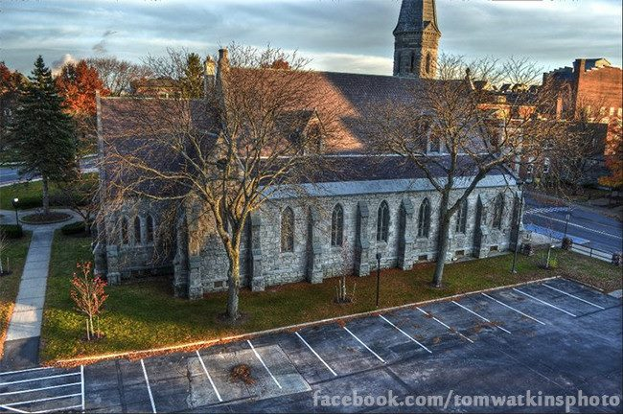
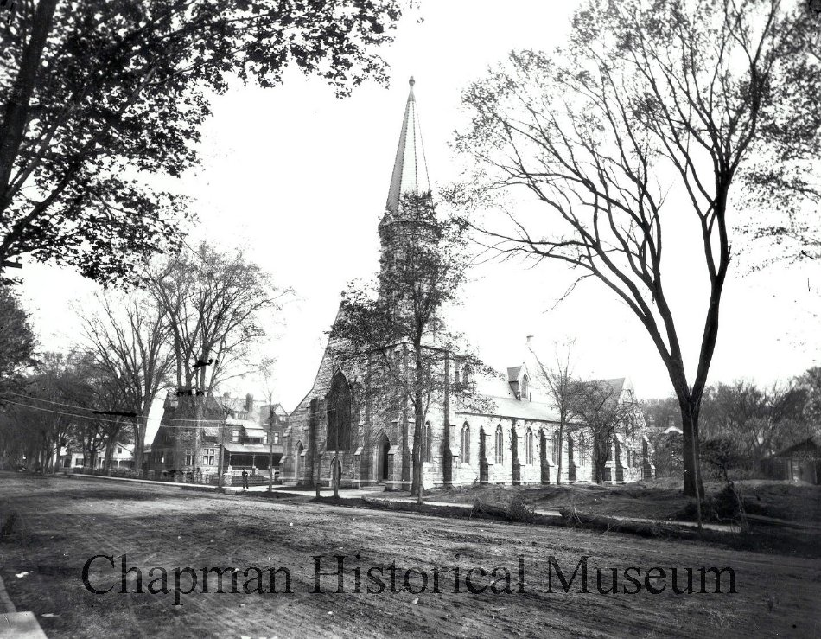
Photo credit: Seneca Ray Stoddard, 1889.
Used by permission from Chapman Historical Musem
296 Glen Street
Photo credit: Tom Watkins
The Victorian Gothic Revival Church of the Messiah was designed by John W. Summers and built during 1854-1865. Note some of the stained glass windows by Louis C. Tiffany. The Gothic Revival style is distinguished by its arched windows that seem to “point to heaven”.

Slide 6
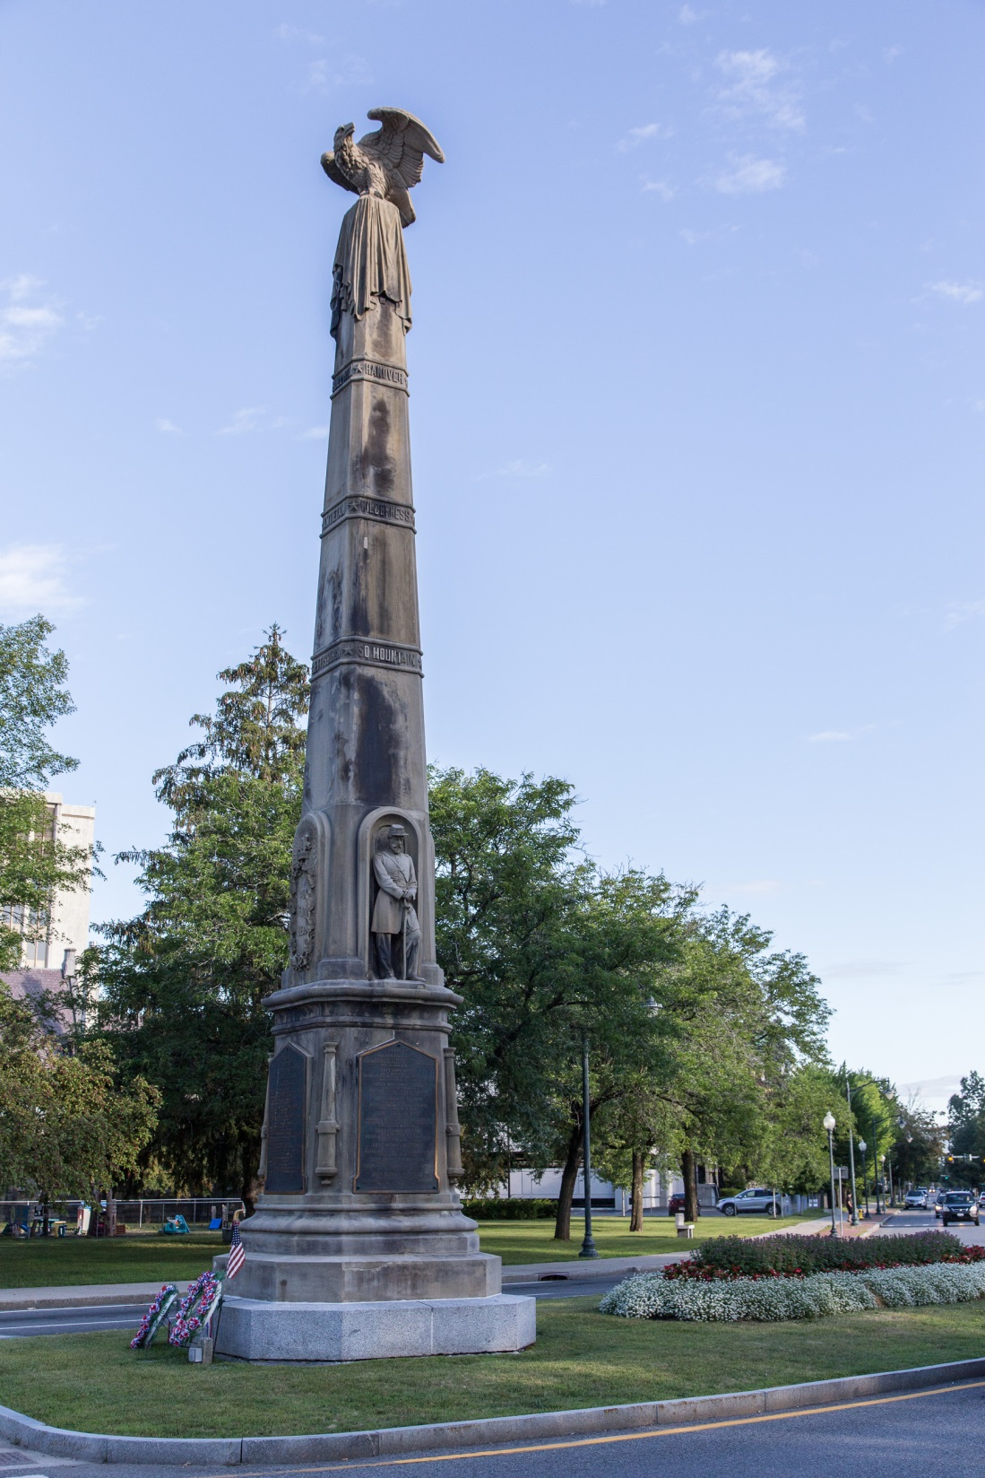
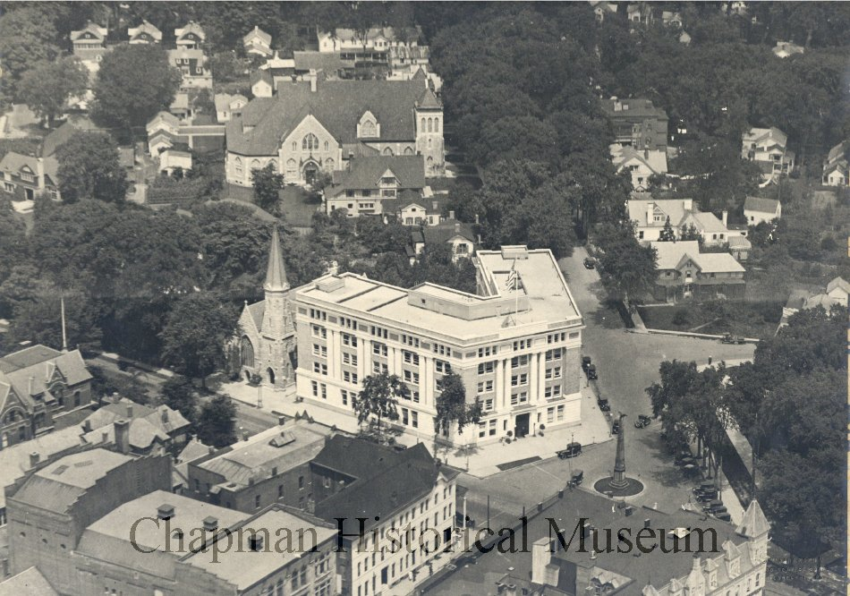
Photo credit: Tom Watkins
Photo: Seneca Ray Stoddard, 1910. Used by permission from the Chapman Historical Museum
Bay Street/Glen Street
The Civil War Monument was built by R.T. Baxter, completed and dedicated in 1872. It is made of Vermont sandstone and weighs 120 tons.
Photo credit: Kenneth C. Zirkel, Wikimedia Commons

Slide 7
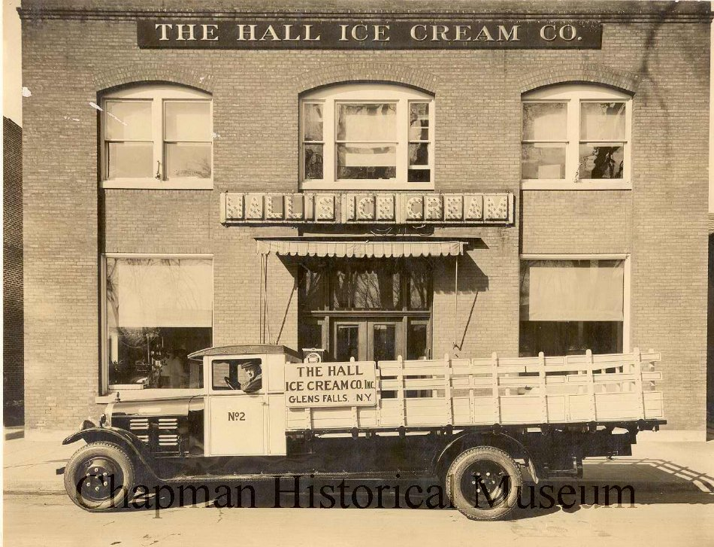
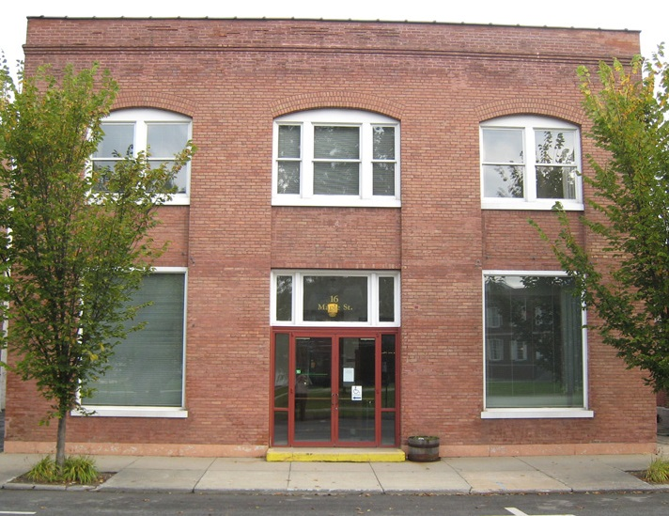
16 Maple Street
Photo credit: H.W. Pangburn, 1925. Used by permission from the Chapman Historical Museum
Originally built for the phone company, this building became the factory for Hall’s Ice Cream and later Borden’s. The motto on the sign: “Eat a Plate of Ice Cream Every Day.”

Slide 8
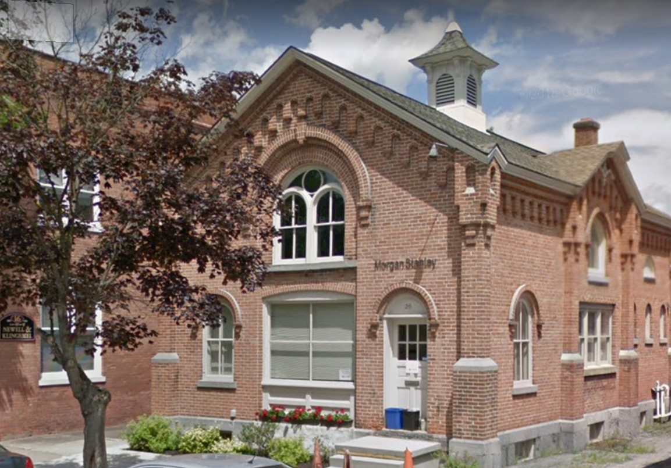
20 Maple Street
Photo source: Google Maps
Crandall Carriage House. This Italianate Revival style structure was built for Henry Crandall in 1870. Crandall’s home was located on the Glen Street side of City Park.

Slide 9
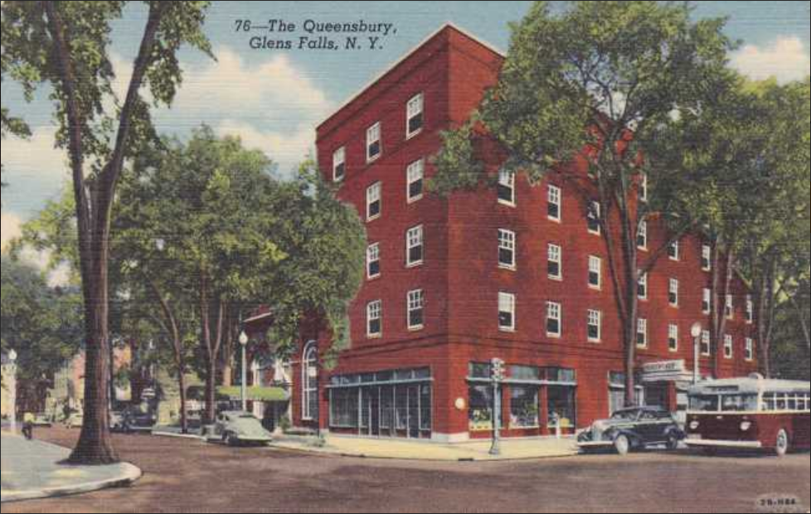
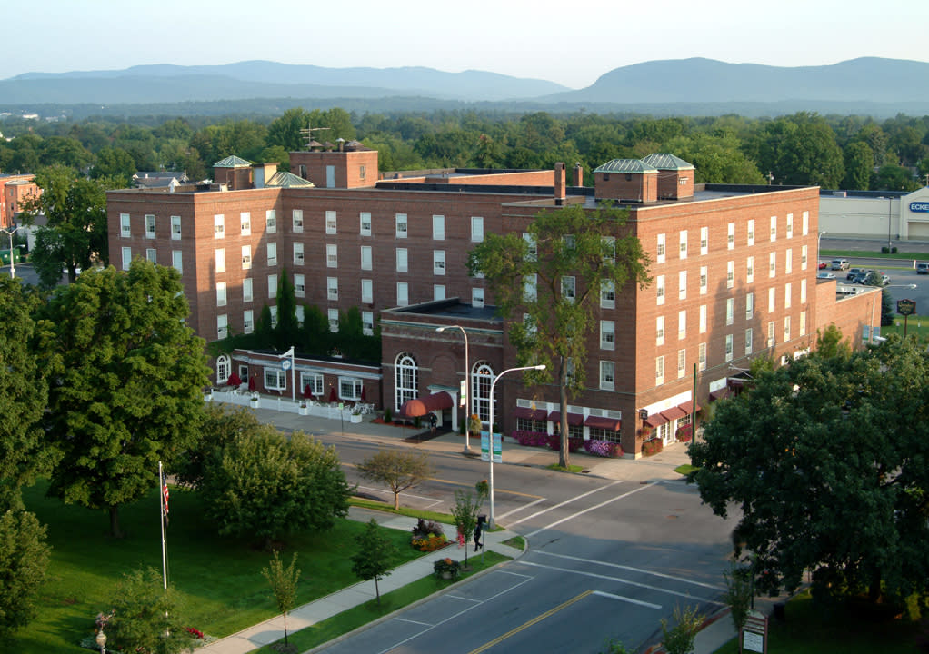
Photo credit: Queensbury Hotel
88 Ridge Street
1942 postcard
The Queensbury Hotel was built in the 1920s by a group of businessmen who ran it for over thirty years. Before the Civic Center was built in the 1970s, there were concerts in the ballroom by performers such as Benny Goodman and Guy Lumbardo. Famous patrons of the hotel include Bob Dylan, Louis Armstrong, Joe Frasier, Jackie Robinson and Robert Kennedy.

Slide 10
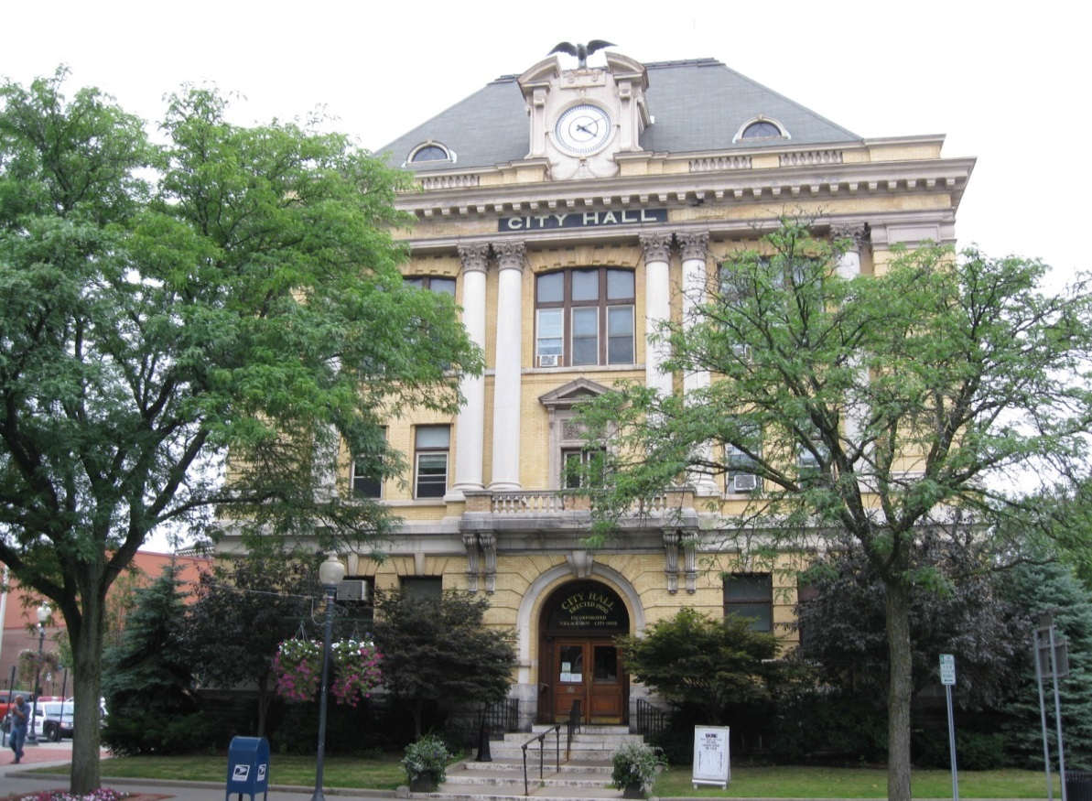
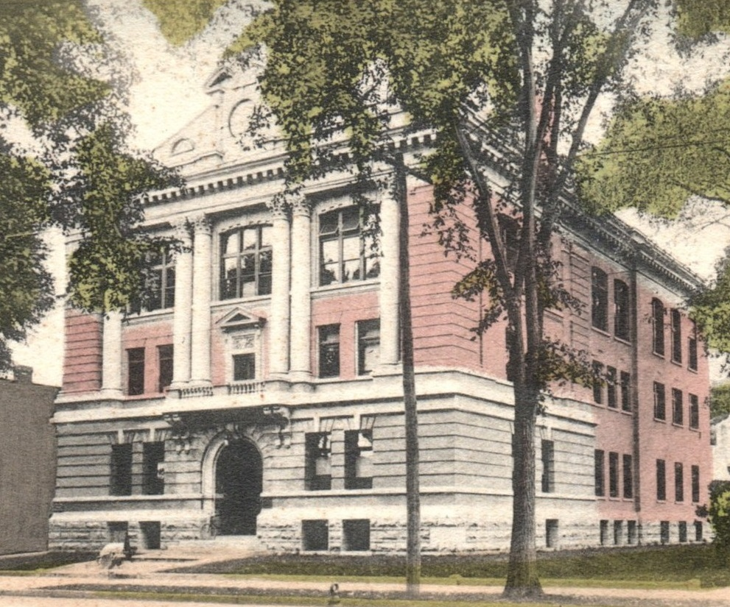
Photo credit: Doug Kerr, Wikimedia Commons
1905 postcard
42 Ridge Street
Built in 1900 as the Village Hall. Renamed when Glens Falls became a separate city from Queensbury on Friday, March 13, 1908.

Slide 11
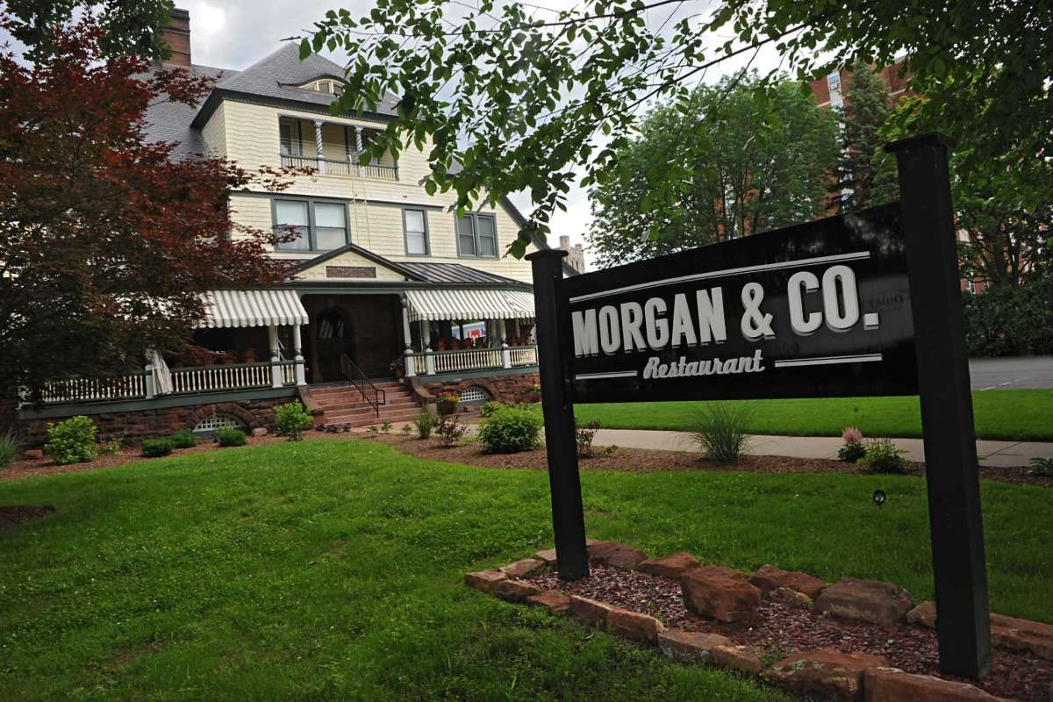
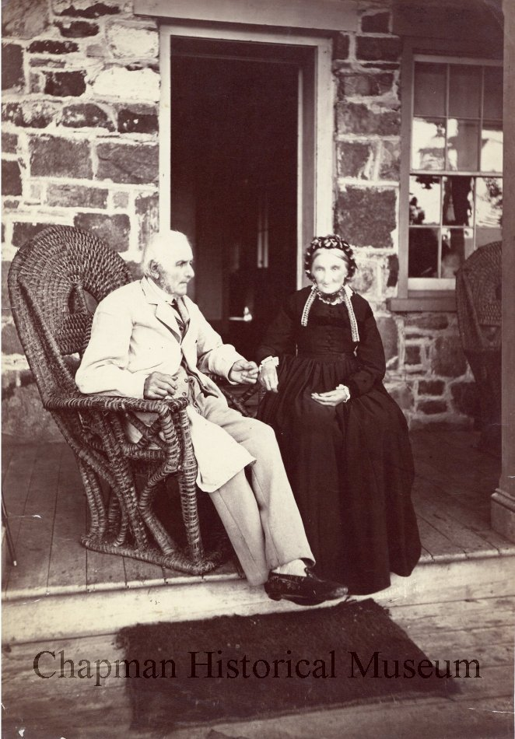
Photo credit: Lori Van Buren, Times Union
Mr and Mrs. McEchron. Photo: Seneca Ray Stoddard,
used with permission from the Chapman Historical Museum
65 Ridge Street
Built in 1891 for local lumber baron William McEchron, the McEchron House was used as a health center for much of the 20th century. Newly renovated, it is now home to Morgan & Co restaurant and apartments.

Slide 12
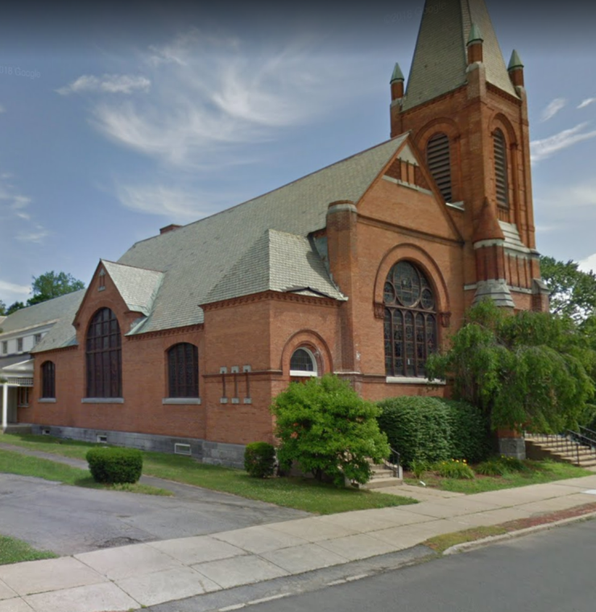
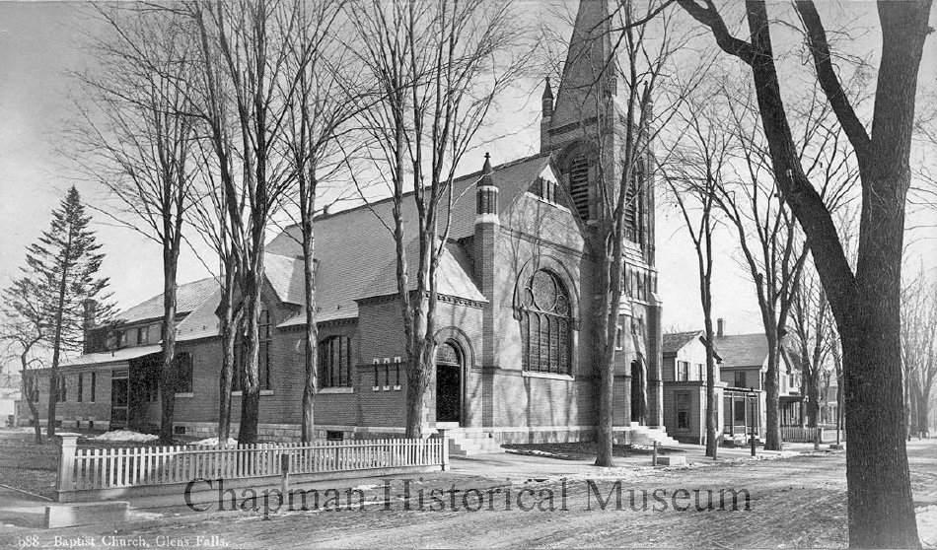
100 Maple Street
Photo: Seneca Ray Stoddard, c. 1885. Used with permission from the Chapman Historical Museum
The first Baptist Church in this location was built in 1834; it was rebuilt in 1884 and an addition was made in 1925. It was the Suffragette meeting place. Susan B. Anthony spoke here in 1894 to such a large crowd it led to Glens Falls being the site of the 1900 NYS Convention of the National American Woman’s Suffrage Association, with Carrie Chapman Catt as the keynote speaker.

Slide 13
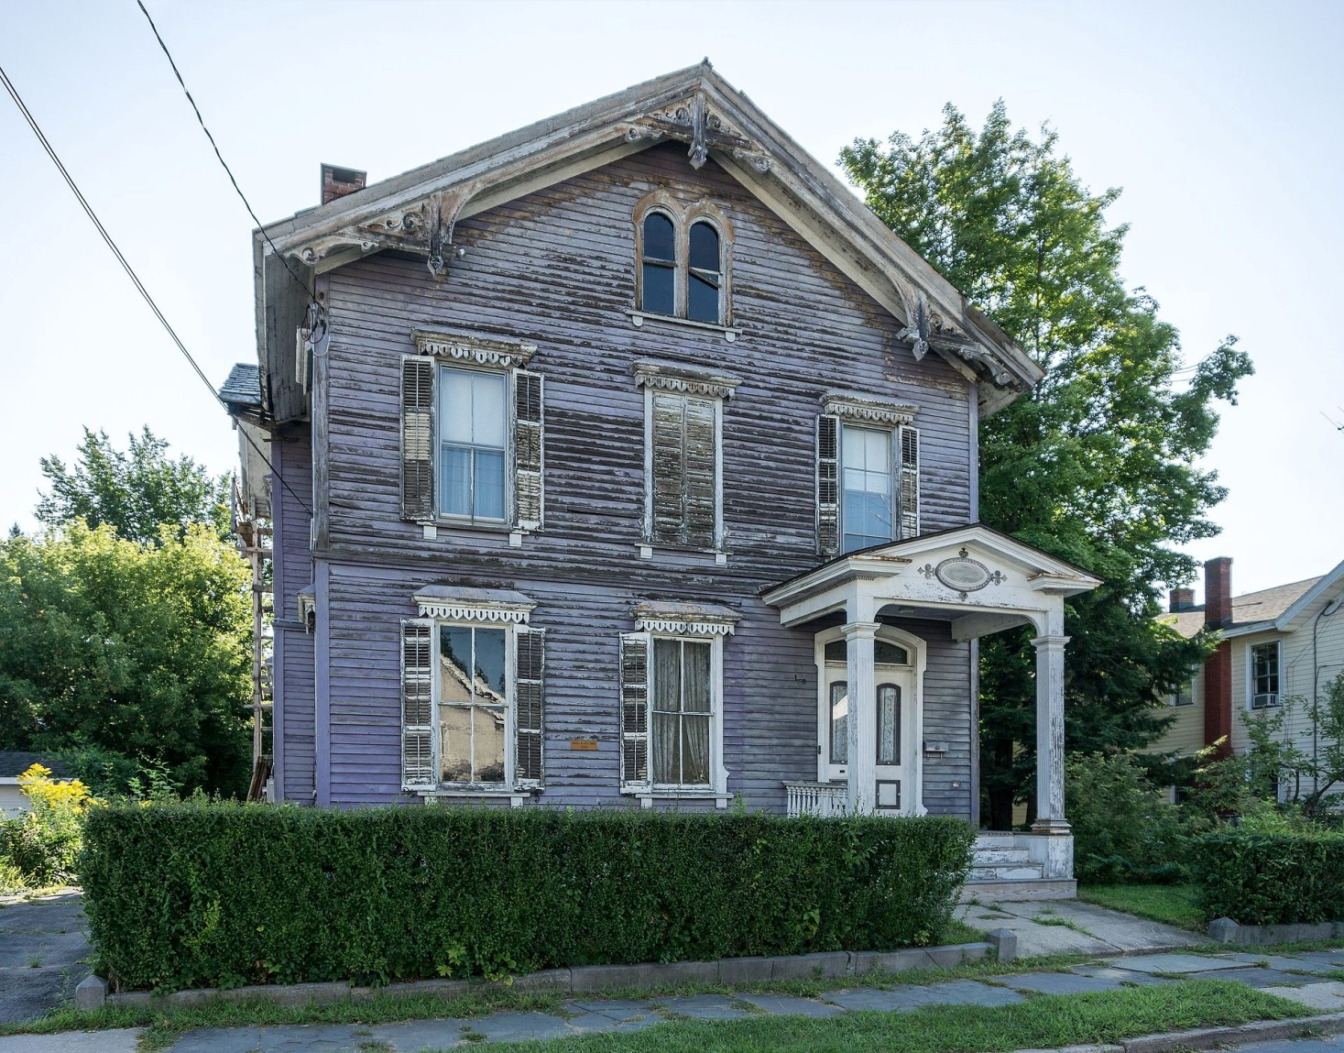
17 Center Street
The Russell Little home was built in 1839 and is on the National Register of Historic Places. Mr. Little was founder and president of Glens Falls Insurance Company from 1864-1891. 20 Center Street was the birthplace of Charles Evans Hughes in 1862, former NYS Governor, US Secretary of State and Chief Justice of the U.S. Supreme Court.
Photo credit: Kenneth C. Zirkel, Wikimedia Commons

Slide 14
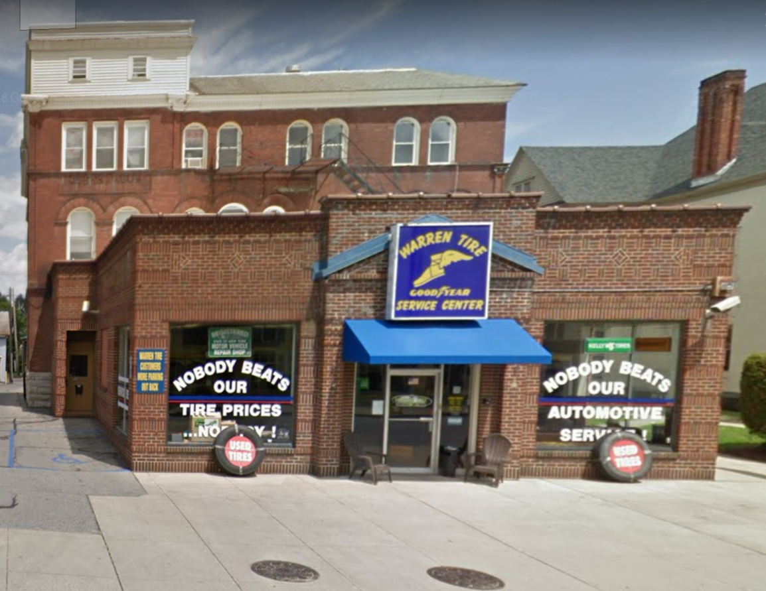
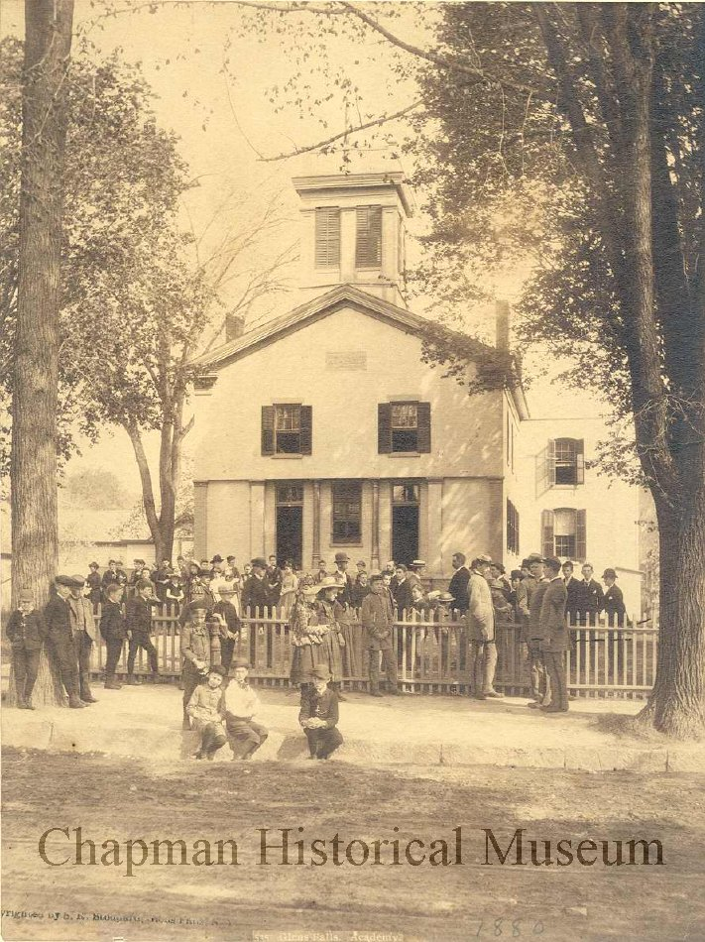
92 Warren Street
The rear portion of this building was constructed in 1841 and used as the Glens Falls Academy (private High School) until 1914. Note the still visible sign under the three windows to the left of the third floor.
Photo Seneca Ray Stoddard, 1880. Used with permission from the Chapman Historical Museum

Slide 15
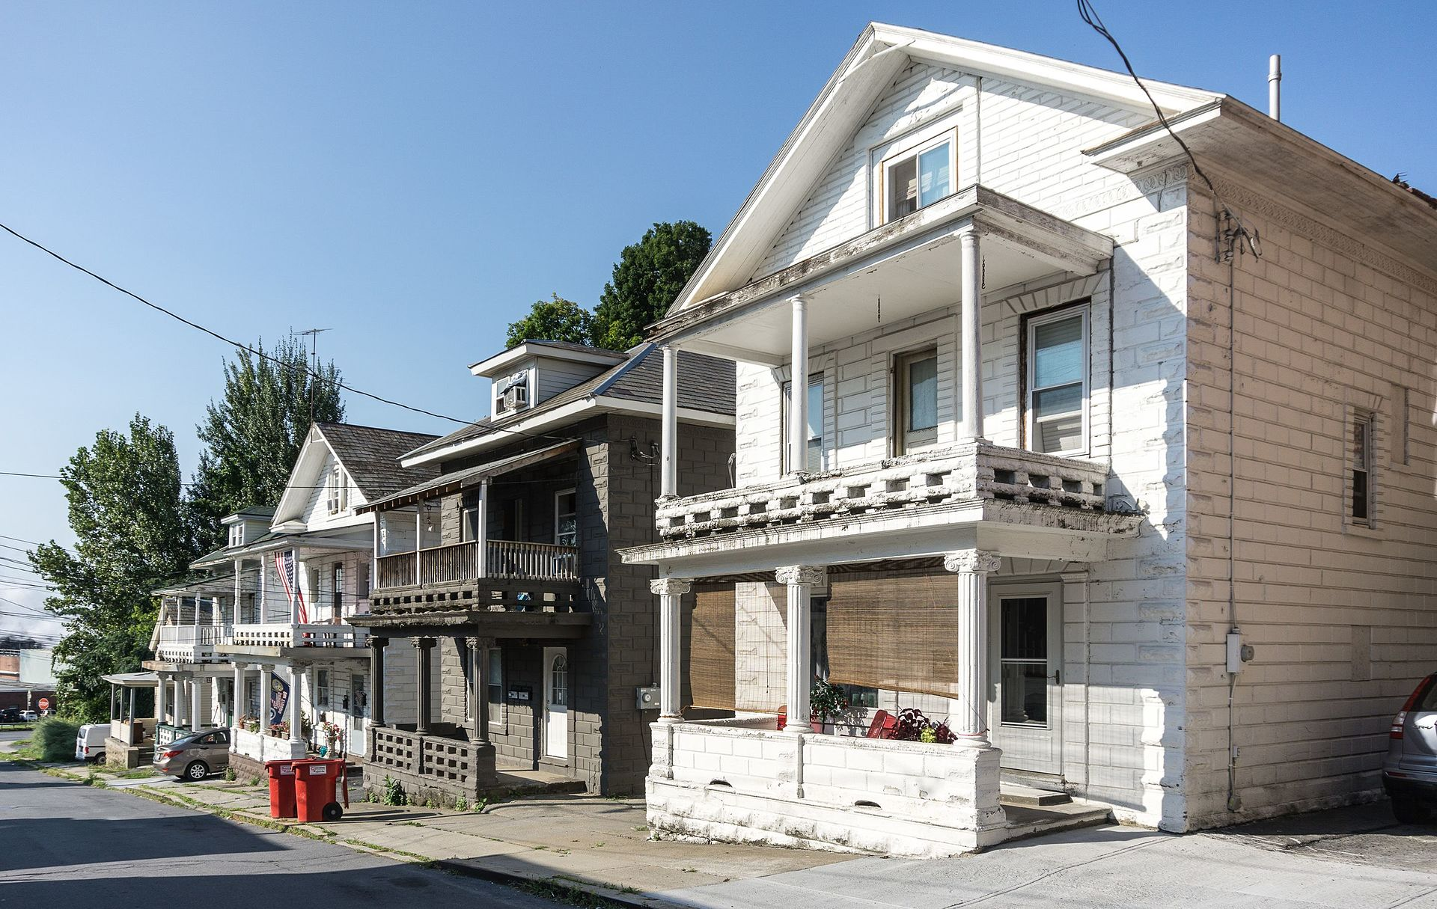
Fredella Avenue Historic District
Photo credit: Kenneth C. Zirkel, Wikimedia Commons
Look down this street named after Joseph Fredella, an Italian-American building contractor who designed the homes you see on the right side of the street, using materials and designs reminiscent of Italy. The houses were built between 1914 and 1918 and were innovative structures because of the use of cement block covered with concrete decoration to resemble ashlar stone and classical porches. The Fredella Ave Historic District has eight contributing buildings and was added to the National Register in 1984.

Slide 16
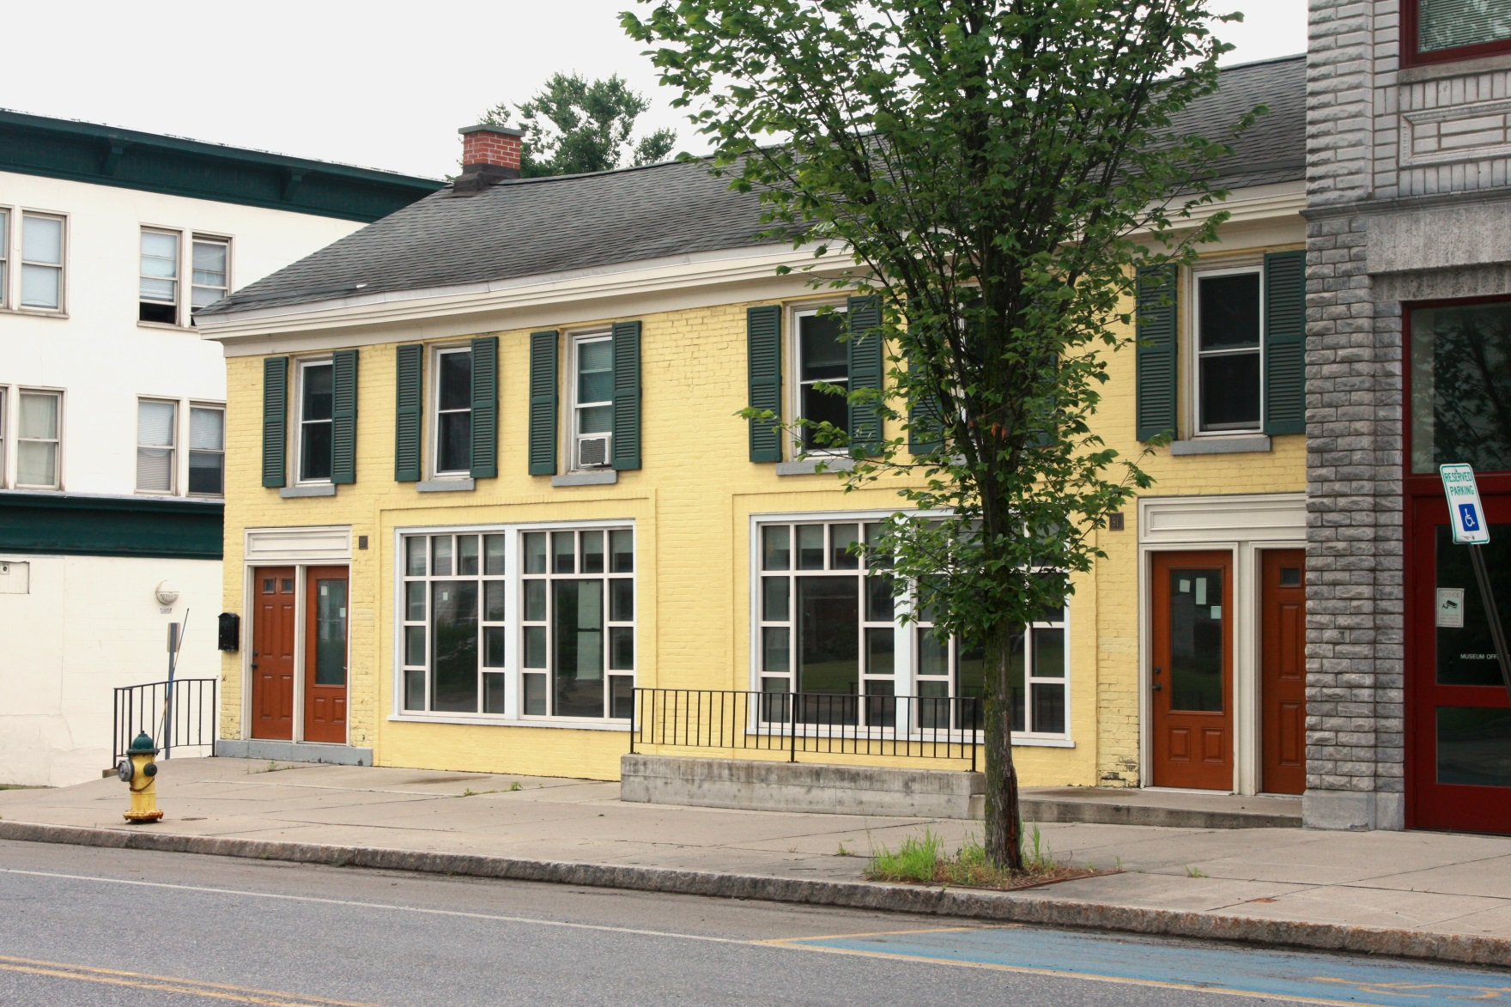
91 Warren
Street
The Williams Woods house was building in 1830 (possibly earlier) as a blacksmith shop. It is one of the oldest buildings in Glens Falls.

Slide 17
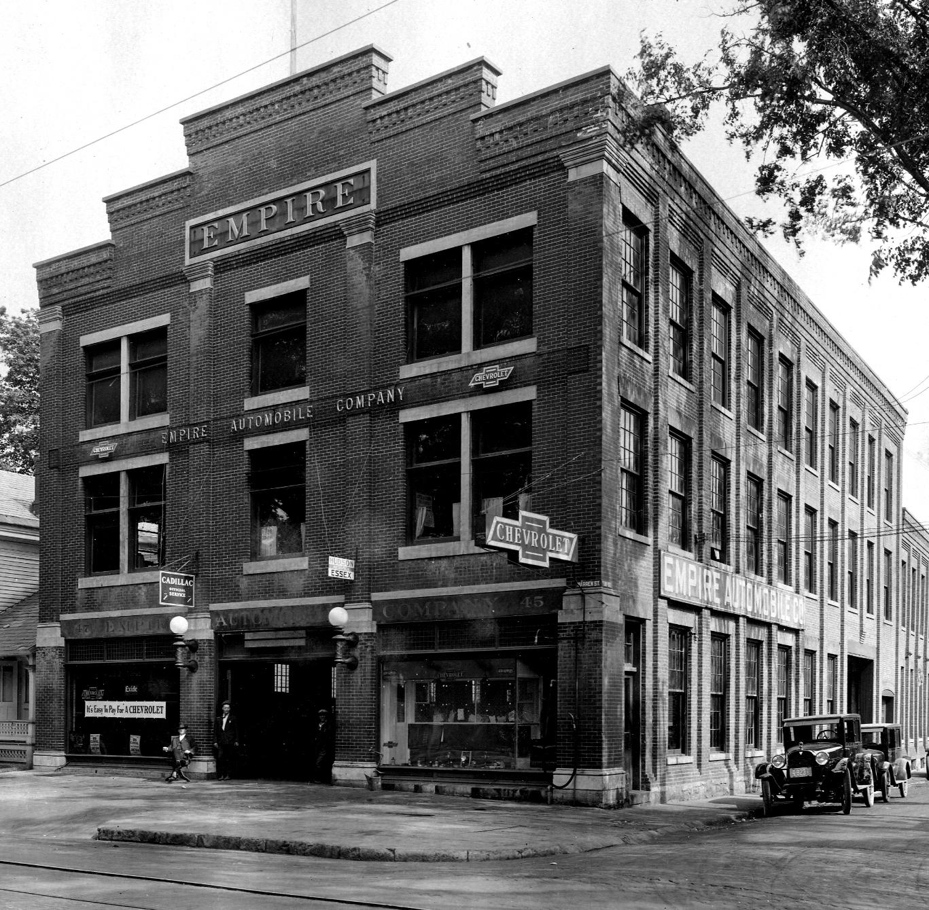
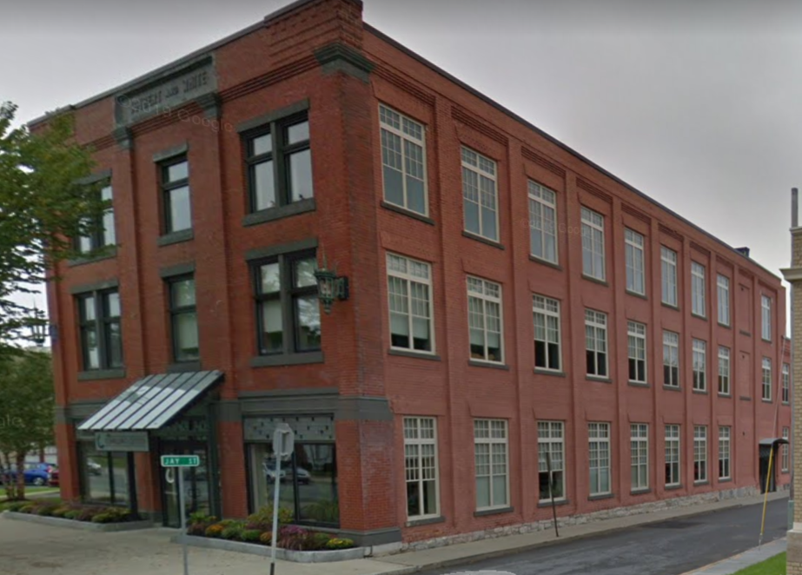
79 Warren Street
Photo credit: Warren County Historical Society
The Joubert and White Building was built in 1905 and designed by Ephraim Potter. Joubert and White were the world famous makers of buckboards and carriages used by the wealthy Morgan, Vanderbilt, Rockefeller, Astor and Louis C. Tiffany families. The Royal Palace of London exhibits Joubert and White carriages among its collections.

Slide 18
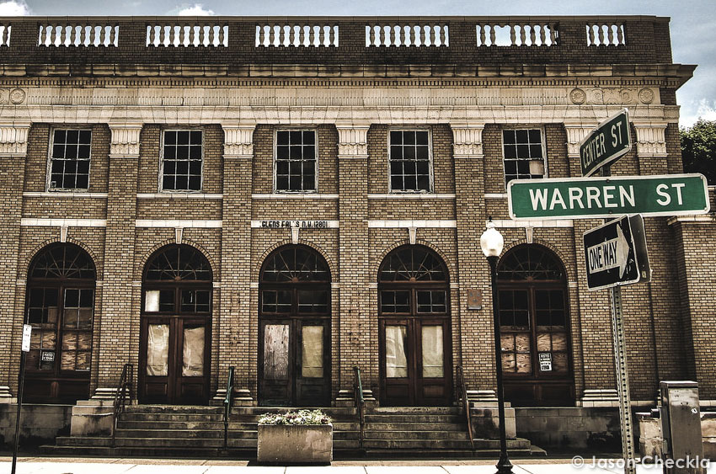
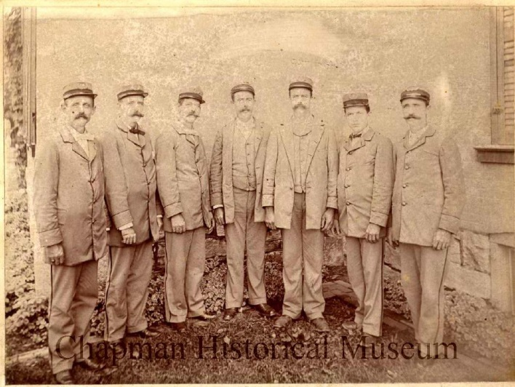
Early Glens Falls Postal Workers. Photo used by permission from the Chapman Historical Museum.
67 Warren Street
Photo credit: Jason Checkla
Built on the south side of Warren Street between Center and Church Streets in 1915, this building served as the Glens Falls Post Office until 1977 when it became the home for the Armed Forces Reserve Center. It is currently being renovated for offices.

Slide 19
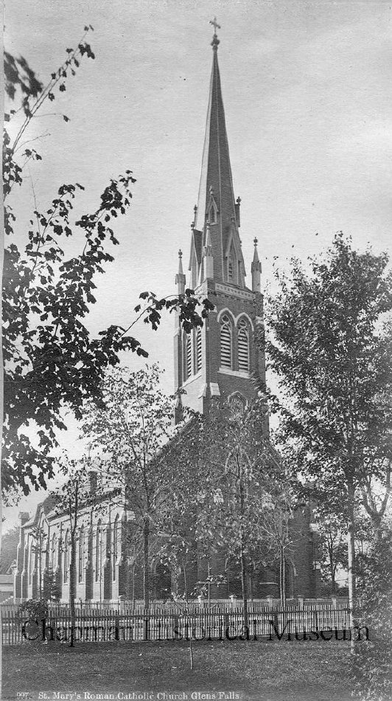
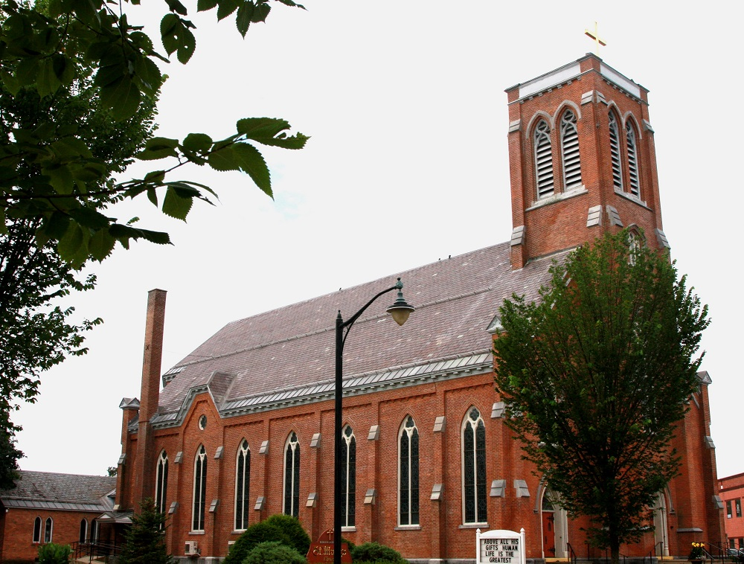
61 Warren Street
Designed by architects Nichols and Brown and completed in 1869, St. Mary’s Church is another example of the Gothic Revival style. Note that the steeple has been removed.
Photo: Seneca Ray Stoddard, 1880. Used with permission from the Chapman Historical Museum.

Slide 20
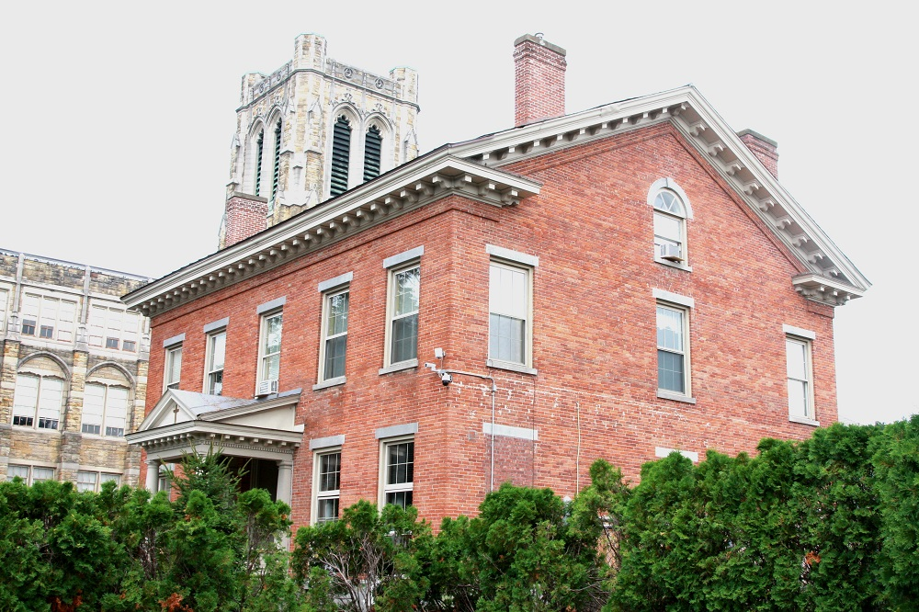
62 Warren Street
St. Mary’s Rectory. First built as the home of Judge Enoch Rosekrans around 1850. By 1900 it was converted to a hospital and later became the home of local entrepreneur Eugene Ashley.

Slide 21
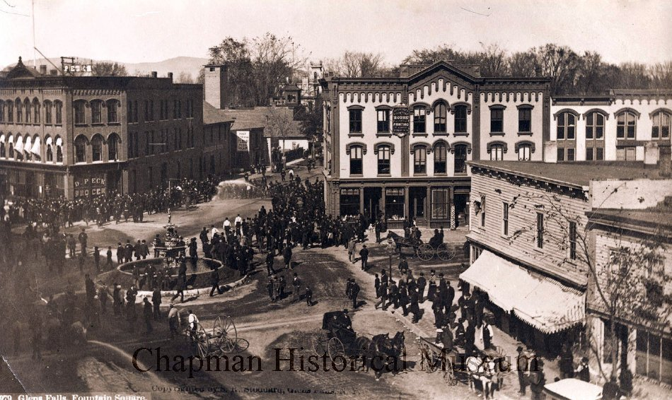
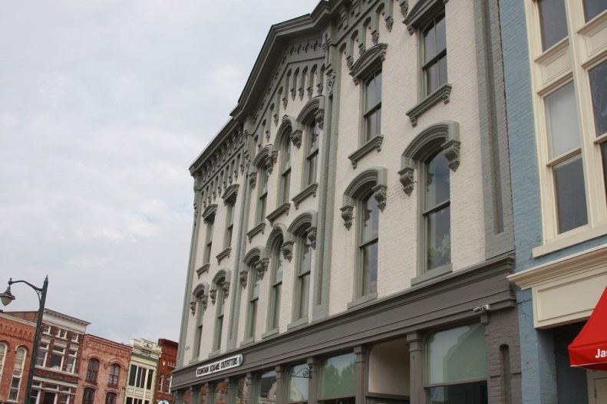
Photo: Seneca Ray Stoddard, 1870. Used with permission from the Crandall Historical Museum
1 Ridge Street
The Cowles Building was designed by Marcus Cunningham and built in 1867. It was the original site of a tavern built and owned by village founder Abraham Wing c. 1775. Ben Franklin is said to have stayed at the tavern in 1776 on his way to ask the Canadians to help the colonies fight the British.

Slide 22
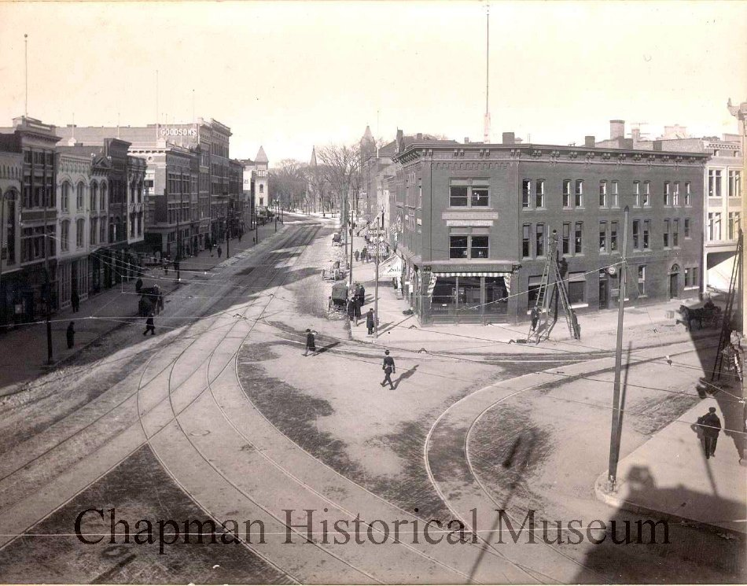
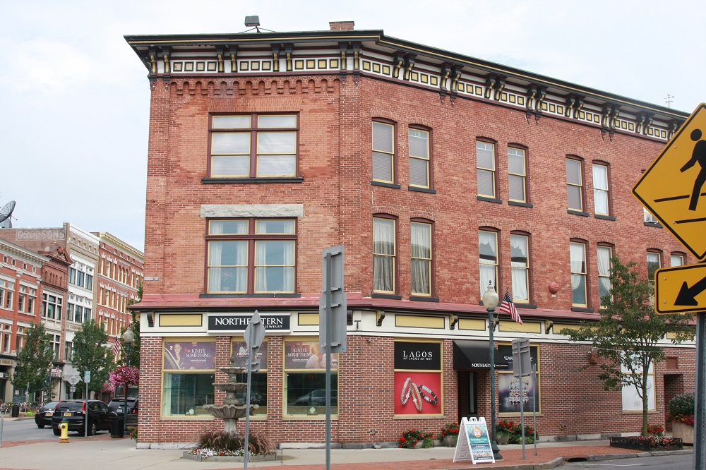
167 Glen Street
Photo: 1909. Used with permission from the Crandall Historical Museum
Built on the corner of Glen and Ridge Streets in 1865 as a wholesale grocery business, the Peck and Byrne Building became the home of Merchants National Bank and Burns Newsroom in the mid 1900’s. Alterations to the façade have been made over the years.

Slide 23
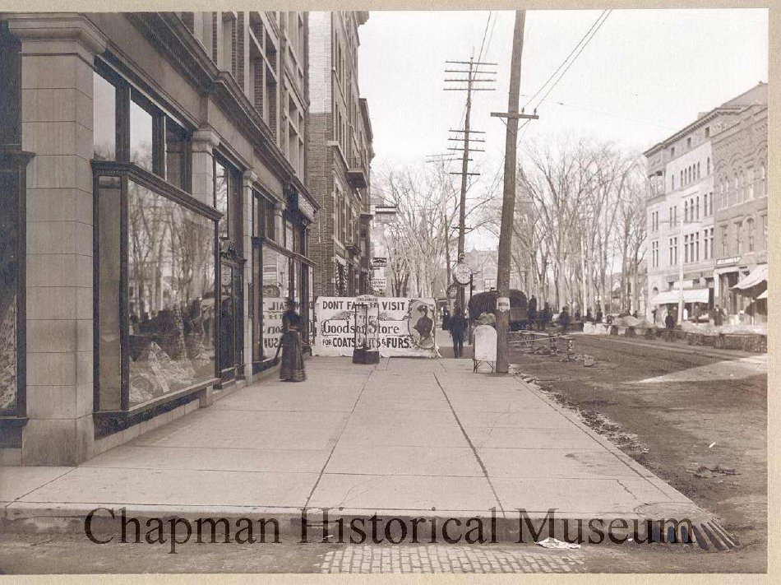
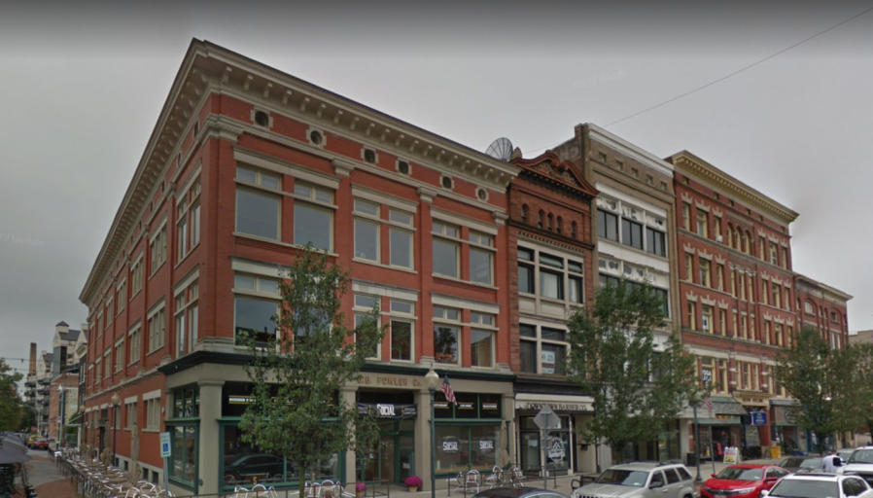
Photo: O.A. Bowler, 1905. Used with permission from the Crandall Historical Museum
190 Glen Street
The B. B. Fowler Building was built in 1903. It was designed by local architect Ephraim Potter to replace the original B. B. Fowler building on the same site that was destroyed by fire in 1902.

Slide 24
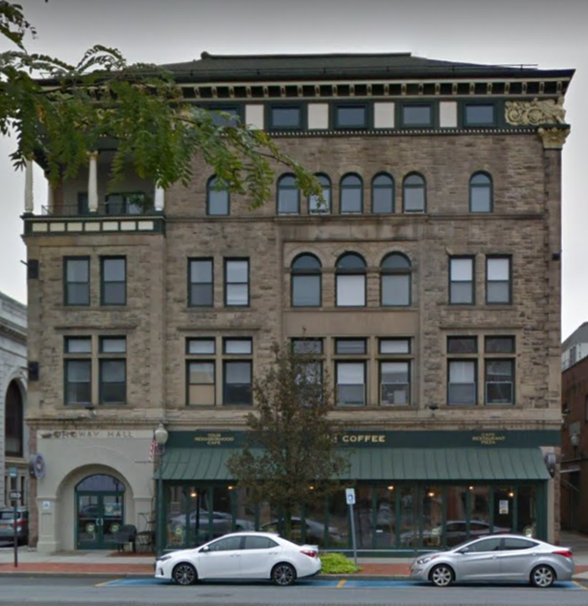
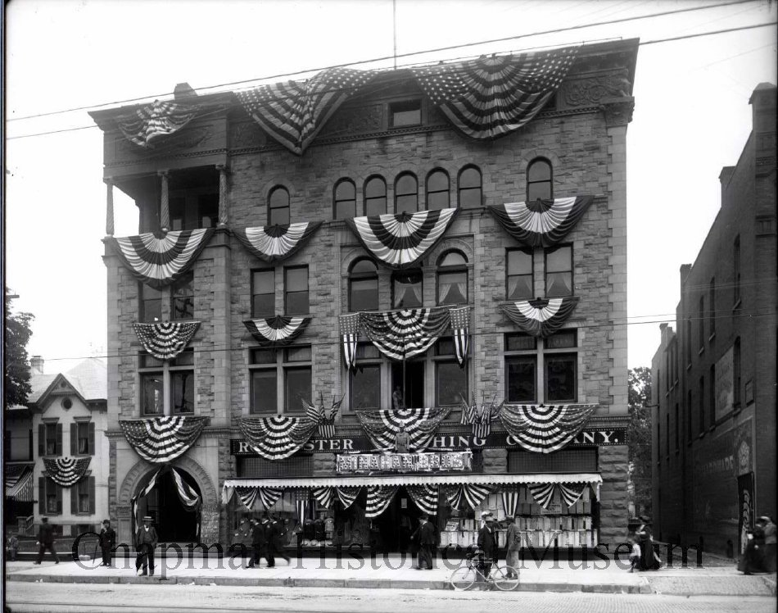
221 Glen Street
Photo: 1900. Used with permission from the Crandall Historical Museum
Built in 1891 as the first Young Men’s Christian Association (YMCA) Building. Construction was funded in part by a $50,000 donation from local lumber baron and philanthropist, Jonas Ordway. The swimming pool was added in 1909. The “Y” remained a popular teen hangout through the 1950’s. The building currently houses Spot Coffee and private apartments. The Romanesque Revival style building always housed a commercial business on the ground floor. The decorative cornice is made of pressed tin. Note the decorative porch on the north end and the “bowsprit-like” maiden on the south corner.

Slide 25
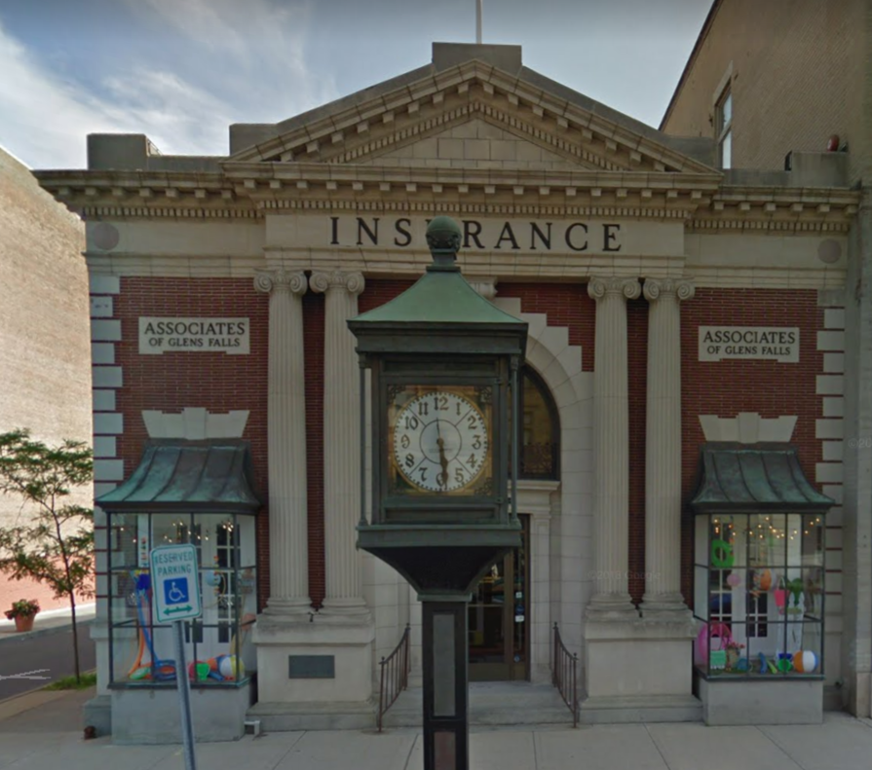
228 Glen Street
Photo: 1900. Used with permission from the Crandall Historical Museum
Designed by Marcus T. Reynolds and erected as Glens Falls Trust Co. in the early 1900s. Note the pedestal clock on the corner (actually controlled by a master clock inside). In a brochure published with the building first opened, the Bank touted the fact that they had a separate room where women could do their banking since it would have been unseemly to walk up to a regular teller.

Slide 26
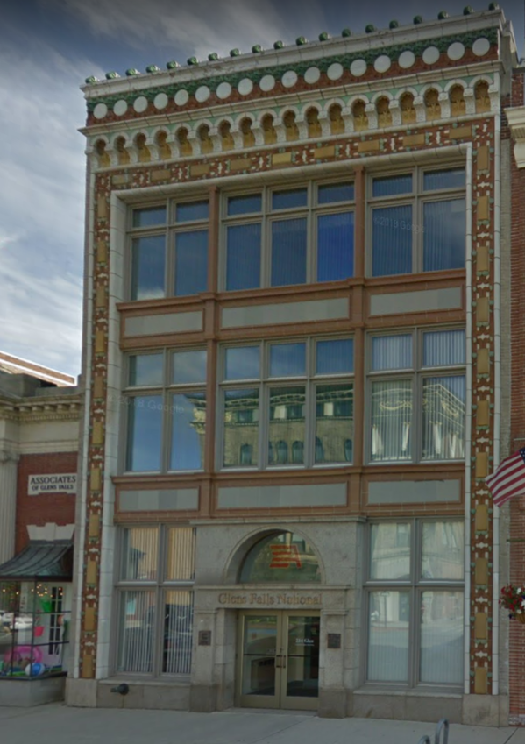
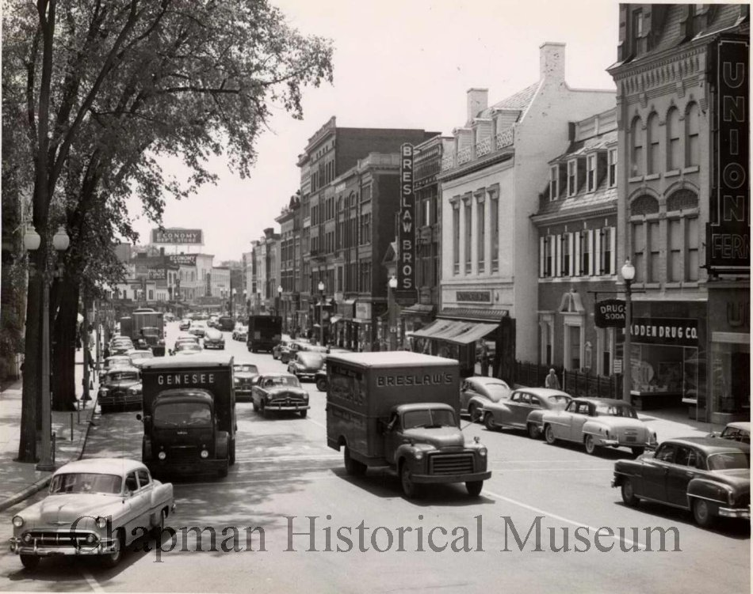
Photo: 1950. Used with permission from the Crandall Historical Museum
234 Glen Street
The Saunders Building was built as a millinery store and was later home to Breslaw’s Furniture store and other businesses before its current use. Note the elaborate terra cotta detail at the front of the building that combines natural and geometric elements.

Slide 27
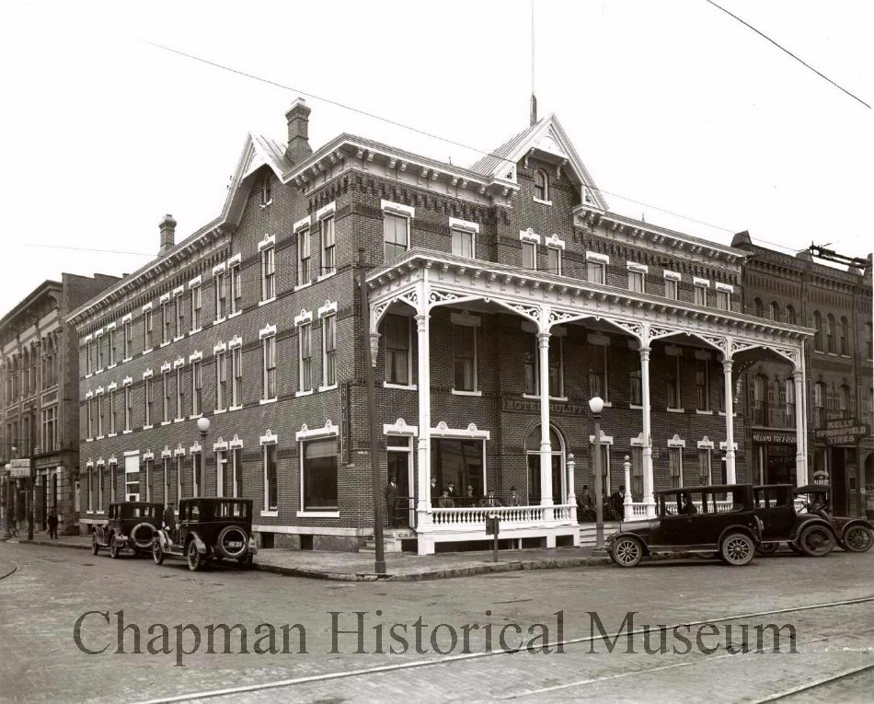
228 Glen Street
Photo: 1899. Used with permission from the Crandall Historical Museum
The Ruliff Hotel was built as the American Hotel with a porch on the Glen Street side.

Slide 28
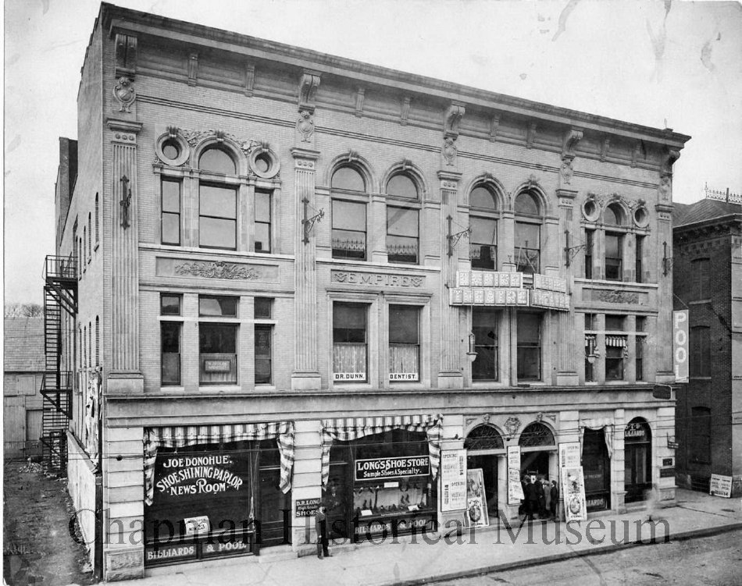
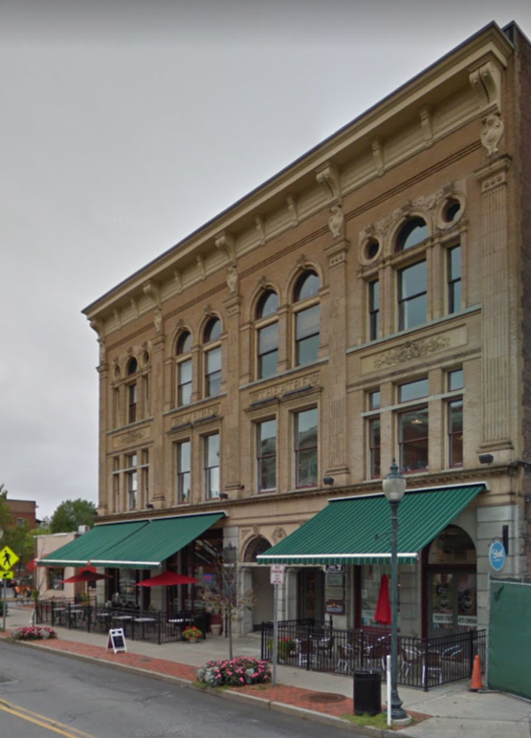
11 South Street
Photo: 1900. Used with permission from the Crandall Historical Museum
When the Empire Theater opened in 1899, it was advertised as “Pleasure Palace” with banquet rooms, cardrooms, parlors, a restaurant and a ballroom in addition to the stage with 1,200 seats. Designed by J.B. McEphattrick in the classical American Renaissance Revival style, it was the premier theater site in the Glens Falls region for many decades.

