Slide 1

An update from the road
By
The New York Sherpa™

Slide 2
Our Vision
1. Personal Interests
2. Recommendations

Slide 3


Slide 4
Mobile Visitors Center
Fairs/Festivals
Travel Shows
Malls
Tactical Locations

Slide 5
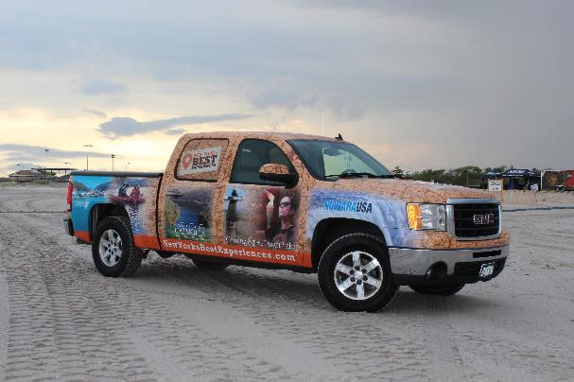
Sherpa Mobile

Slide 6
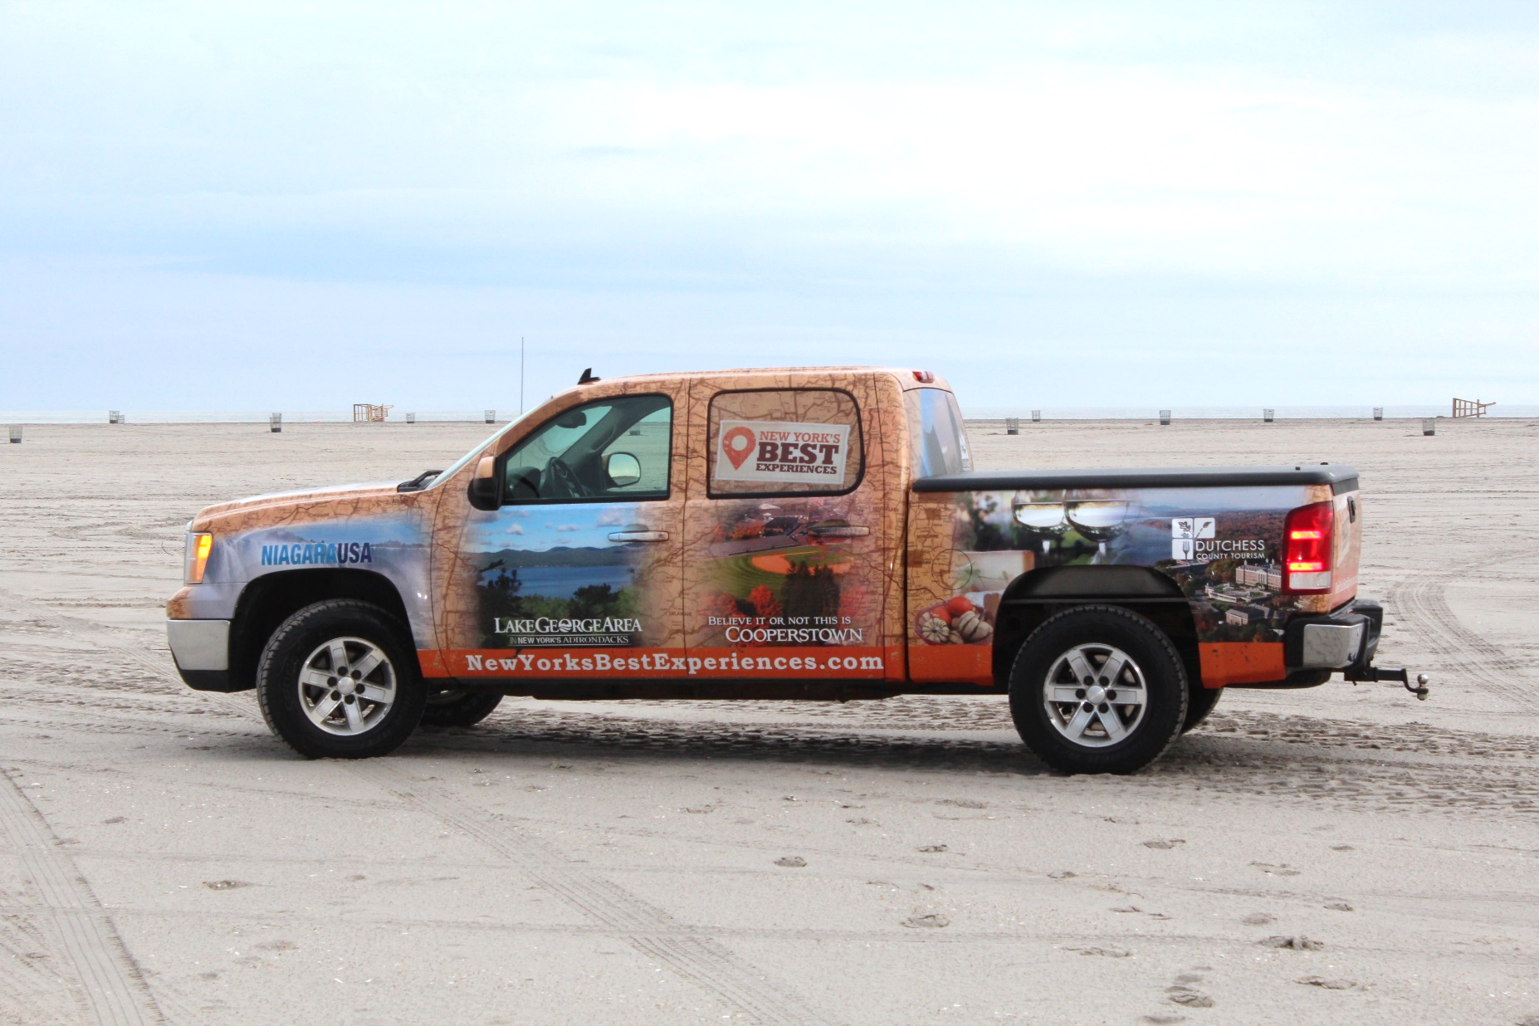
Sherpa Mobile

Slide 7

Northeast RV Show, Suffern, NY

Slide 8

Northeast RV Show, Suffern, NY

Slide 9



Slide 10
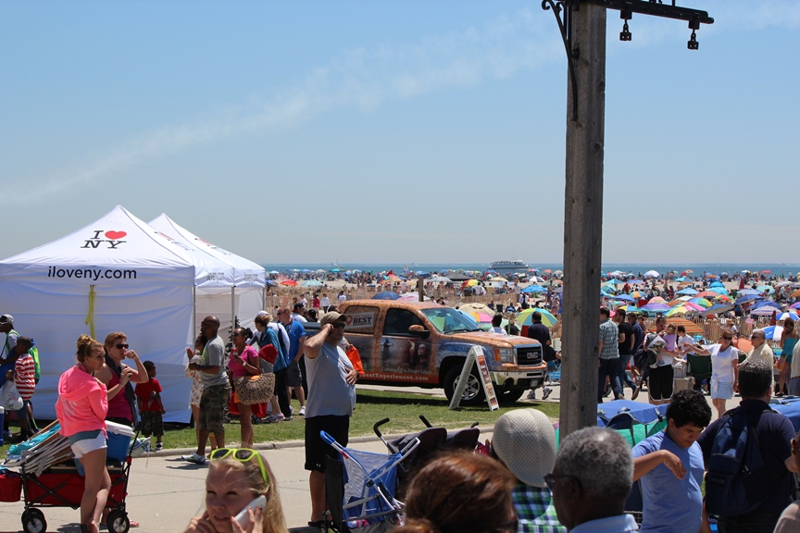
Jones Beach Air Show, Jones Beach, NY

Slide 11
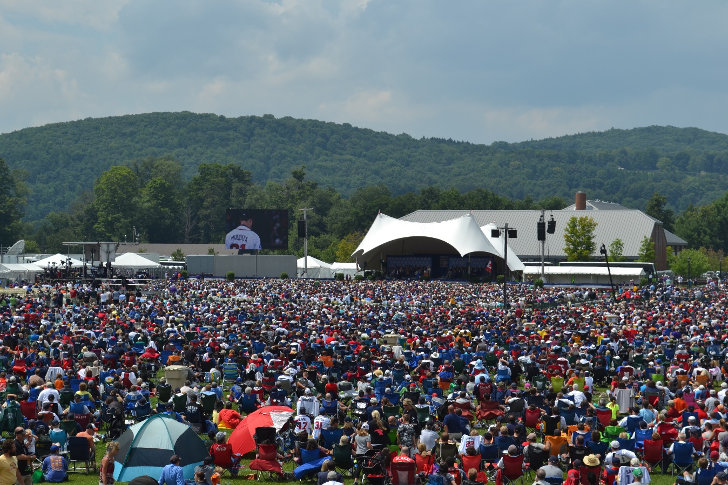
Baseball Hall of Fame Induction 2014

Slide 12
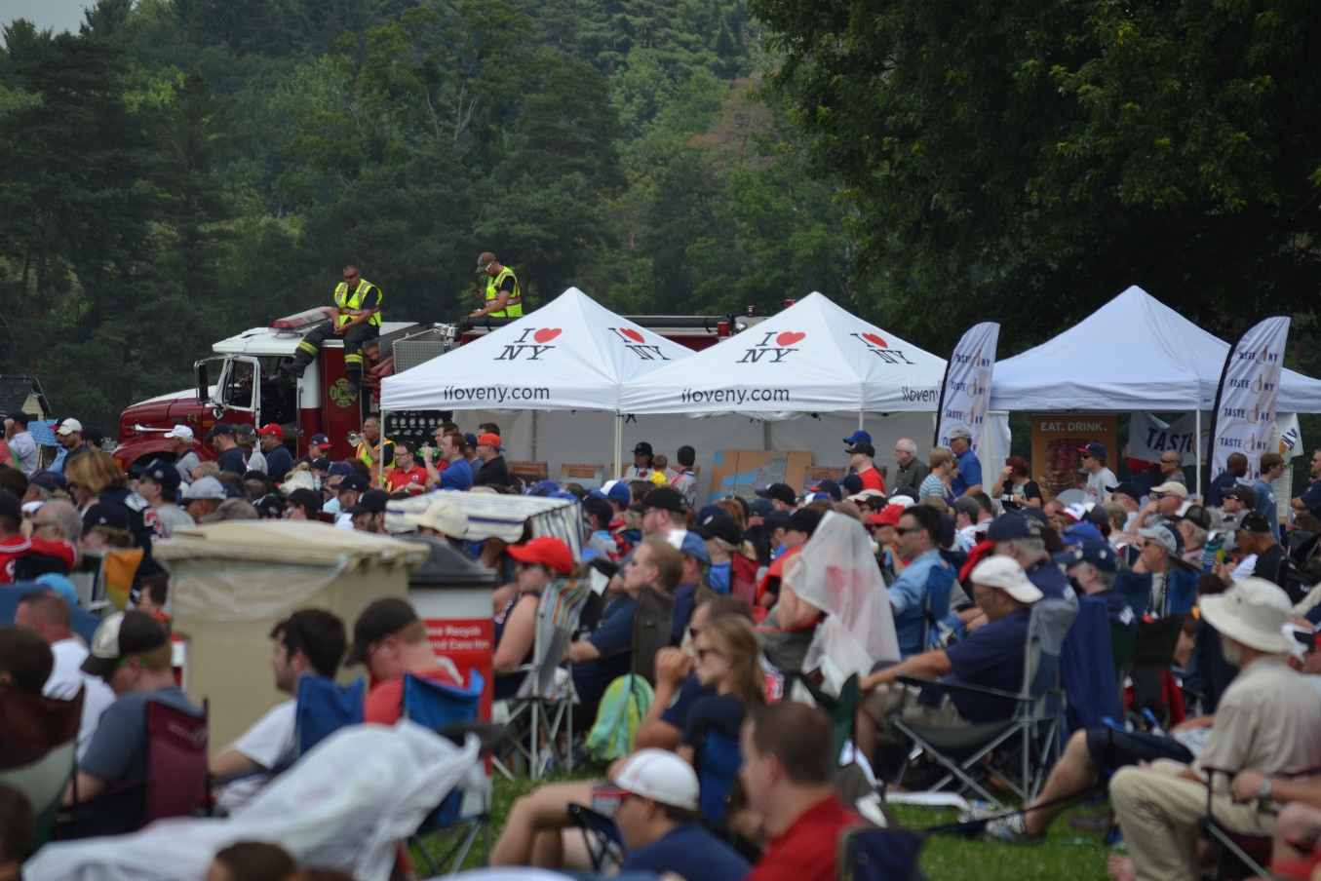
Baseball Hall of Fame Induction 2014

Slide 13
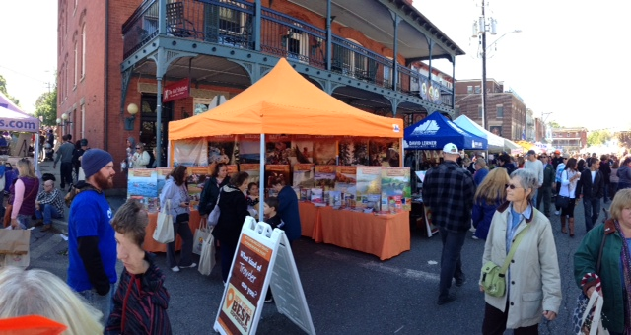
Warwick Apple Fest, Warwick, NY 2014

Slide 14
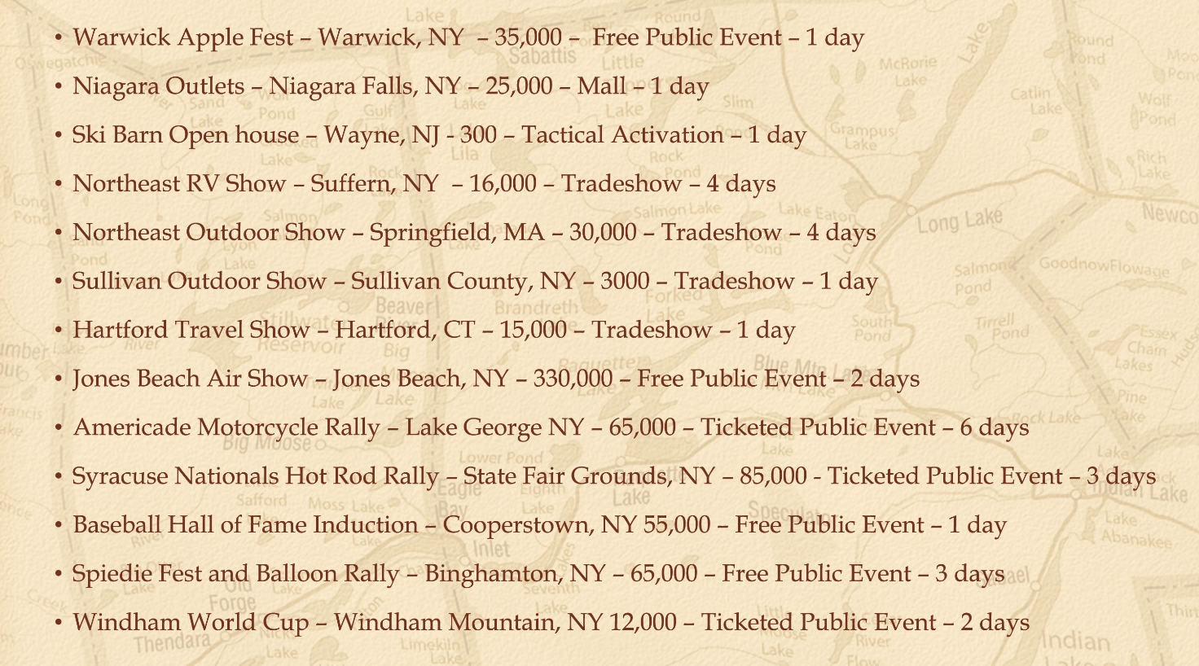

Slide 15
Lake George Details
Travel Guide Very Popular
Niagara Falls, Cooperstown, Lake George
#1 Distributed Guide

Slide 16
Lake George Details
Lake George = Adirondacks
“I was there as a kid”
“We love Lake George”

Slide 17
Lake George Details
People are hungry for experiences & authenticity
Why are you “Famous”
Fishing, paddling, hiking
Events

Slide 18
Lake George Details
Take what we do into your marketing
Talk about them
“Something for everyone”?

Slide 19
Thank You!

