Slide 1
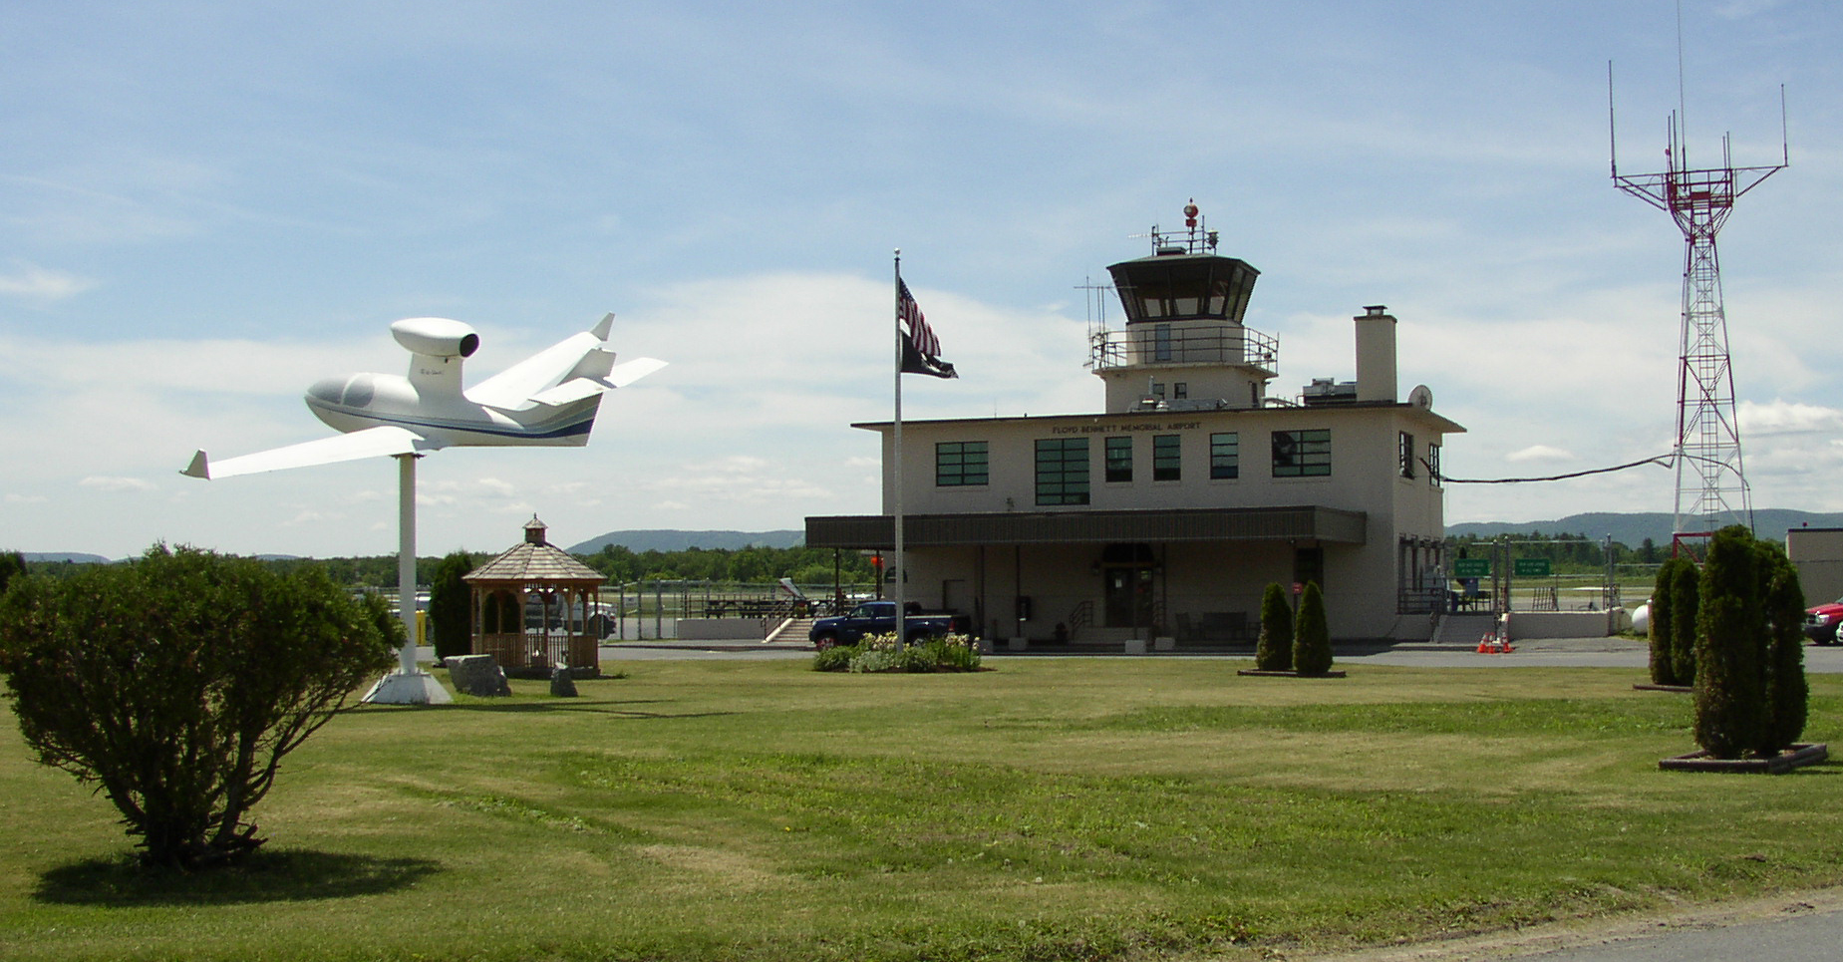
Floyd Bennett Memorial Airport Warren County
Runway 1/19 – To Extend or Not to Extend
October 31, 2016

Slide 2
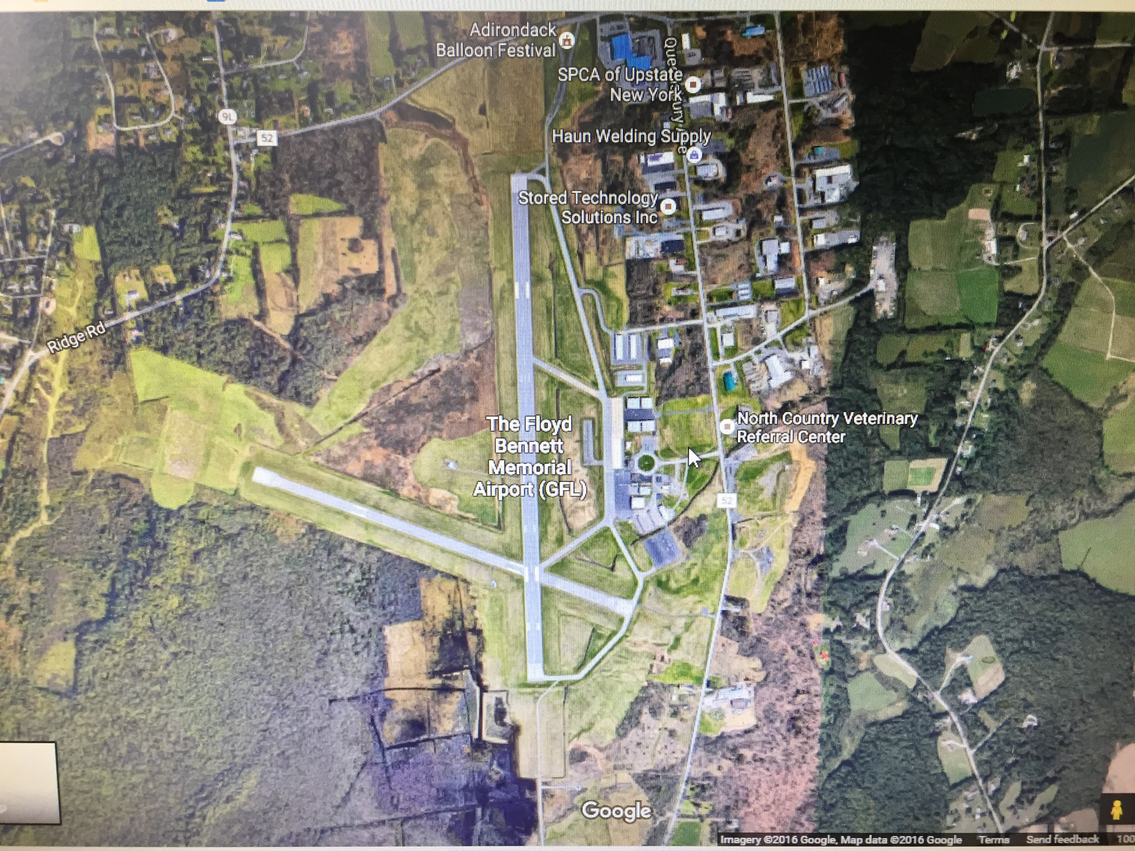
The Airport is a County asset.
The County should make reasonable investments in County assets.
The County invests significant amounts of money and resources into the Airport (“GFL”) on an annual basis.
Runway 1/19 is 5000’ long (longer than runway at Saratoga, which is 4699’ long and receives far more traffic than GFL).

Slide 3
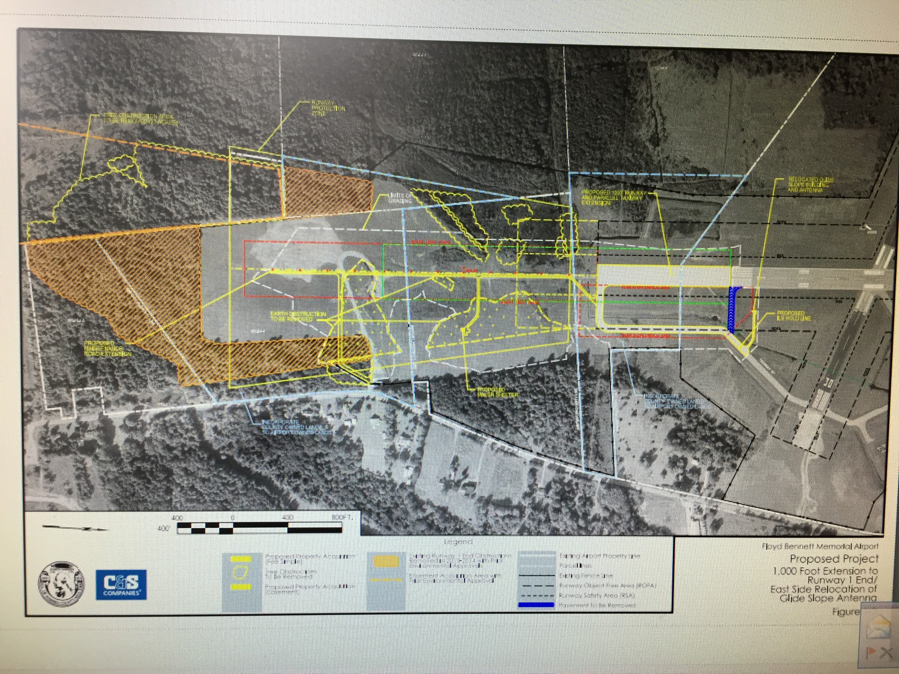
Reasons to Extend Runway 1
Past efforts to carry out the preferred alternative (extend Runway 19 to the north) were not successful
Greater ease and safety* for existing private jets owners/operators that would like to take on greater amounts of fuel so that the jets can travel longer distances without stopping after leaving GFL
One-time infusion of construction dollars, and possibly jobs, during the construction phase of the project

Slide 4
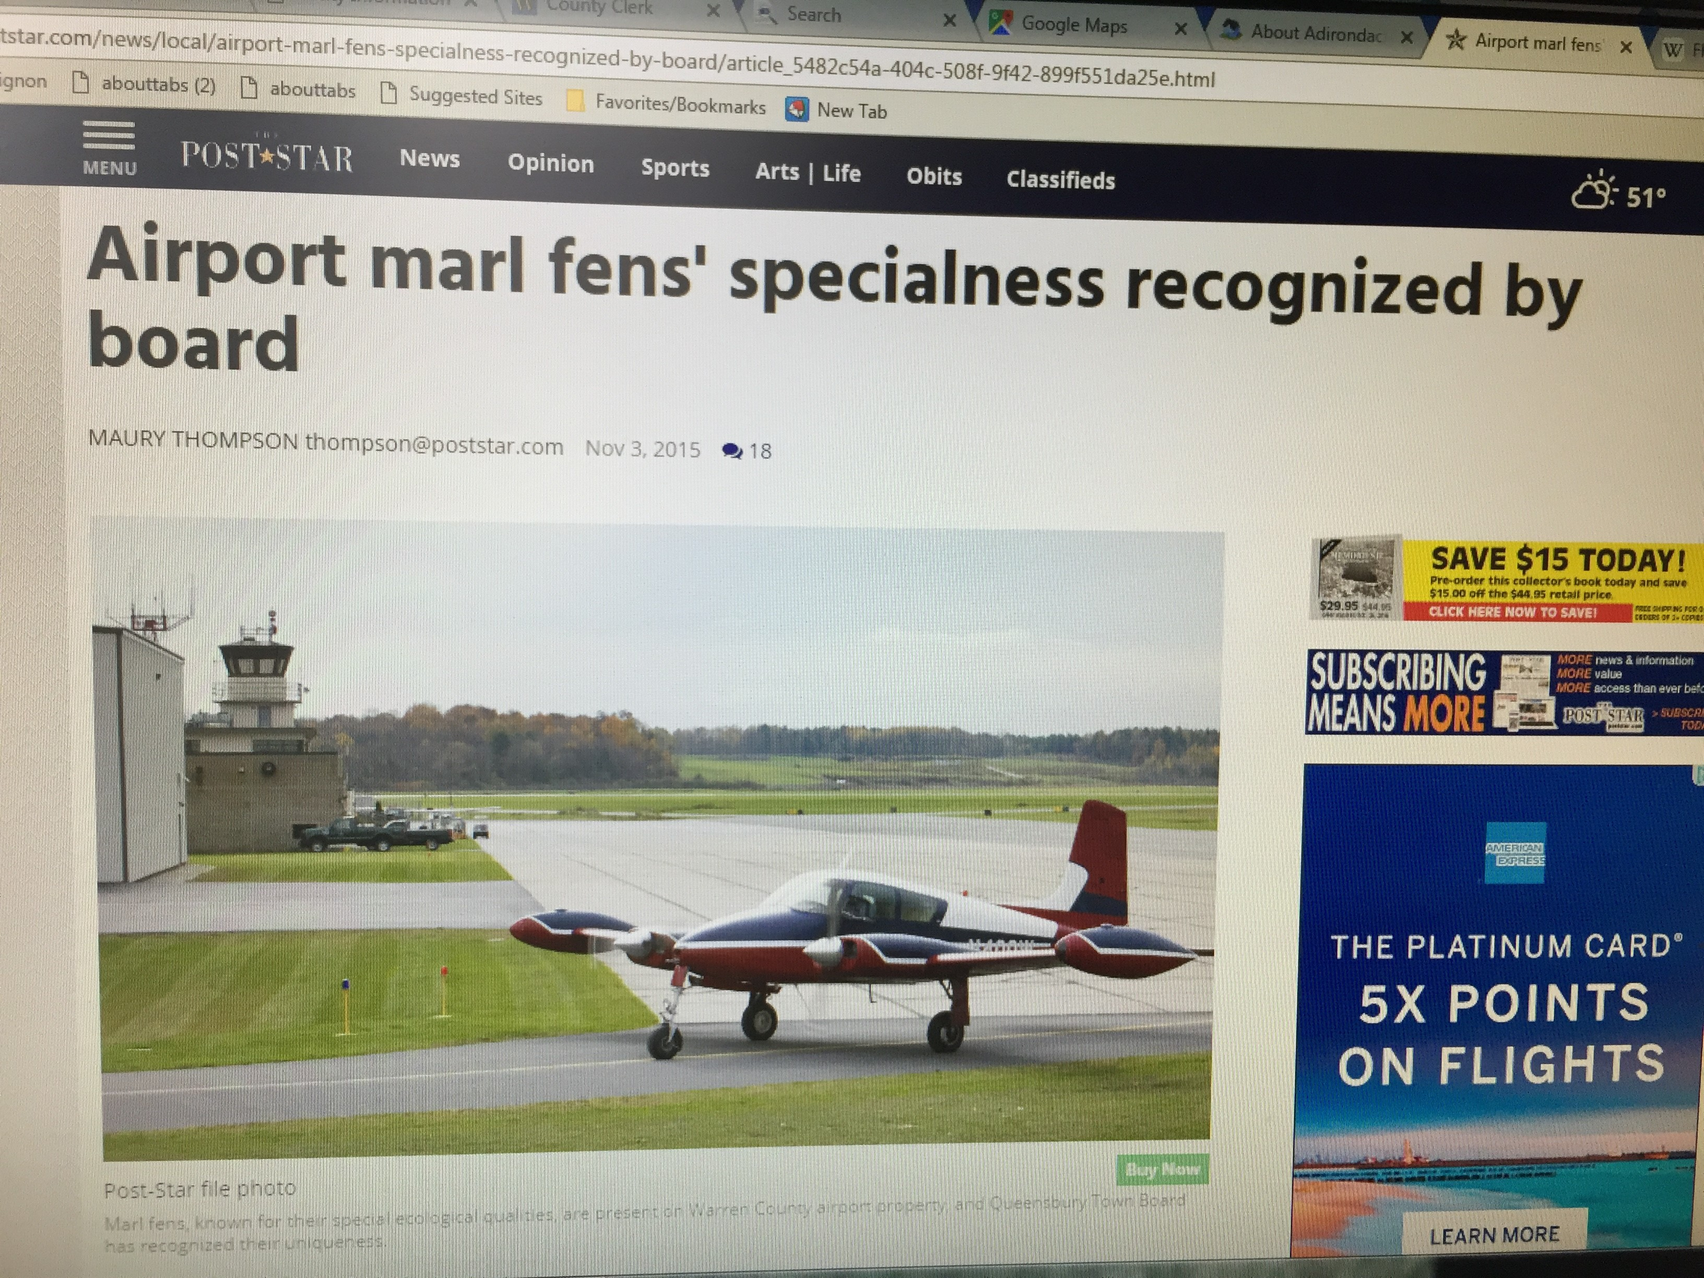
Reasons Not to Extend Runway 1
Numerous adverse environmental consequences
Impacting 66.7 acres
Removing 10 acres of terrain
Filling 10.57 acres of wetlands
Removing 23 acres of trees

Slide 5
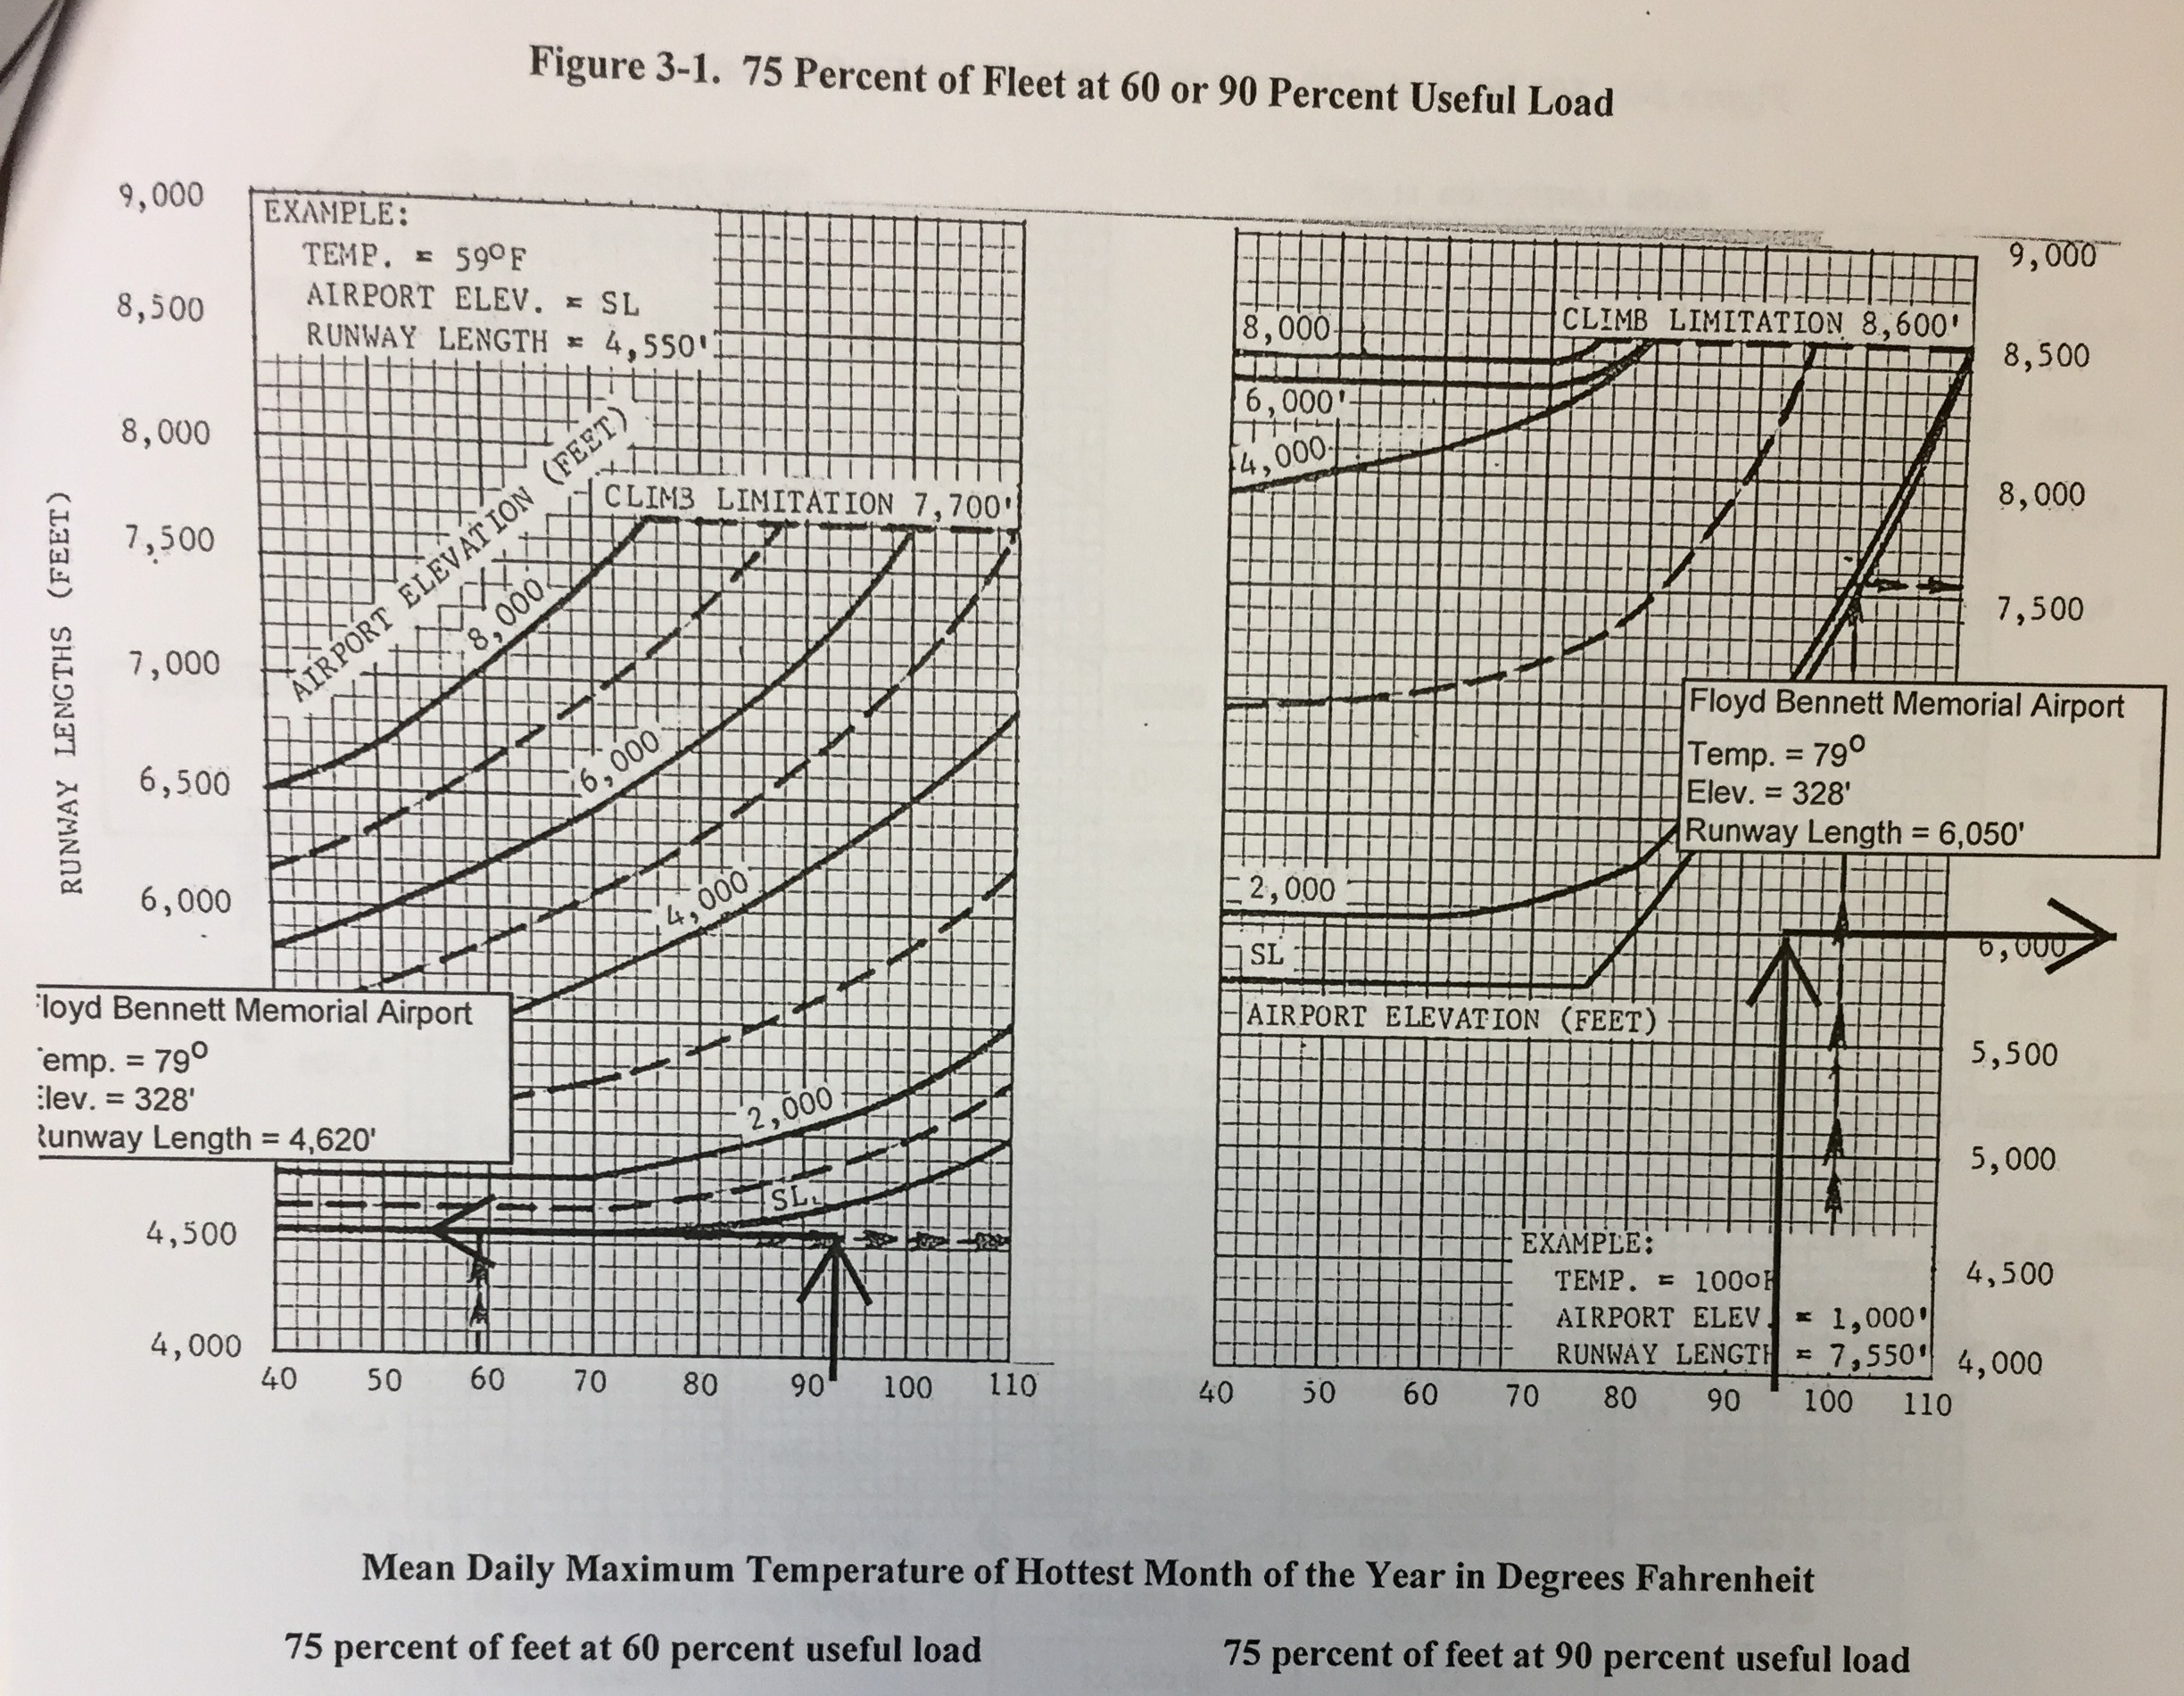
Reasons Not to Extend Runway 1 (cont.)
No FAA requirement to extend
Design tables show 4620’ is sufficient length for GFL

Slide 6

Reasons Not to Extend Runway 1 (cont.)
No evidence of ongoing annual benefits that may be reaped from the extension. However, ongoing maintenance costs will be a drain on the County.

Slide 7
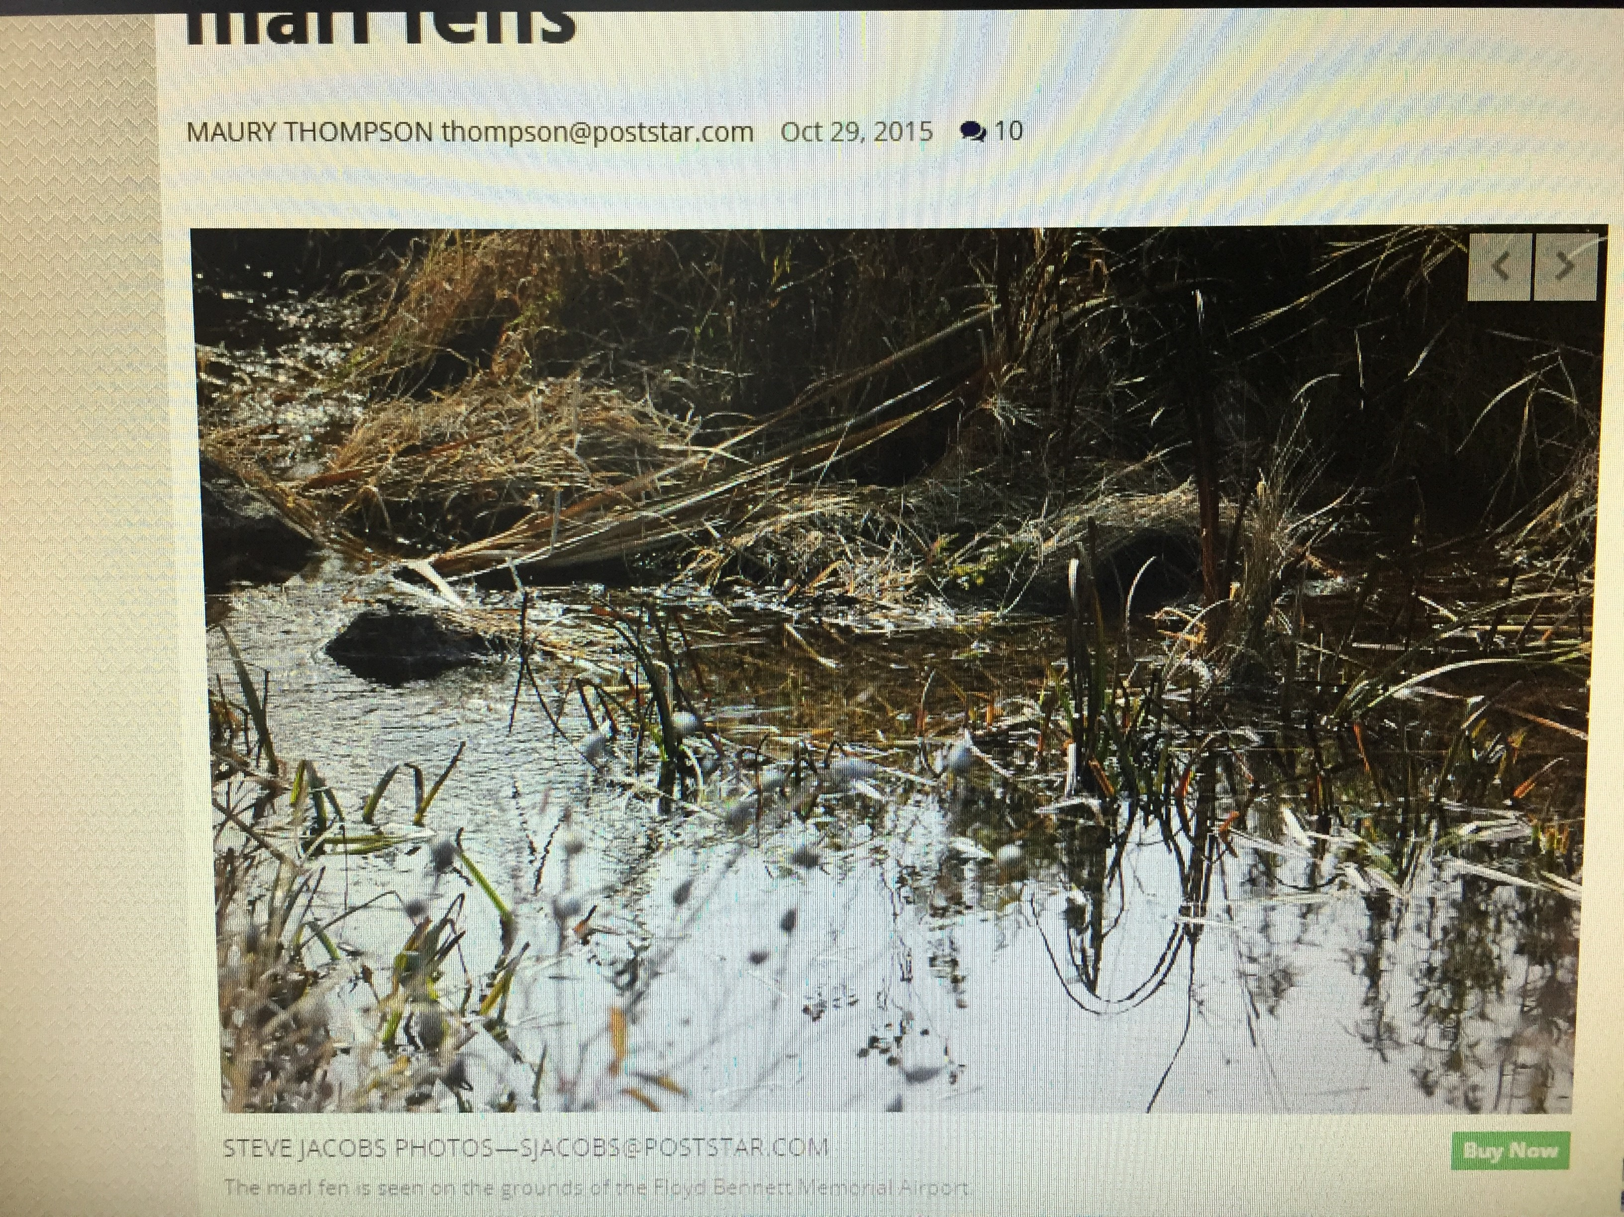
Costs to Warren County from Runway Extension
$$
Lost opportunity to invest in other important County projects
Environmental damage
Bad public relations?

