Slide 1

In the Travelers Own Words
By
The New York Sherpa™

Slide 2
Our Vision
We believe…
Personal Interests
Recommendations

Slide 3
Simple Mission:
First Time Visitors

Slide 4


Slide 5
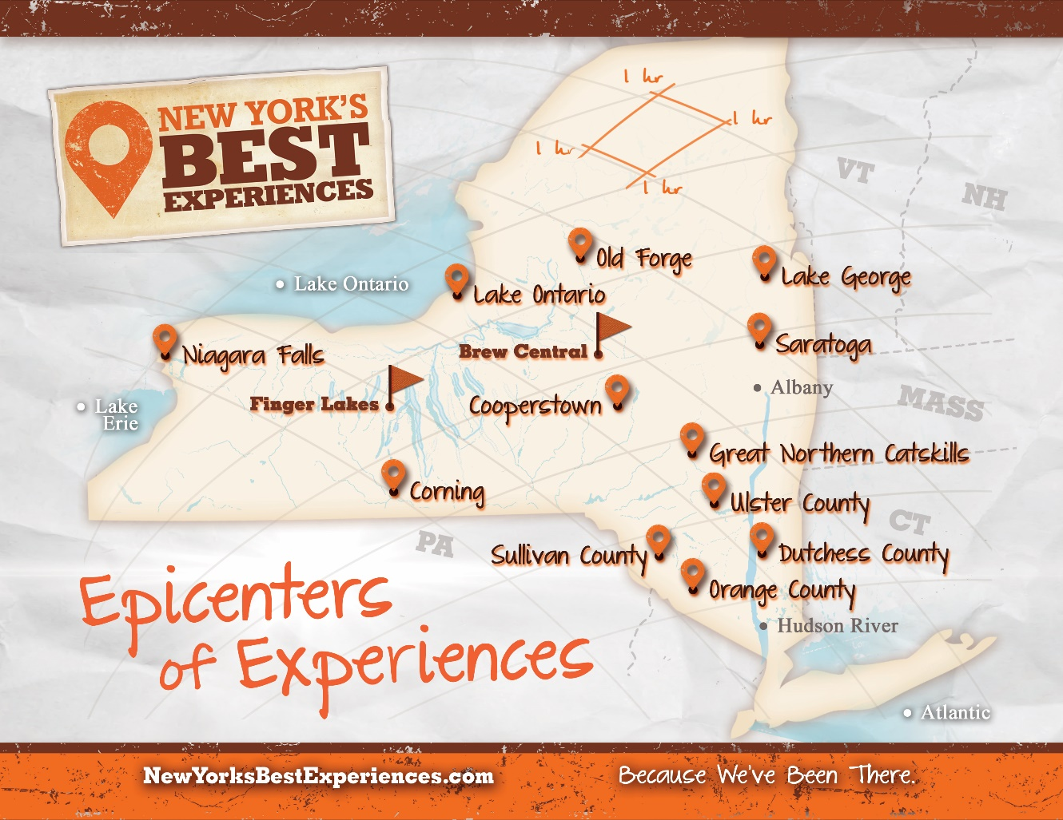

Slide 6
Mobile Visitors Center
Fairs/Festivals
Travel Shows
Malls
Tactical Locations

Slide 7
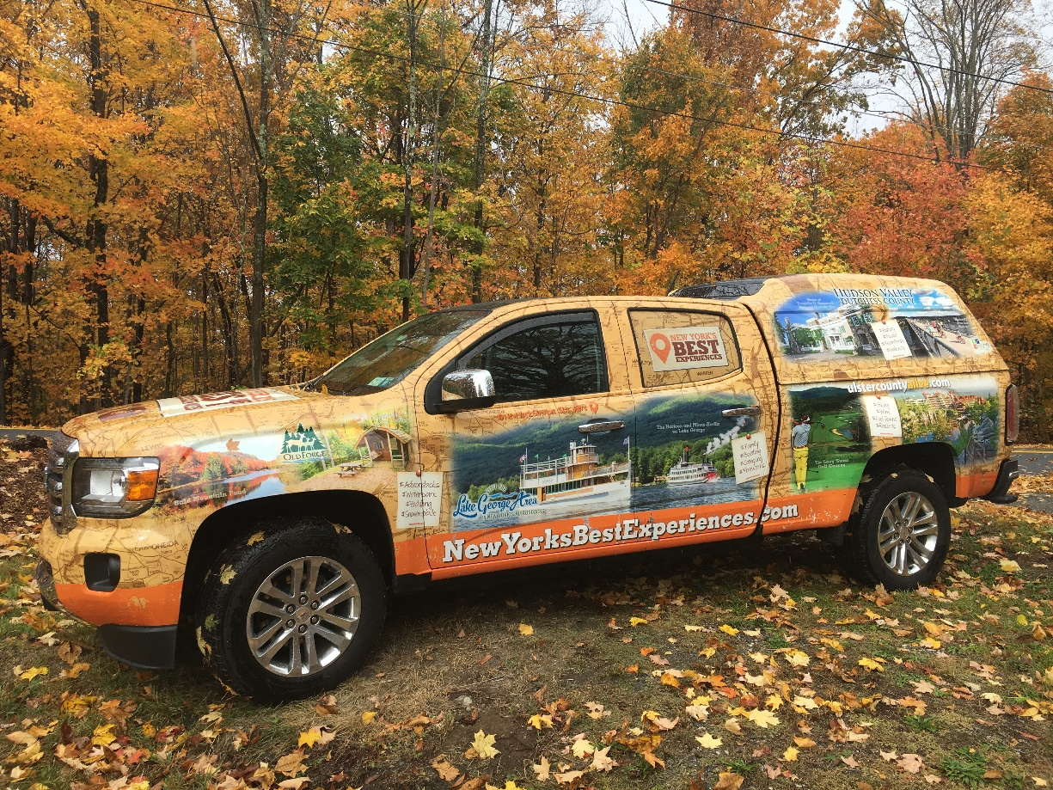
Sherpa Mobile

Slide 8
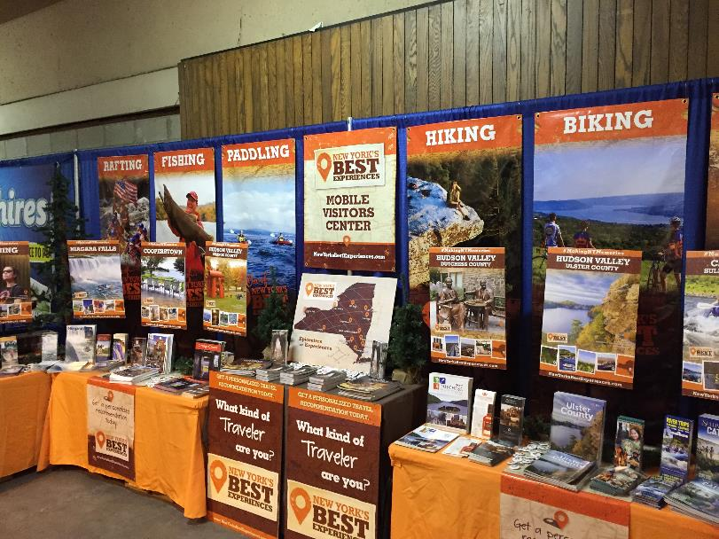
Northeast RV Show, Suffern, NY

Slide 9



Slide 10
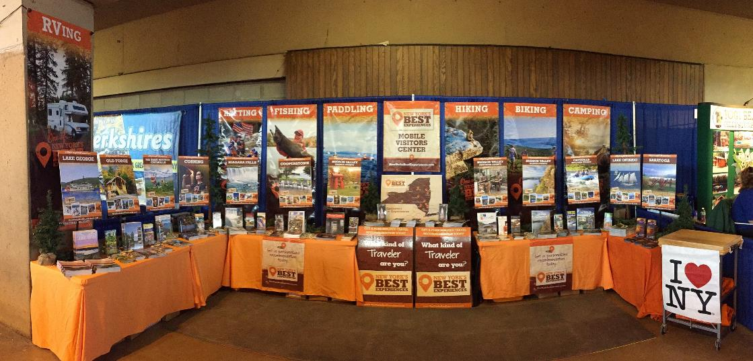
Northeast RV Show, Suffern, NY

Slide 11
15 Destinations on Tour

Slide 12
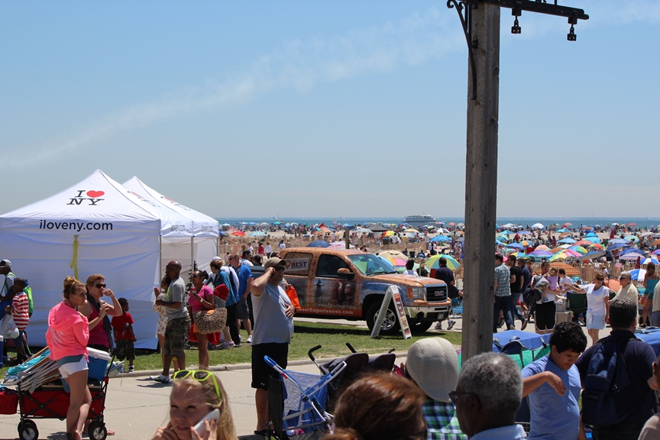
Jones Beach Air Show, Jones Beach, NY

Slide 13
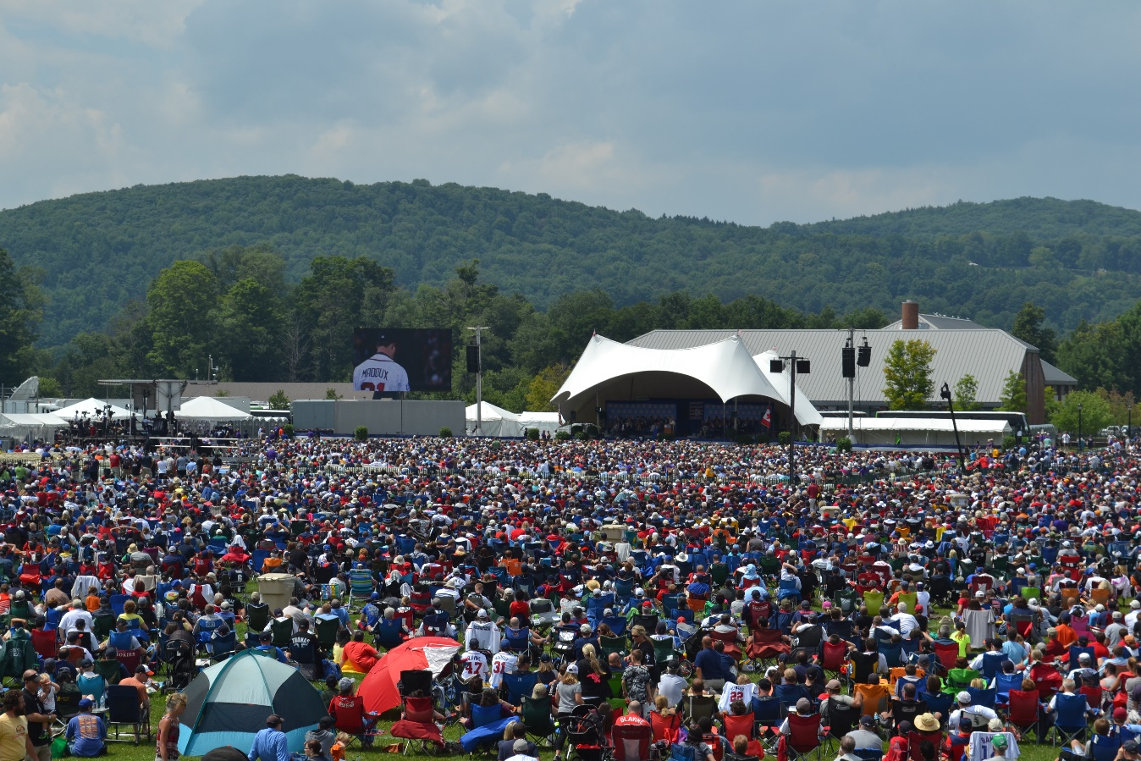
Baseball Hall of Fame Induction

Slide 14

Grand Central Terminal

Slide 15
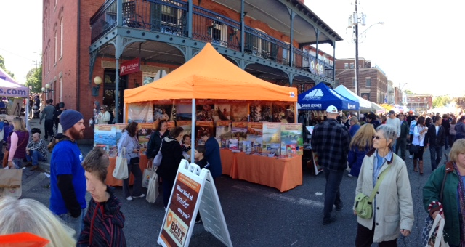
Warwick Apple Fest, Warwick, NY

Slide 16
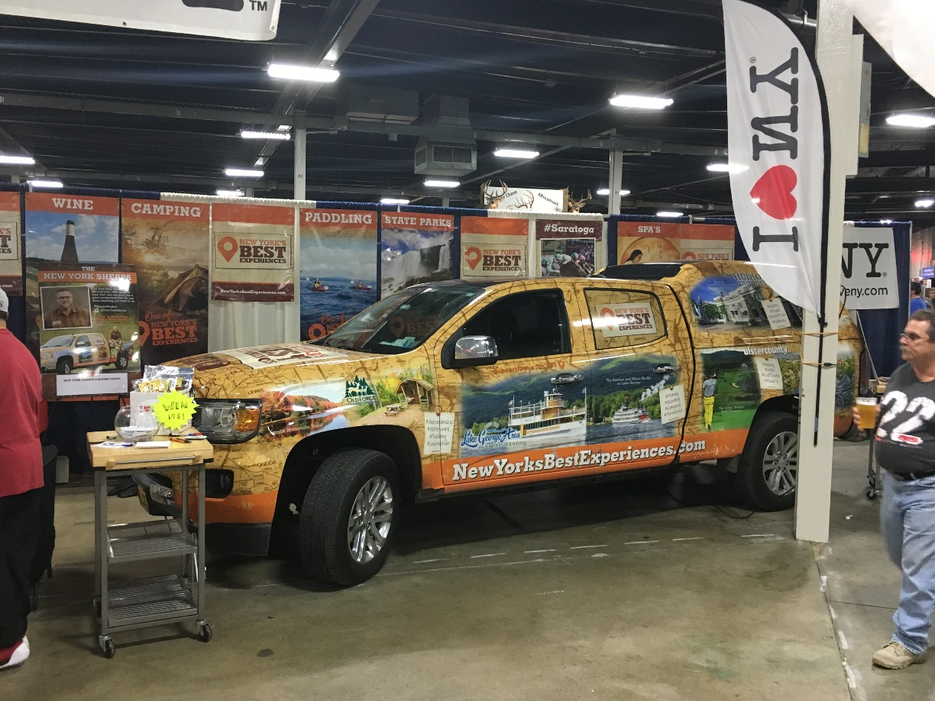
Sherpa Mobile

Slide 17


New York’s Best Experiences Travel Guide

Slide 18
Humans are the best app

Slide 19
Sliver of the pie must be people

Slide 20
Brand Advocacy
PR Value

Slide 21
3rd Party Credibility

Slide 23
Lake George Details
Lake George = Adirondacks
Cooperstown, Niagara Falls, Lake George

Slide 24
3
Lake Georges
1 Mile South
1 Mile north
Boaters

Slide 25
How are we performing?

Slide 26
25% of the cost (or less)
500-600k live impressions
3,000-4,000 guides

Slide 28
Hi Josiah,
It was a pleasure meeting with you at the Philadelphia Travel and Adventure Show. Last year your group told us about the Lake George area and based on your group and the information we went there for vacation in July 2016. We loved it! It was perfect for our family trip. We have been fortunate to travel all over the world but I never realized how much was so close to Philadelphia. This year I specifically looked for your group when I attended the show this past Saturday. After talking with you and your staff at the booth I think we will be visiting Corning and the Finger Lakes this summer. Thank you again for your help and suggestions.
Regards,
Jackie Gerhart
Wynnewood, PA

Slide 29
Lake George Details
Take what we do into your marketing
Talk about them
“Something for everyone”?

Slide 30
Instagram
@NewYorkSherpa

