Slide 1
Warren County EDC and LDC Update 23 Aug 2021

Slide 2
EDC Update Topics
Broadband Updates and NTIA Grant Process
Housing Workgroup Updates and Next Steps
Business Activity Update
Ed Bartholomew Memorial Fund and Tournament

Slide 3
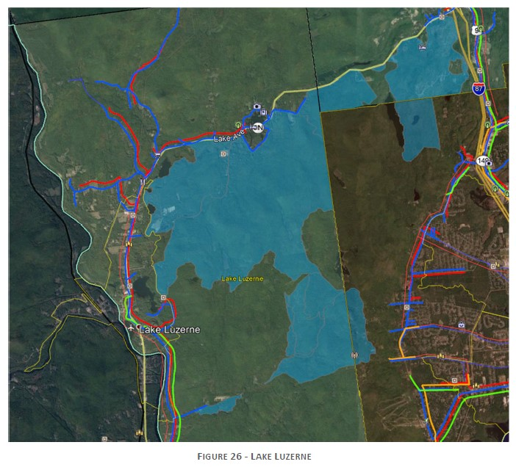
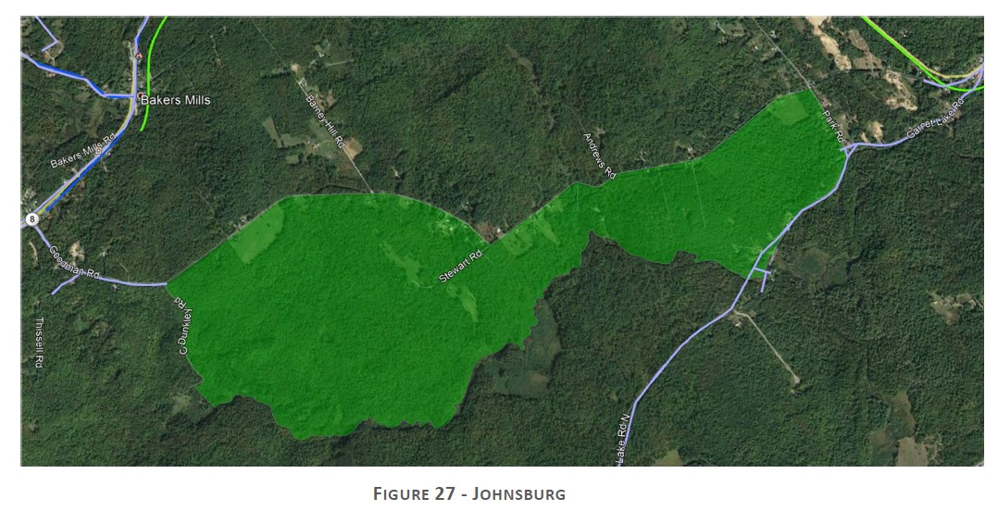
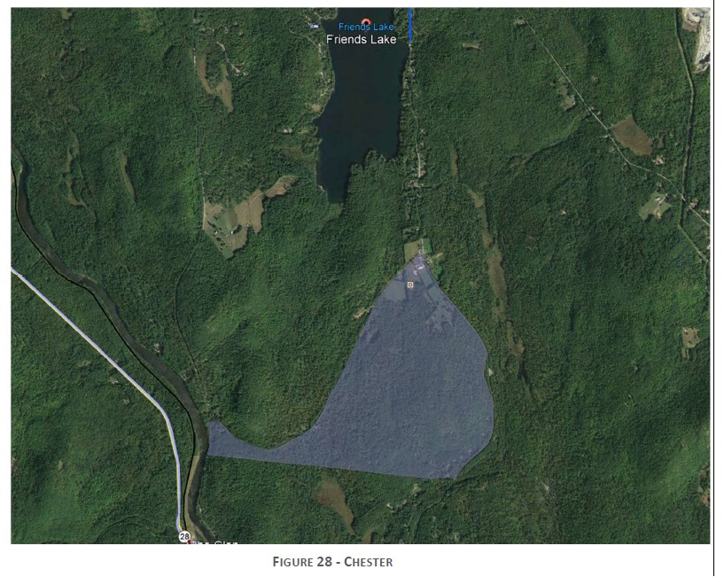
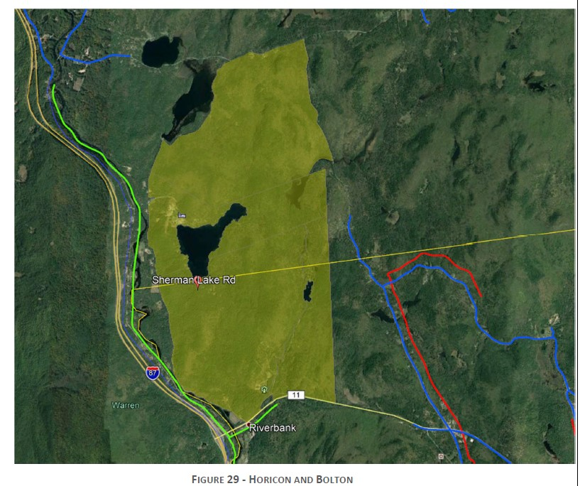
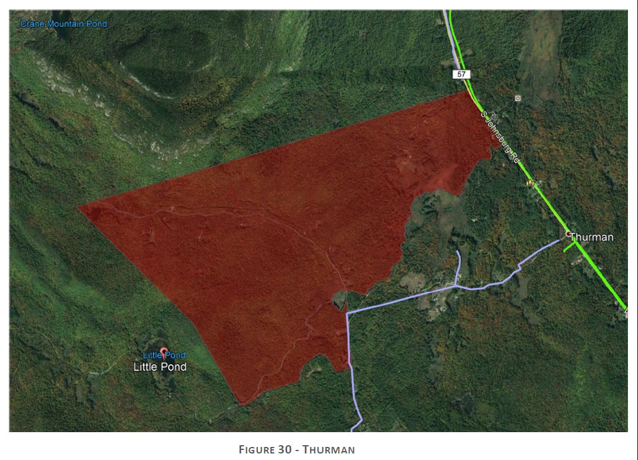
Five Areas Identified to address most of the estimated 600 addresses
unserved in Warren County

Slide 4
Housing Working Group
Why housing?
Housing as been identified as a fundamental economic driver and key to economic development in our region (EDC/Roost Survey)
What are we currently working on?
We are working with a small group of people with backgrounds in different areas involving housing to collect and analyze data to better understand the housing shortage and the economic impact of that shortage.
What is the next step?
The next step is to use the data to better inform the players in housing development (builders, regulators, banks etc.)
First step was August 18th where Dr. Yun, the lead economist for the Nation Association of Realtors, shared national data and help with context on our local data
Second Step will be a follow-on session to include a broader audience around rental market and pipeline for area in terms of all housing stock
EDC will also host its Planning Conference this fall with local data, discussions on related topics such as short term rentals, zoning best practices, other case studies on increasing supply
What is the end goal?
The end goal is to better educate the public on what is driving housing supply, prices, demand, the overall impact of housing on the local economy and best practices for dealing with housing issues.

Slide 5
Housing Supply (Price) Including 500K+

Slide 6
Housing Supply (Price) <500,000

Slide 7
Housing Supply (Price) <350,000

Slide 8
Business Support and Opportunity
Business Support/Opportunity
Updated list total of over 90 active projects/inquiries
Key new prospects include potential regional economic development project, expansion of local manufacturing and distribution facility

Slide 9
WC LDC Update
First Half 2021 activity
Return to full payment for majority of loan portfolio from pandemic interest only
Full payment by one loan with plan to complete a second
Settlement being finalized with one loan in delinquency
Developing potential new loan targets including material cost and supply chain related support
Working on Governance and organizational enhancements

