Slide 1

Tourism Committee Meeting January 25, 2022
Warren County Tourism Department
Notes:
Welcome

Slide 2
2021 Key Performance Indicators
Smith Trend Hotel Demand
AirDNA Short-Term Rental Demand
Occupancy Tax Collections
Website Analytics
Mobile Tracking Data
Email Marketing
Social Media Analytics
Notes:
Welcome

Slide 3

Smith Trend Hotel Analytics
2019 Demand = 1,034,734
2020 Demand = 760,359
2021 Demand = 1,037,416
Demand = Number of Rooms Sold
Notes:
Warren County is back on par with 2019 hotel demand, once again eclipsing 1 million rooms sold. Demand was steadily increasing before COVID, and was back on track in 2021.
2019 Supply = 1,962,594 2020 Supply = 2,004,015 2021 Supply = 2,032,337
Supply = Number of Rooms Available

Slide 4
Smith Trend Hotel Analytics
2019 ADR = 152.79
2020 ADR = 154.59
2021 ADR = 173.58
ADR= Average Daily Rate
Notes:
While demand is back on par with 2019, ADR has increased significantly, which influences revenue – next slide.

Slide 5
Smith Trend Hotel Analytics
2019 Revenue = $158,094,877
2020 Revenue = $117,543,051
2021 Revenue = $180,070,444
Notes:
Increase can be attributed to high ADR. Guests were willing to a higher room rate. The challenge next year could be maintaining the 2021 ARD.

Slide 6

Short-Term Rental Analytics
2019 Demand = 88,500
2020 Demand = 122,300
2021 Demand = 163,600
Demand = Reservation Days
Notes:
Self explanatory . . .
2019 Supply = 209,200 2020 Supply = 162,400 2021 Supply = 175,800
Supply = Available Days

Slide 7
Short-Term Rental Analytics
2019 ADR = $326
2020 ADR = $341
2021 ADR = $395
ADR = Average Daily Rate
Notes:
Both hotel and short term rental ARD increasing. NOTE: Short term rentals are 90% entire homes and can command a higher rate

Slide 8
Short-Term Rental Analytics
2019 Revenue = $28.6 million
2020 Revenue = $40.8 million
2021 Revenue = $63.2 million
Revenue = Booking price + cleaning fees
Notes:
Not all of this revenue can be considered Occupancy tax-able – not cleaning fees, is my understanding. Maybe Mike Swan can tell the committee about short-term rental occ tax collections!!!

Slide 9
Occupancy Tax Collections
2017 $4,331,907.90
2018 $4,510,948.31
2019 $4,864,331.73
$4,119,370.34
$6,447,612.97
2021 Collections Continue Through March 31, 2022
Notes:
Self-explanatory ☺ But collections still coming in through MARCH 31!!!!!

Slide 10
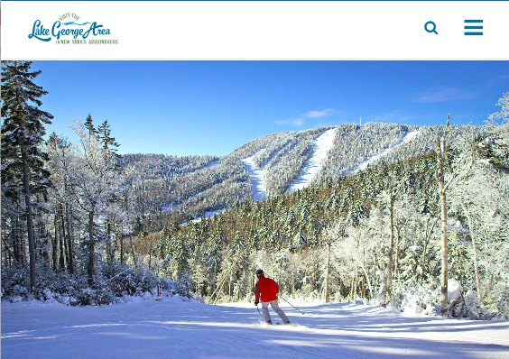
Website Analytics VisitLakeGeorge.com
Visitor Sessions:
2017 1,068,745
1,370,329
2019 1,853,801
1,883,609
2,558,715
Notes:
Website sessions are defined as a series of contiguous actions by a visitor on an individual website within a given time frame. Visits to website driven by google ad words, organic social media, paid digital (Workshop) and social media (Workshop and Kacey)

Slide 11
Website Analytics Visitor Origin
New York State 63% of sessions
New Jersey 11%
Connecticut 5.5%
Massachusetts 5.4%
Pennsylvania 4.6%
Notes:
Within New York State, primarily New York City DMA (Designated Marketing Area) NY City, Long Island, Hudson Valley, NJ, CT.
Followed by Capital District corridor (I-87), then western NY (I-90) corridor. Beyond that, ask Joanne for breakdown.

Slide 12
Website Analytics
Mobile = 77%
Desktop = 19%
Tablet = 4.5%
Users
Female = 57%
Male = 43%
Age: Evenly split 25-55 years at 20% per 10-year age group 10% 18-24 and 10% 65+
Notes:
Self-explanatory. Note: Our website is mobile-first design, for ease of using on smart phones! (If anyone asks: New site will be, also. (Launch spring)

Slide 13
Website Analytics Top Pages Visited
Home page
Top Attractions
Ice Castles
Things to do
Factory outlets
Events
Revolution Rail
Balloon Festival
Notes:
Welcome

Slide 14
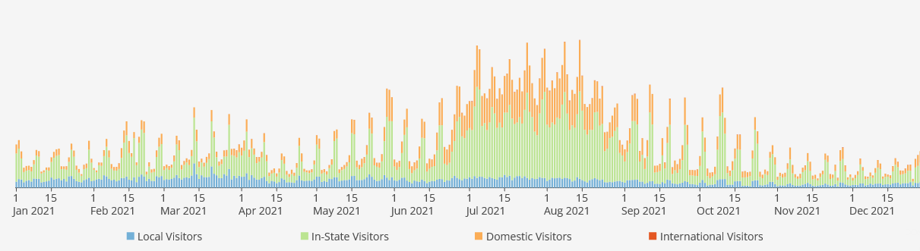
Mobile Tracking Data
Notes:
Dashboard view of visits in 2021. This is measured by cell phones that are actually in Warren County. It does not measure EVERY person visiting, but we understand this is comparable to high level confidence survey results, because these people were actually here!!! Obviously summer and weekend spikes.

Slide 15
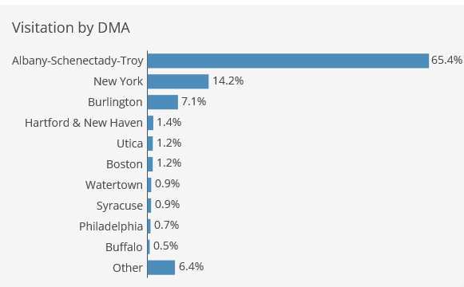
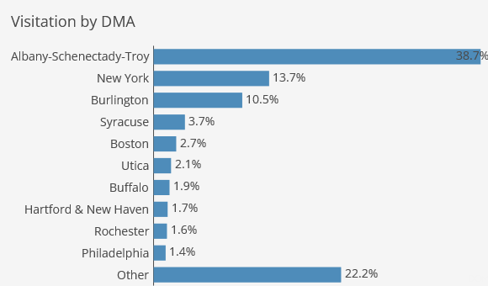
Mobile Tracking Data
Great Escape
Glens Falls
Notes:
We would like to share a snapshot with each community so they can see what their markets are. You can imagine that North Creek may differ from Glens Falls. Great Escape PI and Glens Falls shown as an example. Ask Joanne for more detail or stop in the office for a demo?

Slide 16
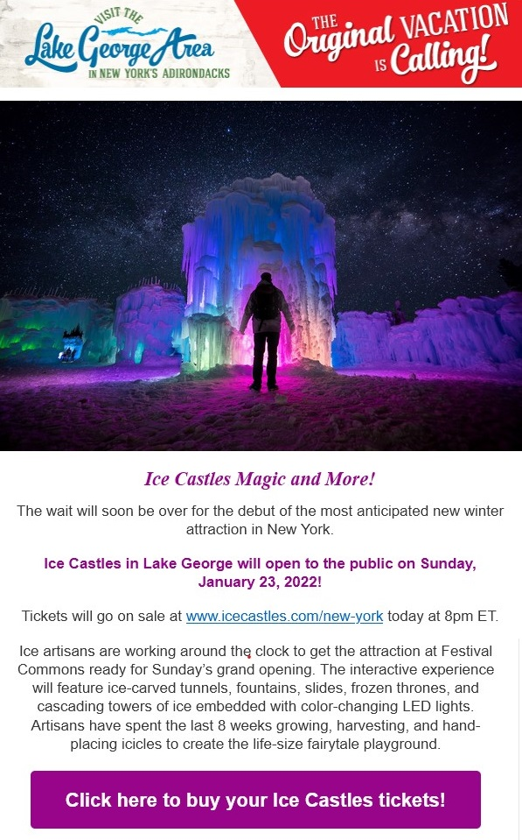
2021 Email Marketing
E Blast Campaign: Monthly email delivered to Opt-In list includes timely blogs, upcoming events and relevant tourism information with helpful links to our website and elsewhere for readers to easily get the information they want.
Emails Delivered: 455,703
Emails Opened: 115,495
Click Throughs: 10,002
Notes:
Above industry open and click thru rates. . . . More detail, ask Joanne ☺

Slide 17
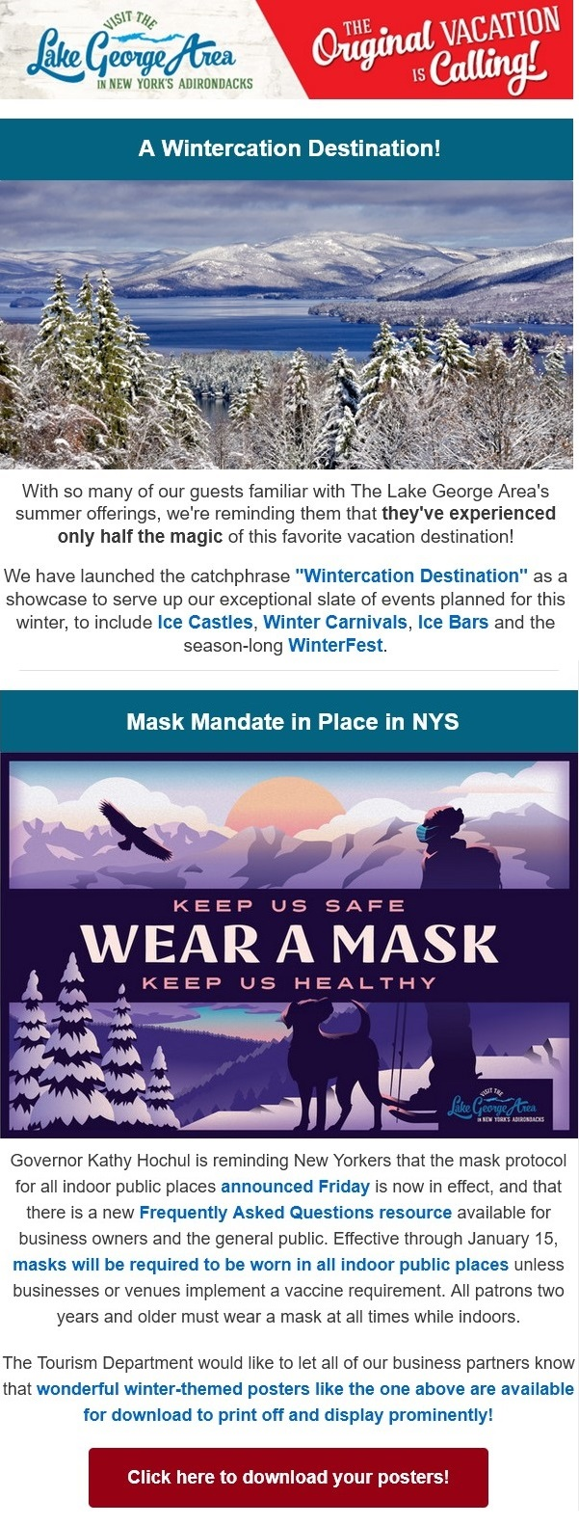
2021 Newsletter Marketing
Newsletter Campaign: Email delivered monthly and on a “breaking news” basis to our Comprehensive Tourism Business List, Warren County officials, state representatives, tourism leaders and local stakeholders reporting important current tourism-related information. This is designed to keep businesses well informed so that they can assist their guests and customers to the furthest extent possible.
Emails Delivered: 15,077
Emails Opened: 3,937
Click Throughs: 561
Notes:
Remind supervisors to open their email newsletters from us ☺

Slide 18

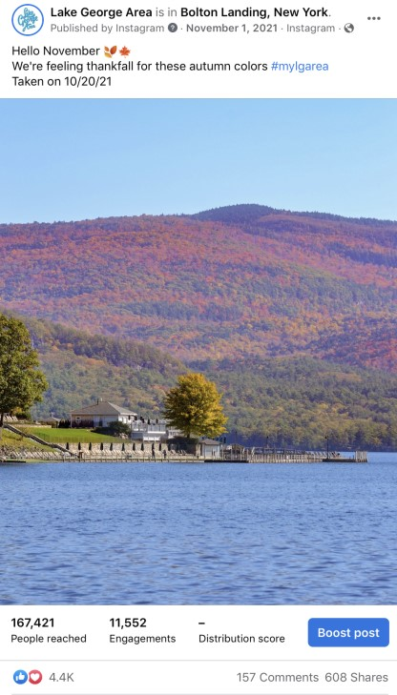
Facebook
Current number of followers: 363,055
Top Organic Post: Hello November
4,477 Likes
157 Comments
Largely Female Audience split between Boomers and Millennials
Notes:
Joanne can provide comparison to other destinations. A few: Visit Adirondacks 114,000; Lake Placid 82,000; I Love New York 1.4m. A few more on Slide 25.

Slide 19
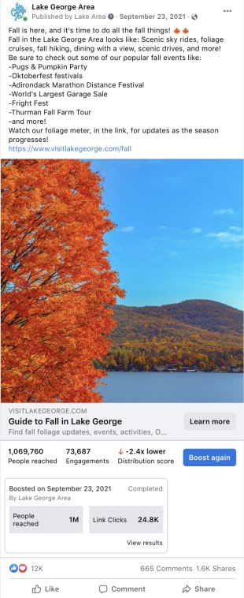
Facebook
Current number of followers: 363,055
Top Boosted Post: Fall is here!
12,834 Likes
25,126 Link Clicks
1,042,431 Paid Reach
Notes:
Reach = The number of people who SAW our content!!! Over a MILLION on this ONE post.

Slide 20

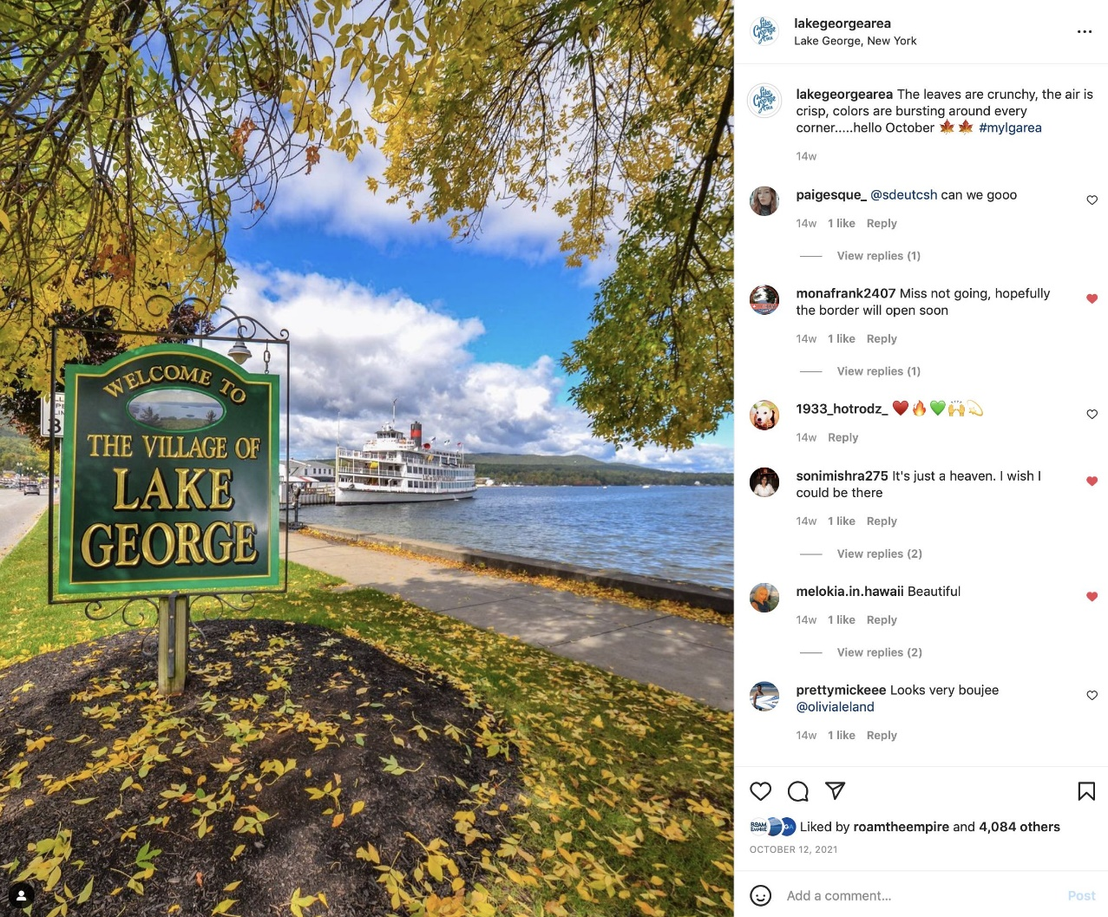
Instagram
Current number of followers: 40,608 (exceeded 40K goal)
Top Instagram Post:
Lake George Welcome Sign
4,084 Likes
Most Liked Post
Largely Female Millennial Audience
Notes:
Welcome

Slide 21
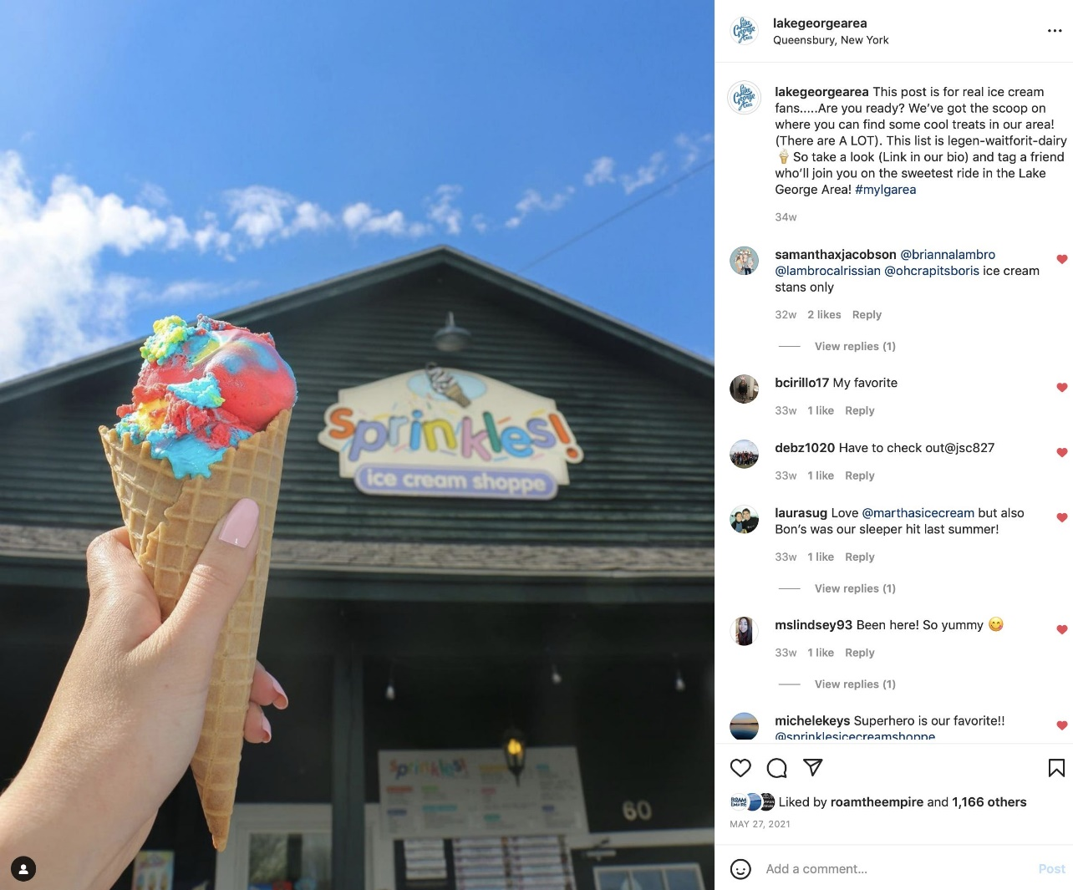
Instagram
Current number of followers: 40,608 (exceeded 40K goal)
Top Instagram Post:
Ice Cream Blog/ Sprinkles
235 Profile Visits
1,166 Likes
97 Link Clicks
Notes:
Ice Cream Blog covers shops throughout Warren County!!!

Slide 22
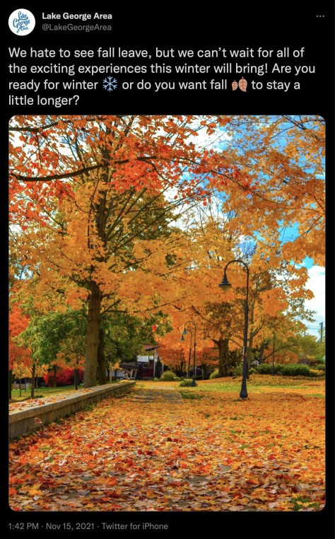

Twitter
Current number of followers:
3,109
Profile Visits in 2021: 18,421
Current Followers: 3,109
Most Popular Tweet (right) earned 2,209 Impressions
Notes:
Welcome

Slide 23

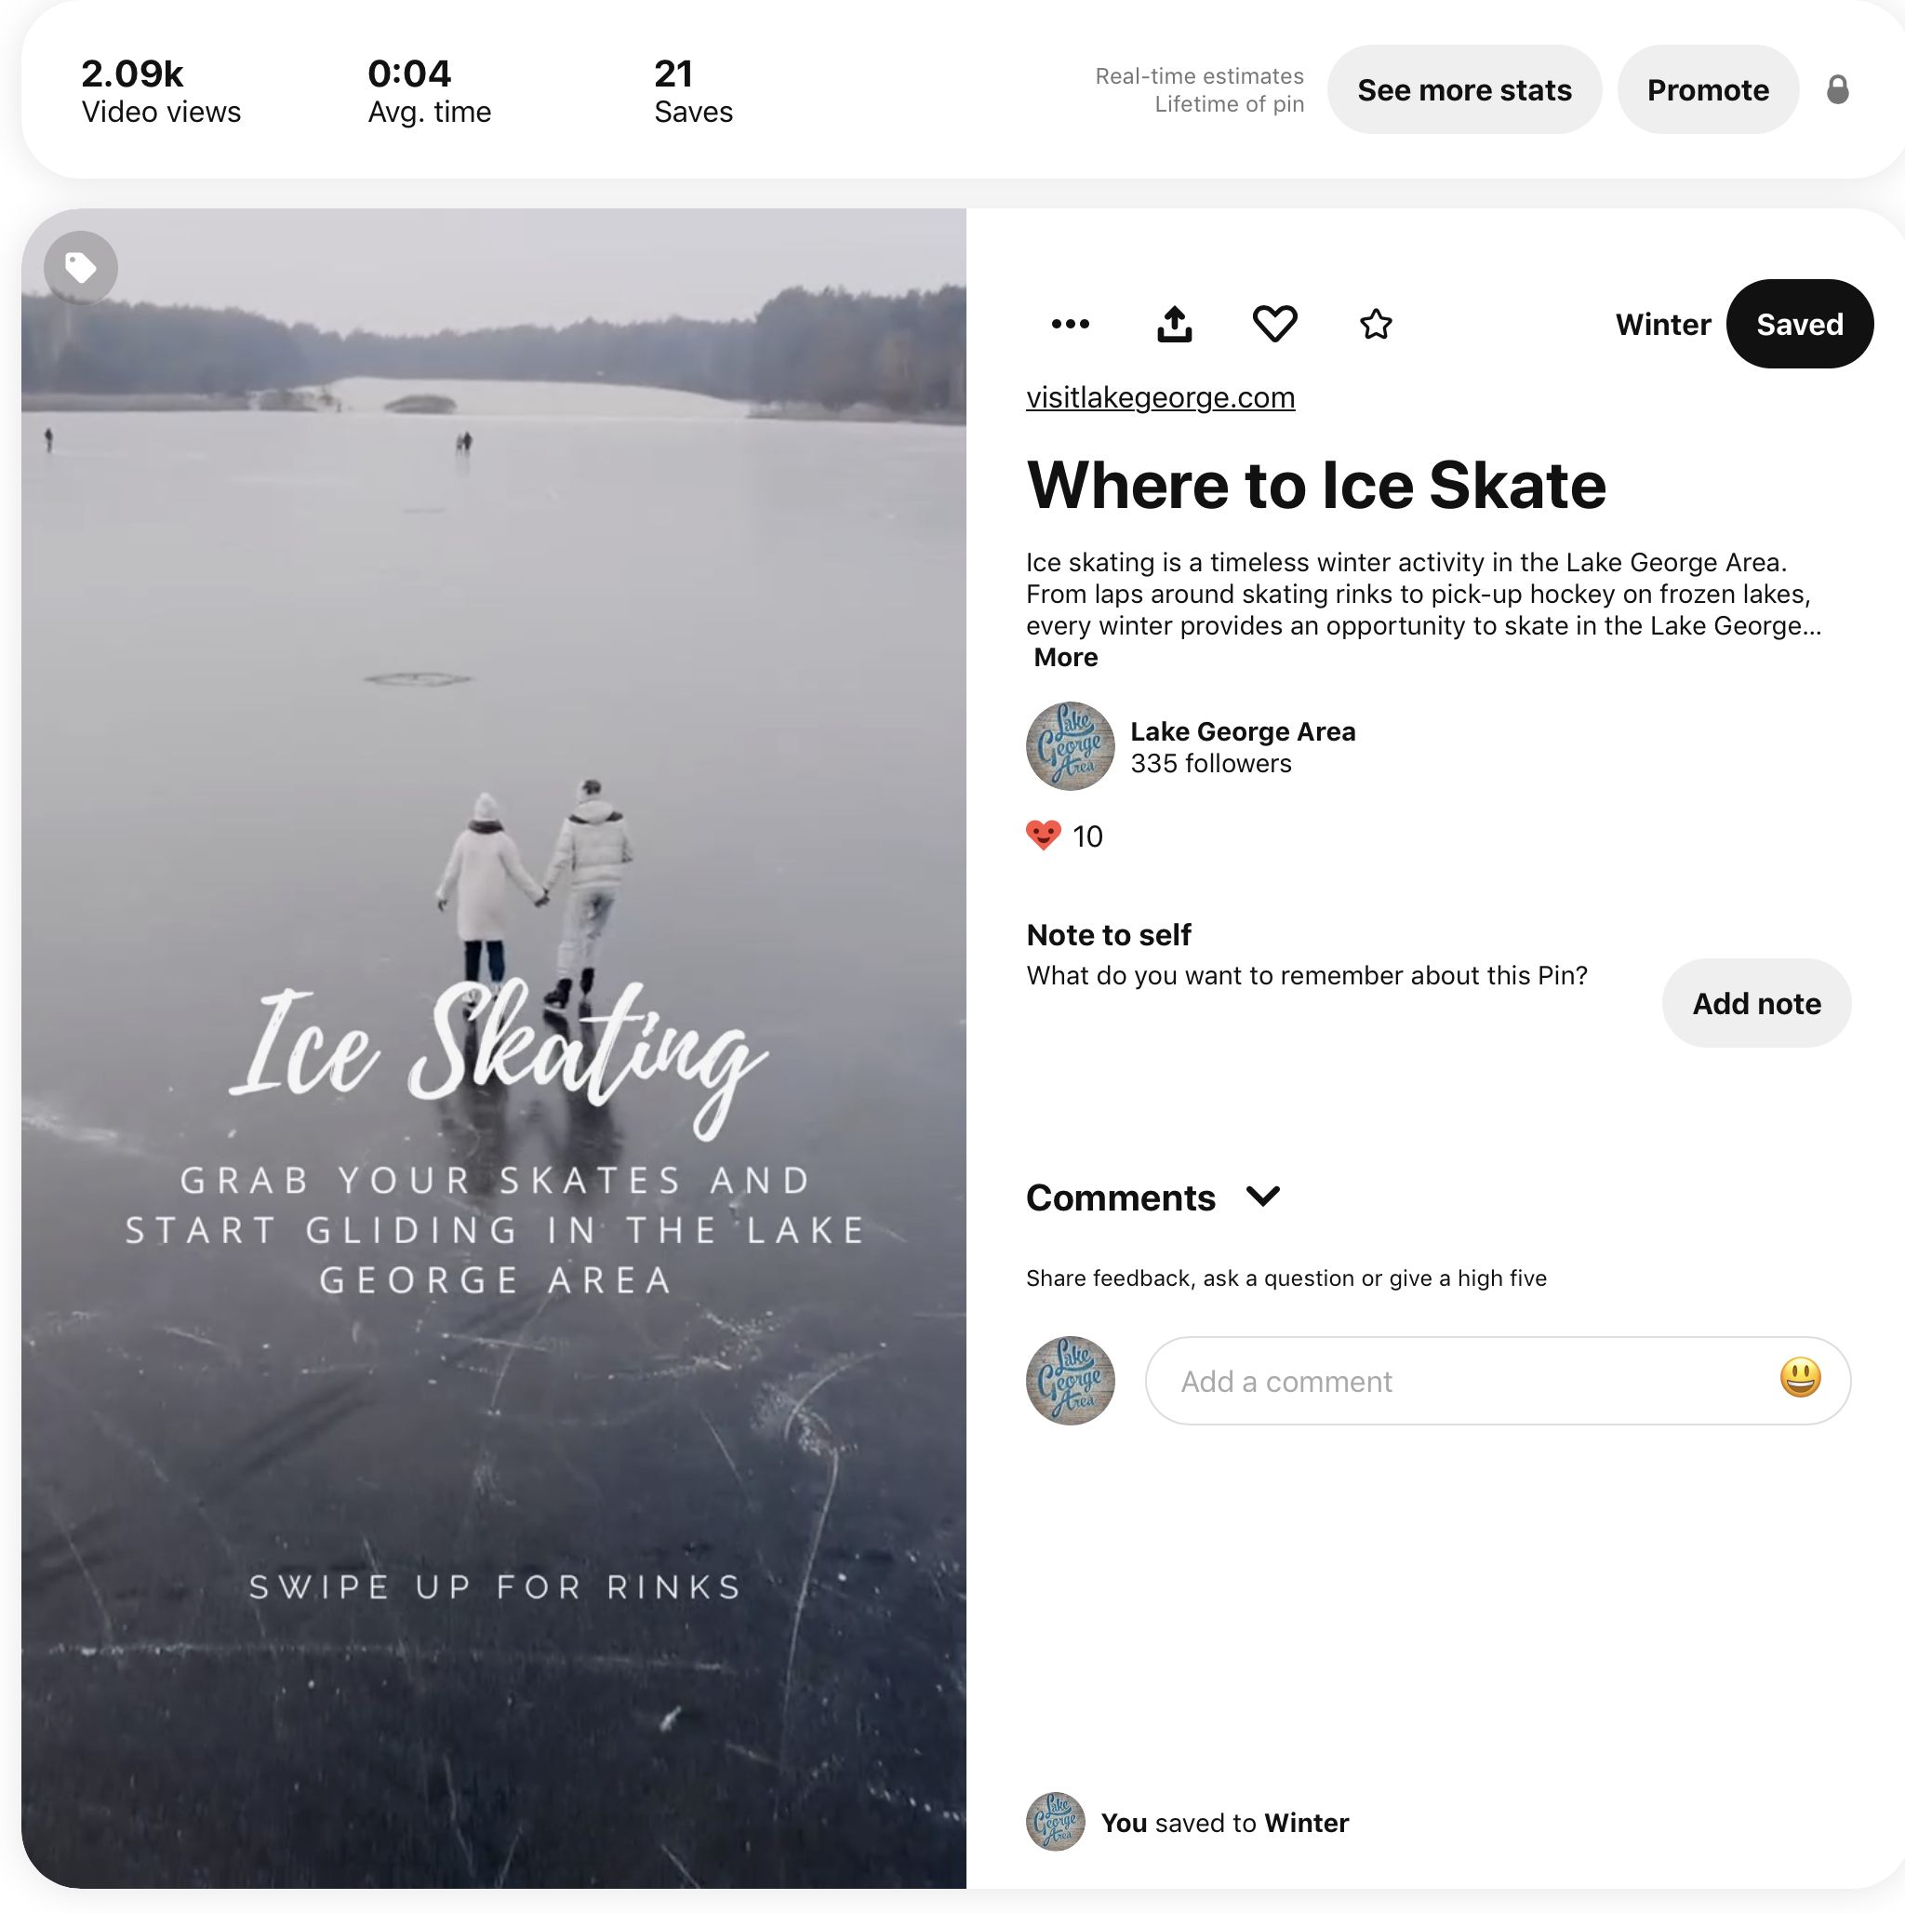
Pinterest
Followers: 335
Impressions in 2021: 250,280
Engagements (including clicks and saves): 8,630
Engaged Audiences (number of Pinners who engaged with our pins): 5,750
Total Audiences (total number of Pinners who have seen or engaged with our pins): 176,150
Notes:
Reach. Reach is the number of people who saw your content on social media. ...
Impressions. Impressions is the number of times your post has been seen, regardless if a link was clicked or not.
Engagements are when people perform actions on your content, whether it be that they like, comment, and/or share your posts.

Slide 24

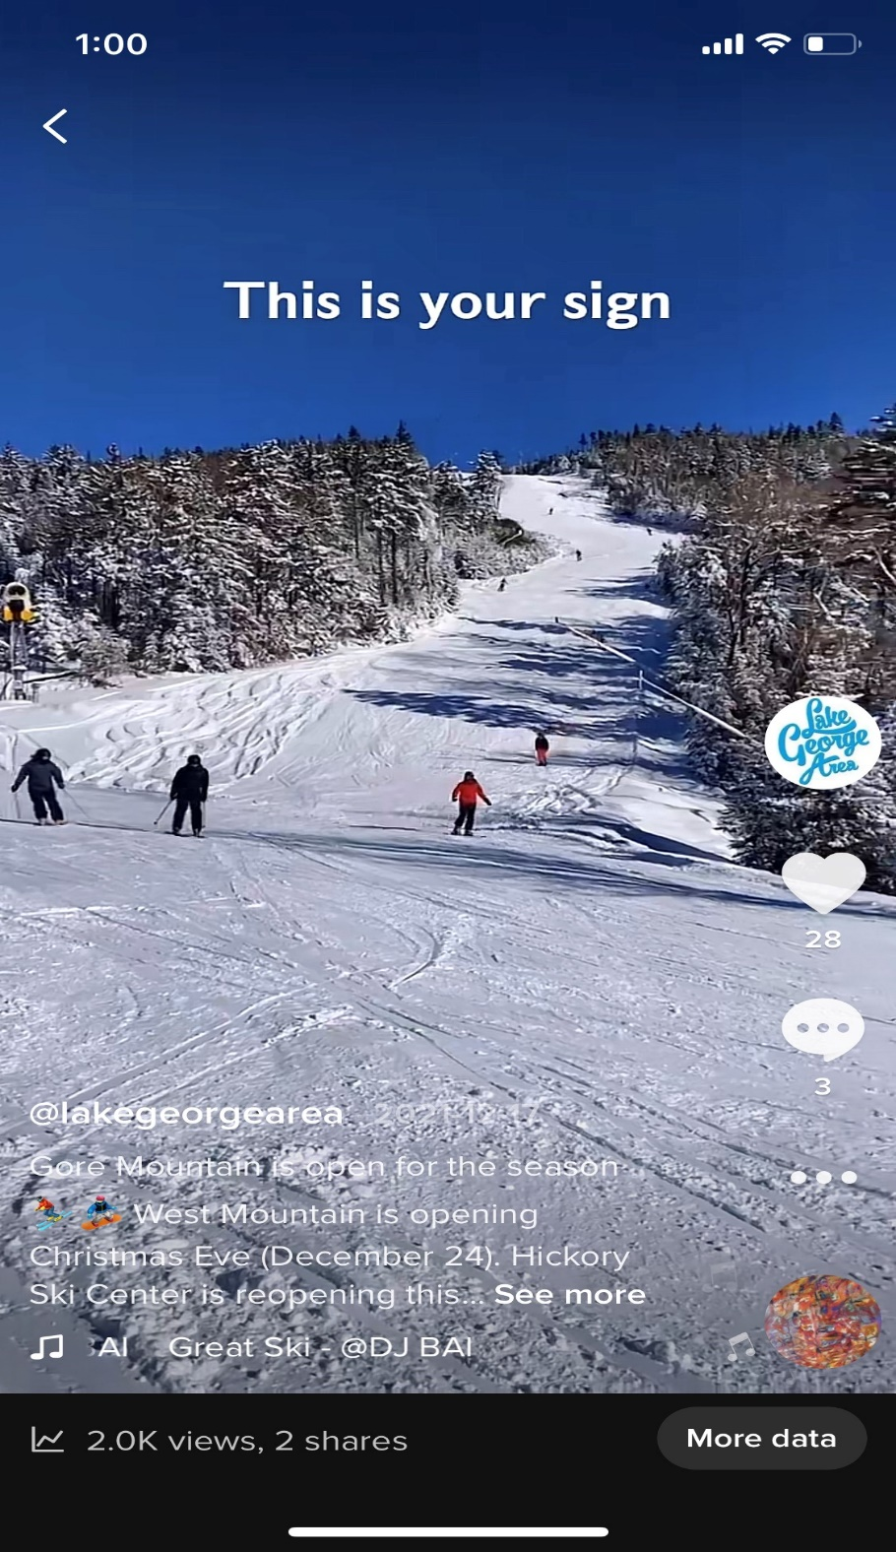
TikTok
Although we’re just beginning to use this platform, videos have reached audiences in Australia, Canada, Netherlands and the United Kingdom
Top TikToks:
This is Your Sign to Ski in the Lake George Area
Most Views: 1,992
Largest Reached Audience: 2,460
What We’re Looking Forward to This Winter
Most Likes: 64
Most Shares: 10
Notes:
Welcome

Slide 25
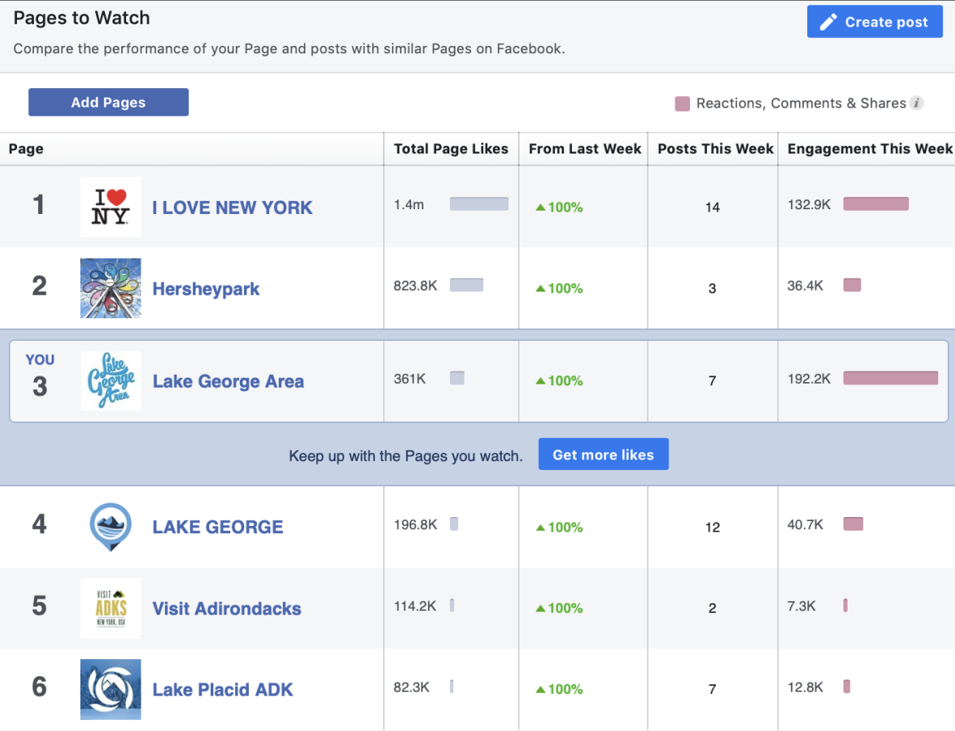
Social Media Activity
Notes:
How we fare, as compared to several competitors. Very well. The need for Community Engagement has skyrocketed. In addition to Kacey, Tanya and Maggie are answering comments and questions non-stop!!! Stop in the office and talk to Kacey about all things social media!

