Slide 1
Gina Mintzer, CMP, MHA
Executive Director
Lake George Regional Convention & Visitors Bureau

Slide 2
LGRCVB Q4 Report
Sales & Services Activities
Marketing & Advertising
Community Development – Convention Services

Slide 3
Outcomes Highlights Investment in action Q4 Budget $120,000

Slide 4

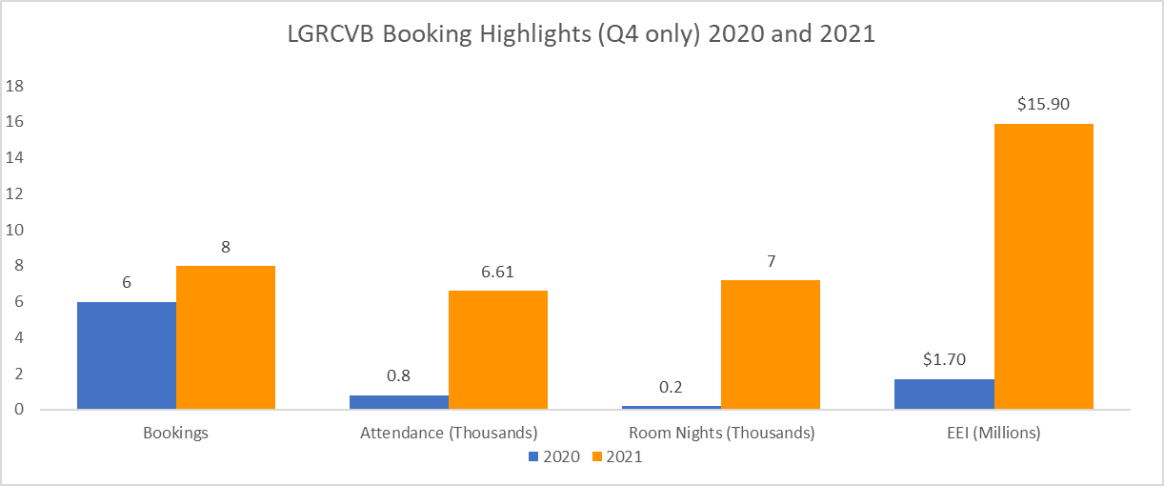

Q4 Sales 8 Bookings $15,900,000 EEI
EEI = Economic and Employment Impact

Slide 5
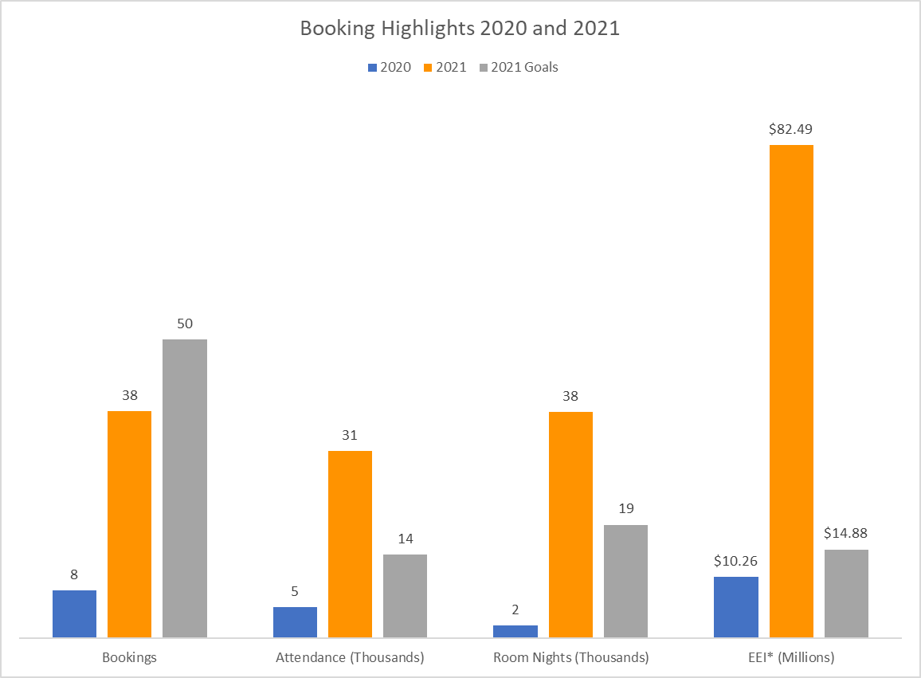
YTD Sales 38 Bookings $82,000,000 EEI

Slide 6
LGRCVB Website Traffic 18,517 Pageviews
*Note: Numbers reflected in 2021 are visitlakegeorge.com and meetlakegeorge.com (launched July 2021)

Slide 7
“In the News” LG Triathlon $123,780 Ice Castles $573,040
AVE= Advertising Value Equivalency $

Slide 8
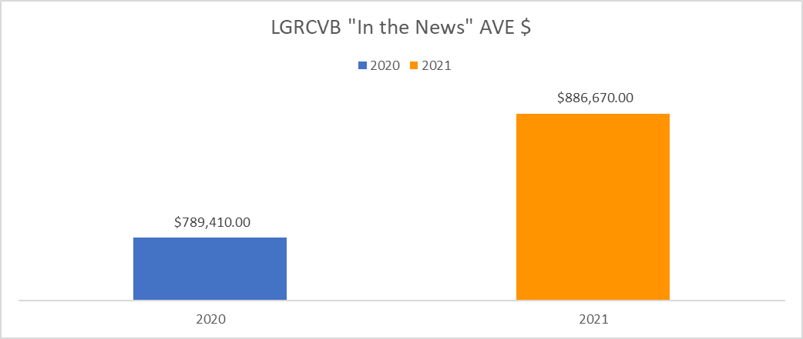
YTD “In the News” $866,670 Ad value
AVE= Advertising Value Equivalency $

Slide 9
Marketing & Advertising

Slide 10
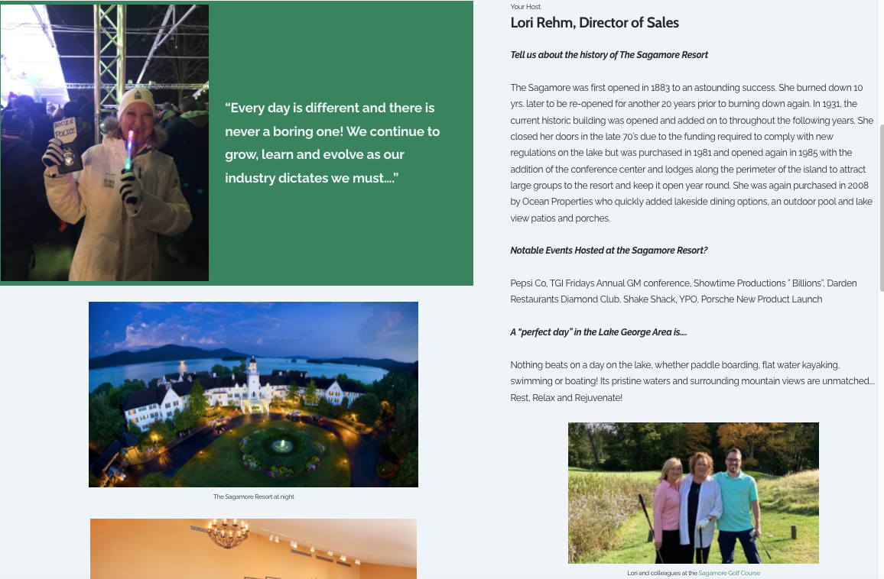
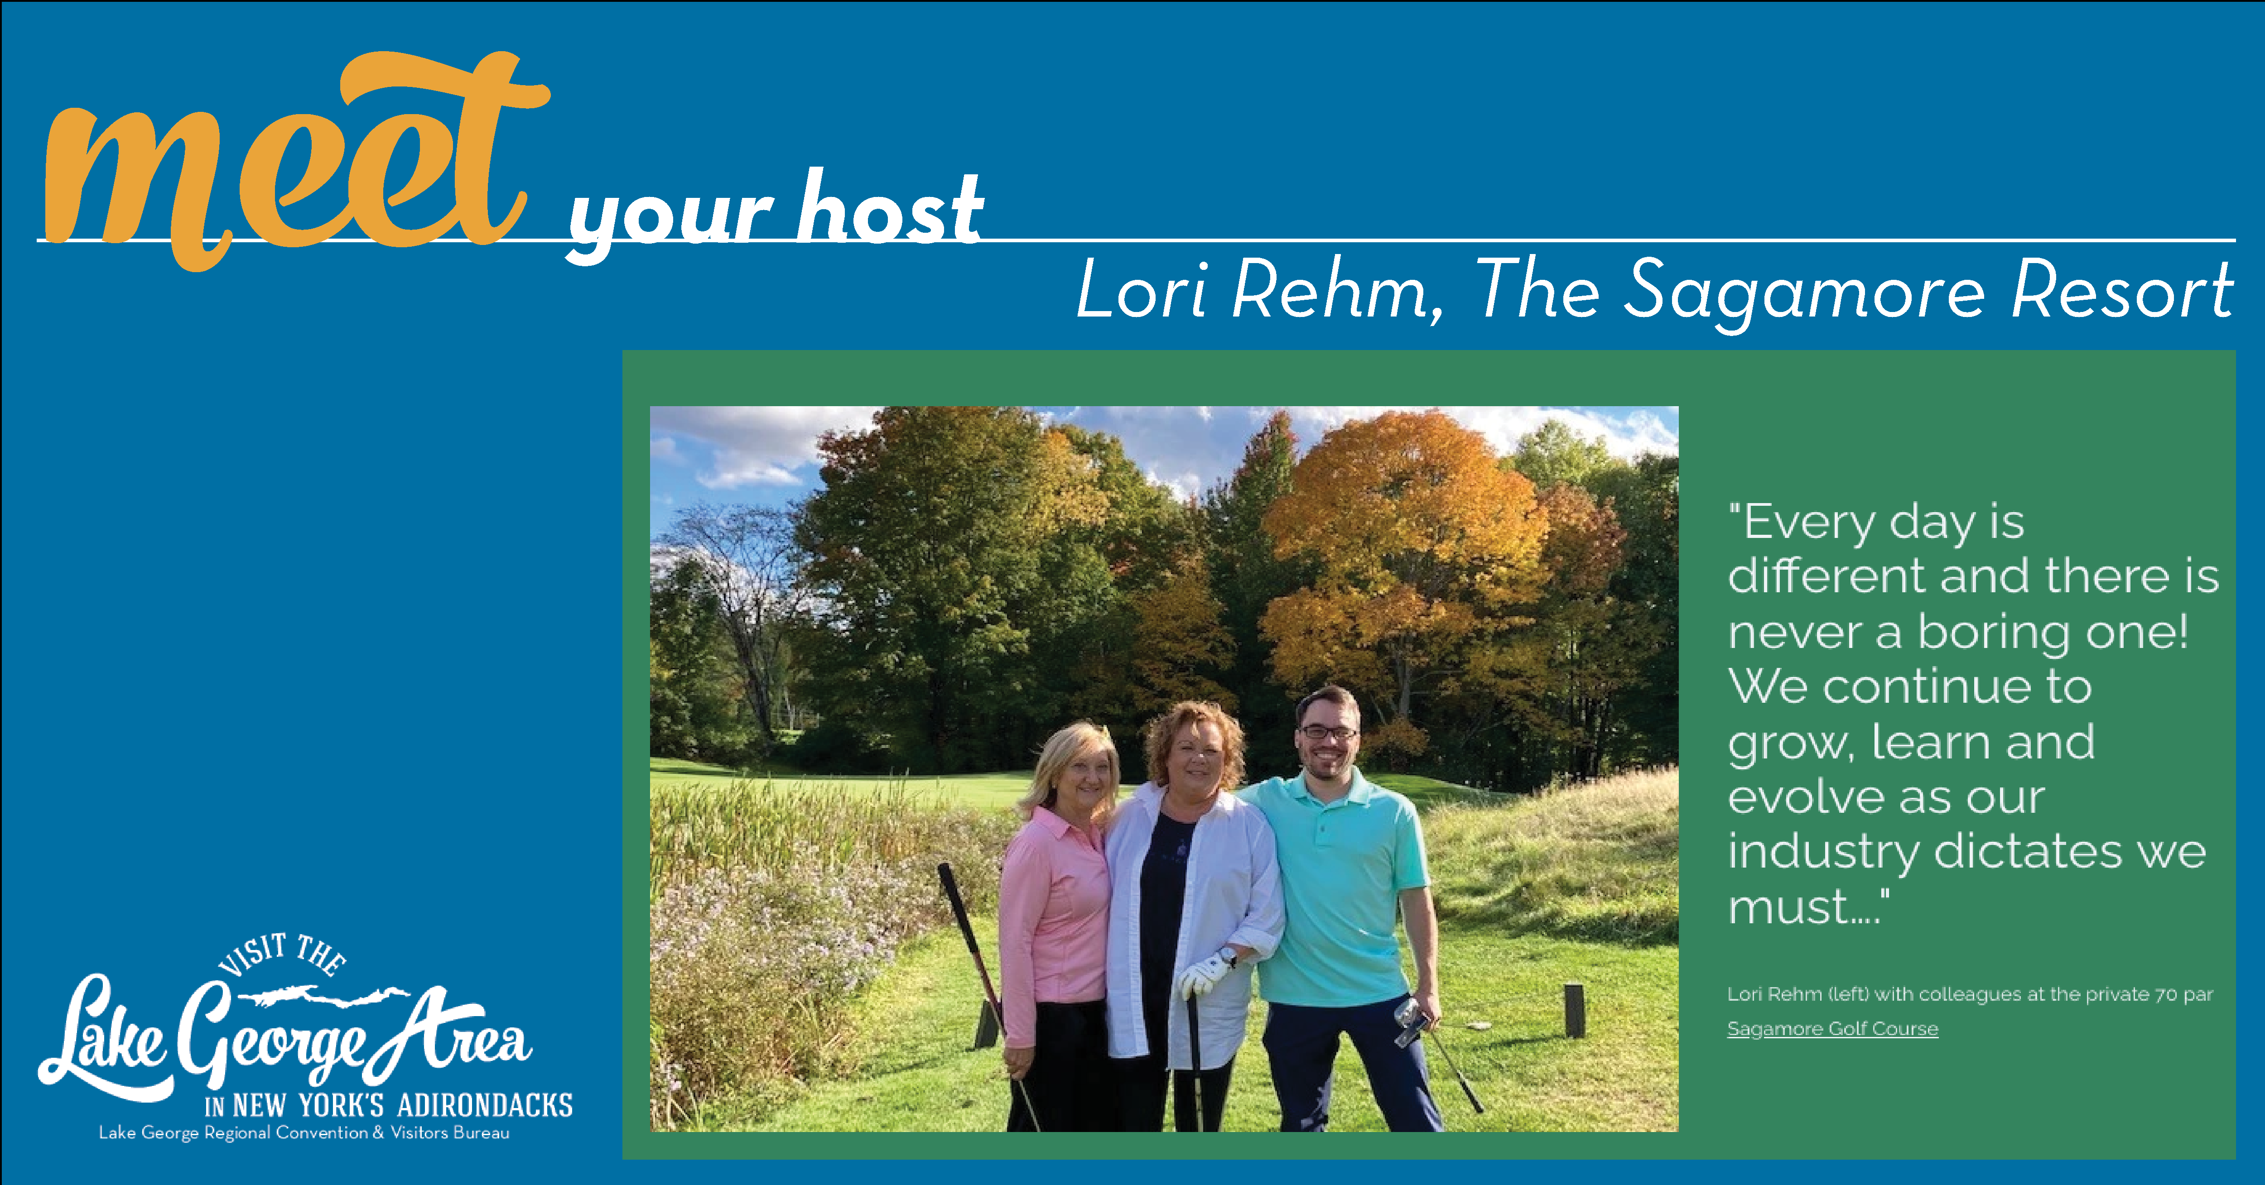
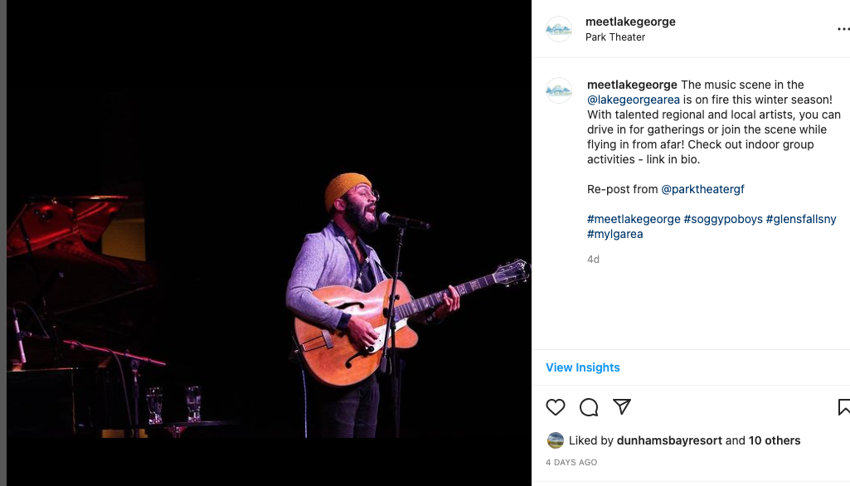
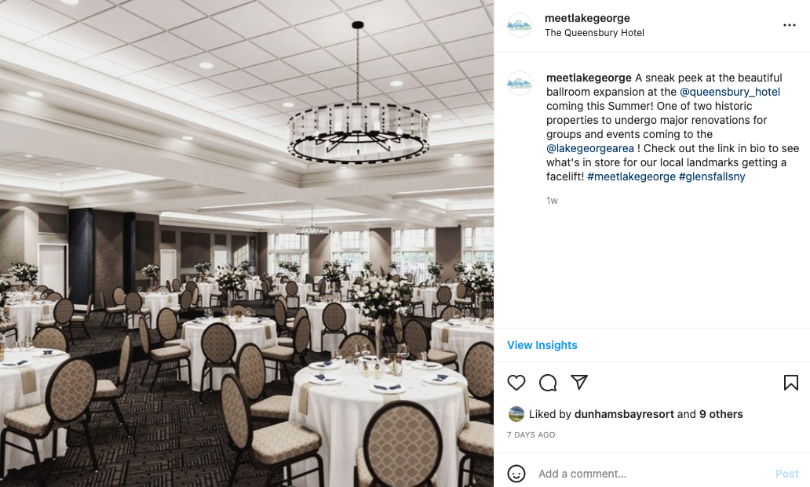
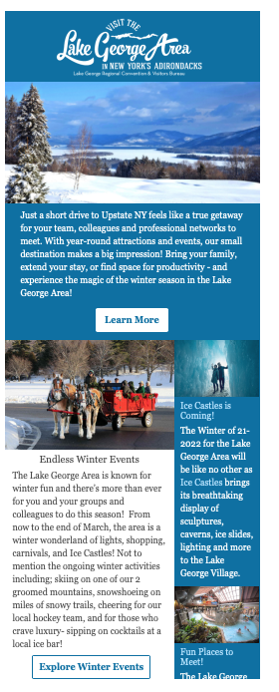
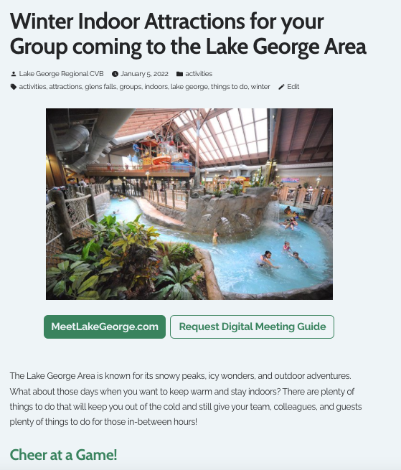
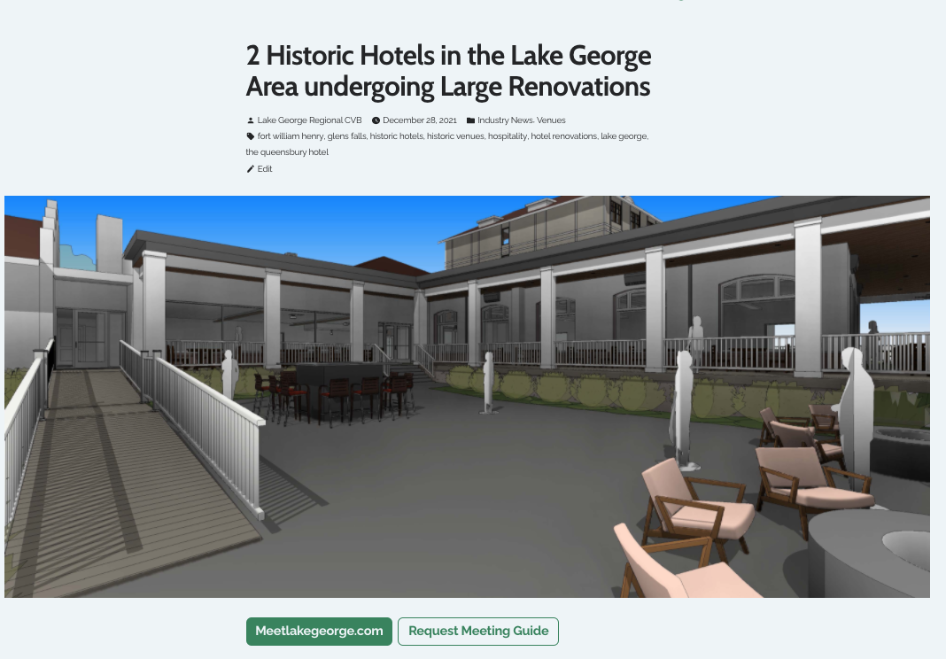
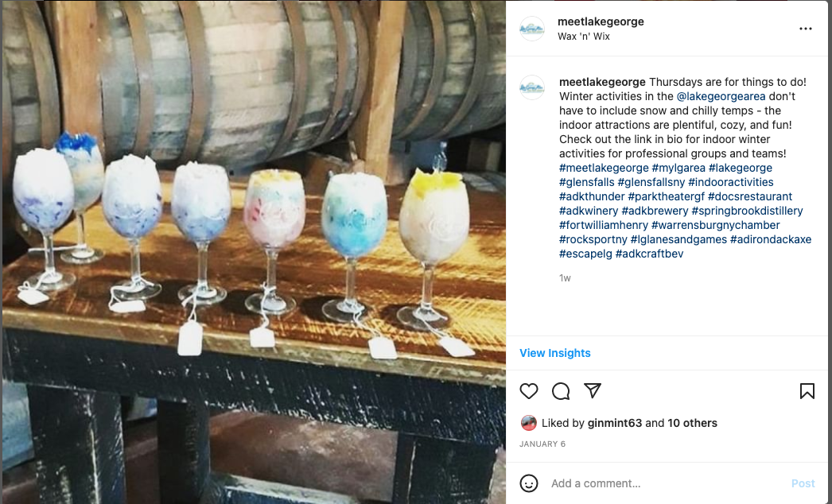
Meetings & Gatherings
Eblasts, Blogs, and Social Media – Winter Indoor Attractions/Things to do, Hotel Renovations and Meet Your Host
272,082 IMPRESSIONS

Slide 11
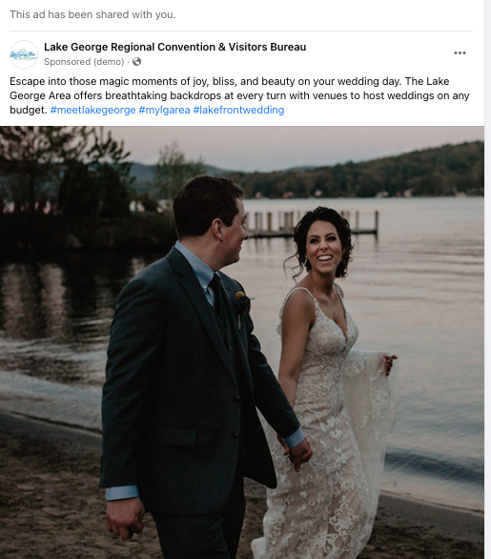

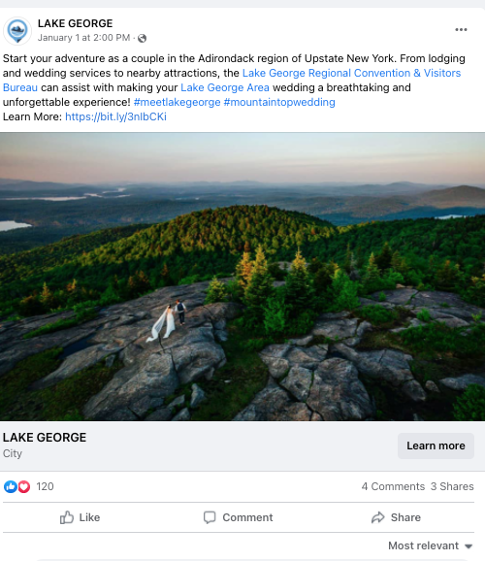
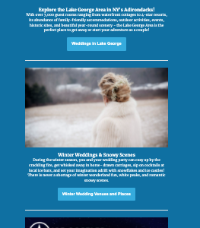
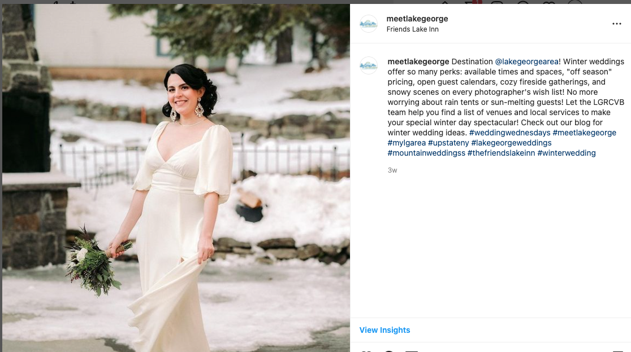
Weddings 49,668 Impressions (December)

Slide 12



Sports Website: 2700 Impressions Newsletter: 4000 sent, 25% open rate

Slide 13
Community Development

Slide 14
Community Development – Convention Services
Convention Services - Ice Castles - NYS Public High School Athletic Association-Volleyball - Winterfest
DEI Initiative
- Travel Unity Presentation
A2D Tourism Training
- 155 Trained To Date

Slide 15
Q & A

