Slide 1
Cyanobacteria, Blue Green Algae & Harmful Algal Blooms (HABs)

Slide 2
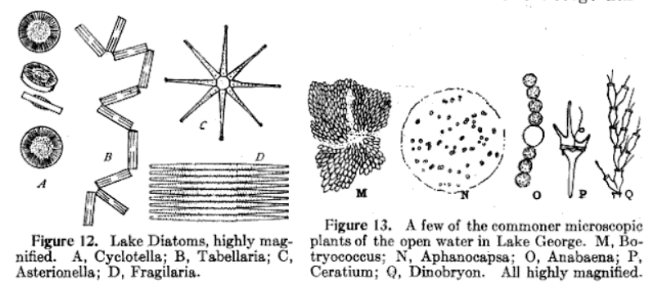
Blue Green Algae Are A Natural Occurrence
Interchangeable words: BG Algae and Cyanobacteria . Cyanobacteria being the more “correct” term.
Natural part of the phytoplankton community in the 1922 Lake George survey
“Green and Blue green algae were present in relatively small numbers”
Aphanocapsa and Microcystis
Needham et al 1922

Slide 3
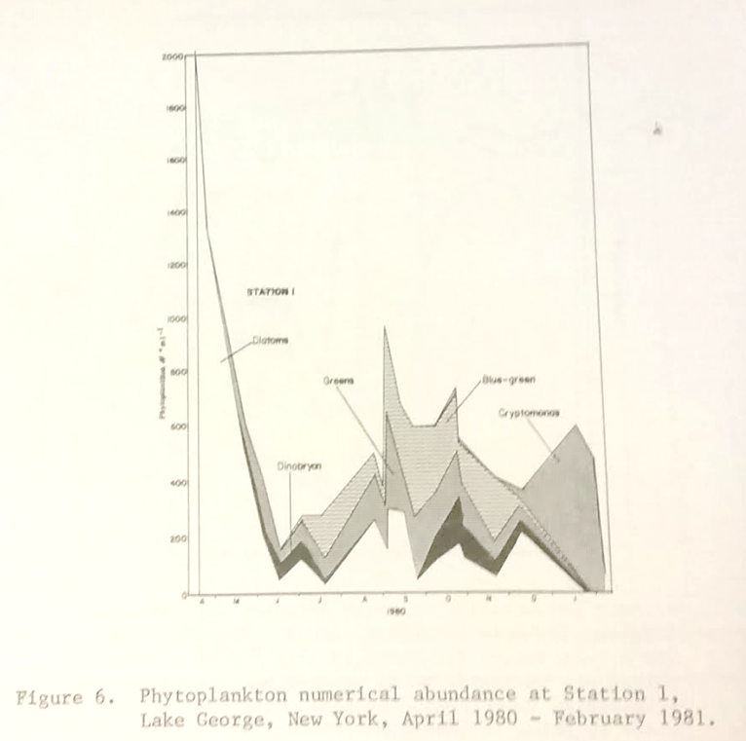
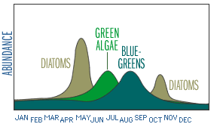
Strong Seasonal Components
Phytoplankton generally have a succession of the dominant forms throughout the Year:
Spring – Diatoms
Summer – Greens
Late Summer to Fall – Blue Greens
Winter – Cryptomonas
Siegfried et al 1986
Water on the Web

Slide 4
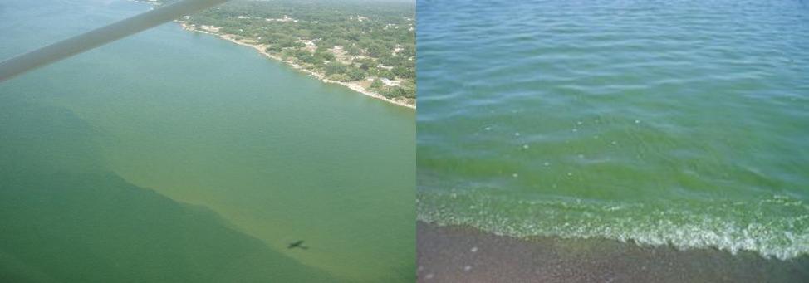
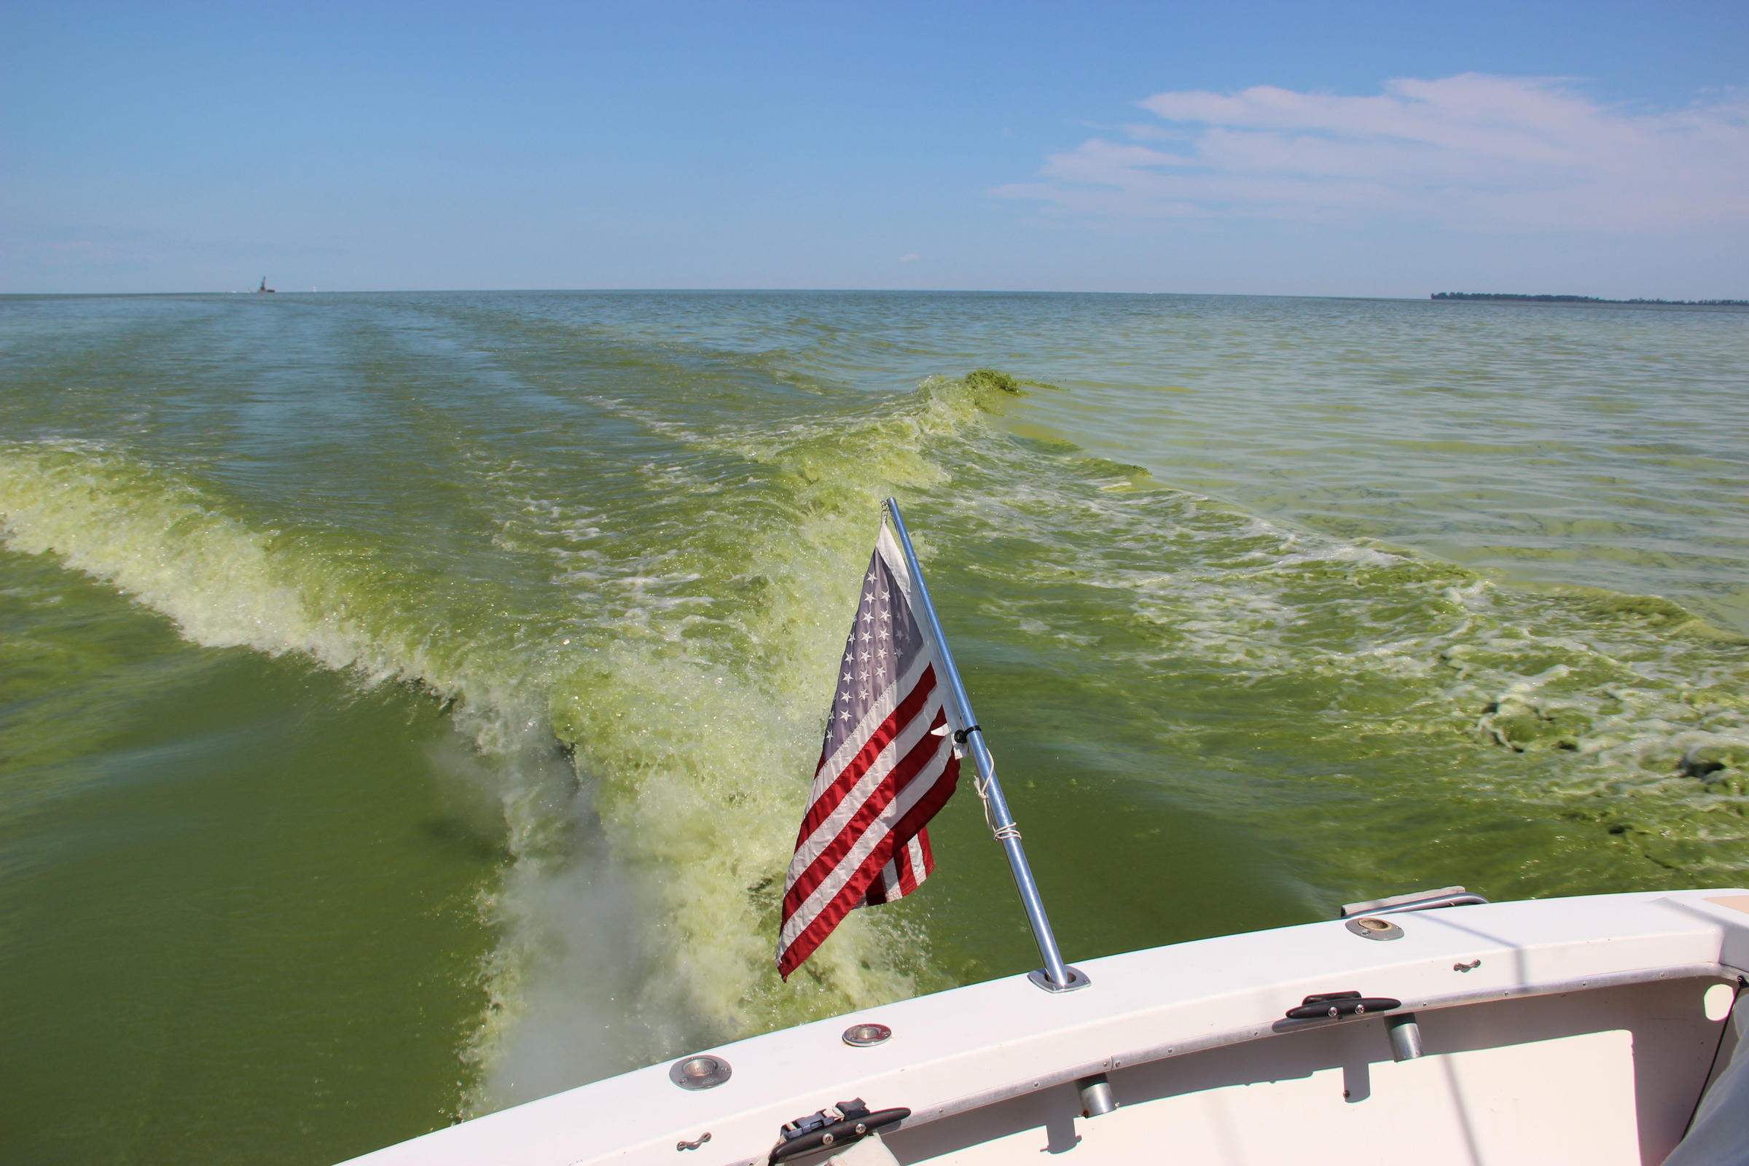
Cyanobacteria Are In A Lake Already But What Is A HAB?
Harmful algal blooms (HABs), occur when colonies of algae — simple plants that live in the sea and freshwater — grow out of control and produce toxic or harmful effects on people, fish, shellfish, marine mammals and birds. The human illnesses caused by HABs, though rare, can be debilitating or even fatal. (NOAA)
Lake County General Health District
Michigan Radio

Slide 5
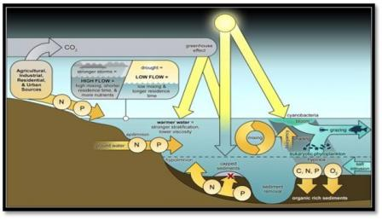
What Factors Cause HABS?
HABs are likely triggered by a combination of water and environmental conditions that may include:
excess nutrients (phosphorus and nitrogen)
lots of sunlight
low-water or low-flow conditions
calm water
warm temperatures
Depending on the weather and the characteristics of the lake, HABs may be short-lived (appearing and disappearing in hours) or long-lived (persisting for several weeks or more).
Paerl et al 2011
---NYSDEC

Slide 6
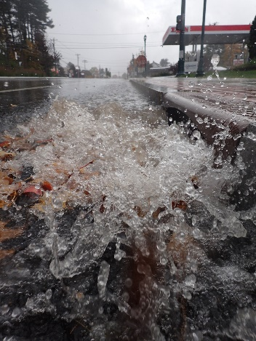
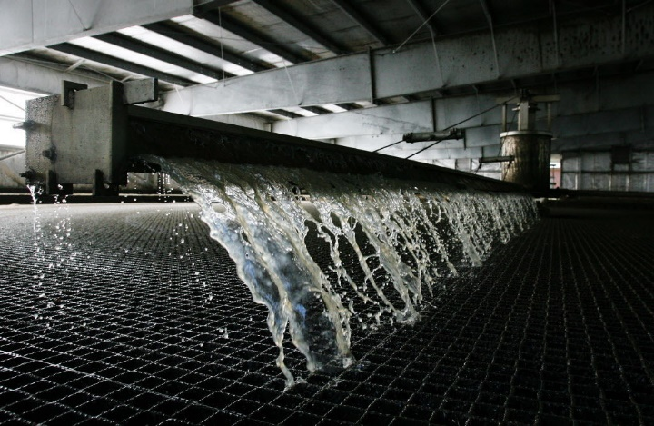
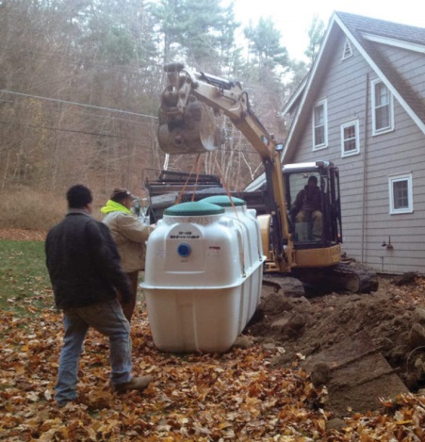
Areas to Improve In
What type of projects for remediation
Waste water treatment plant – Nitrogen only
Stormwater management – Nitrogen and Phosphorus
Septic management – Nitrogen and Phosphorus

Slide 7
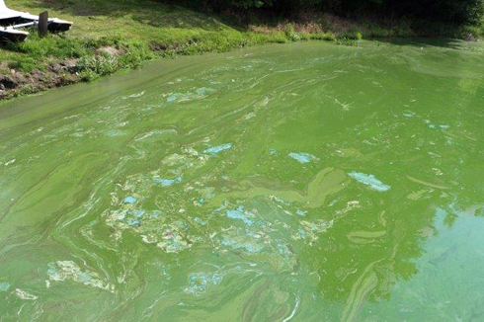
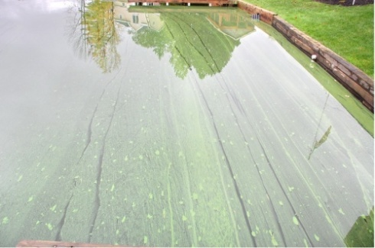
What A Bloom Looks Like…
https://youtu.be/HW_g7yfbfqo

Slide 8
Not All Cyano’s Are Capable Of Producing Toxins
Microcystis
Anabaena
Cylindrospermopsin
Cylindrospermopsis raciborskii
Anatoxins
Chrysosporum (Aphanizomenon) ovalisporum
Fischerella
Gloeotrichia
Nodularia
Nostoc
Microcystis
Planktothrix
Aphanizomenon flos-aquae
Aphanizomenon gracile
Aphanizomenon ovalisporum
Umezakia natans
Anabaena bergii
Anabaena lapponica
Anabaena planctonica
Rhaphidiopsis curvata
Lyngbya wollei
Rhaphidiopsis mediterranea
Cuspidothrix Cylindrospermopsis
Cylindrospermum
Microcystis
Dolichospermum
Oscillatoria
Planktothrix
Phormidium
Anabaena flos-aquae
A. lemmermannii
Raphidiopsis mediterranea ( Cylindrospermopsis raciborskii)
Tychonema
Woronichinia
Oscillatoria
Going further, only certain strains of these will produce the toxins in certain conditions.
And these conditions are not yet known.

Slide 9

Reporting suspected HAB
https://www.dec.ny.gov/chemical/77118.html

Slide 10
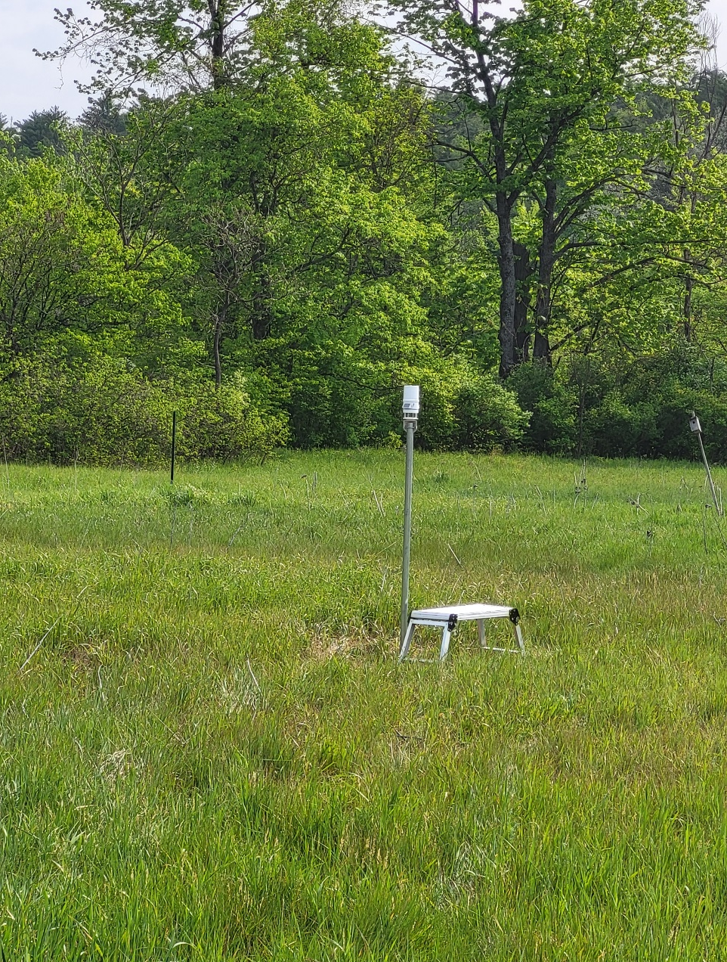
What is the SWCD doing for Water Quality? Monitoring and Sampling
1. Warren County SWCD submitted 2 ARPA funding applications to Warren County:
Weather station set up at the SWCD office, collects solar radiation, precipitation, the conductivity of precipitation, wind (speed, gust, wind direction), temp (current, high, low), relative humidity, barometric pressure, vapor pressure.
Monitoring stations at Lake Sunnyside and Glen Lake, collects air temperature, relative humidity, barometric pressure, rainfall, water level, & water temperature
Conducts outfall inspection and sampling for outfalls in Glens Falls, Lake George and Queensbury for the Ms4 program. Assists other communities as requested with outfall sampling.
Private ponds
Glens Falls Water Supply

Slide 11
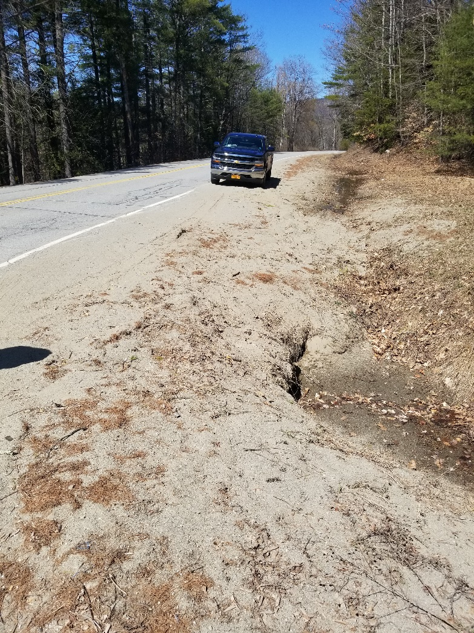
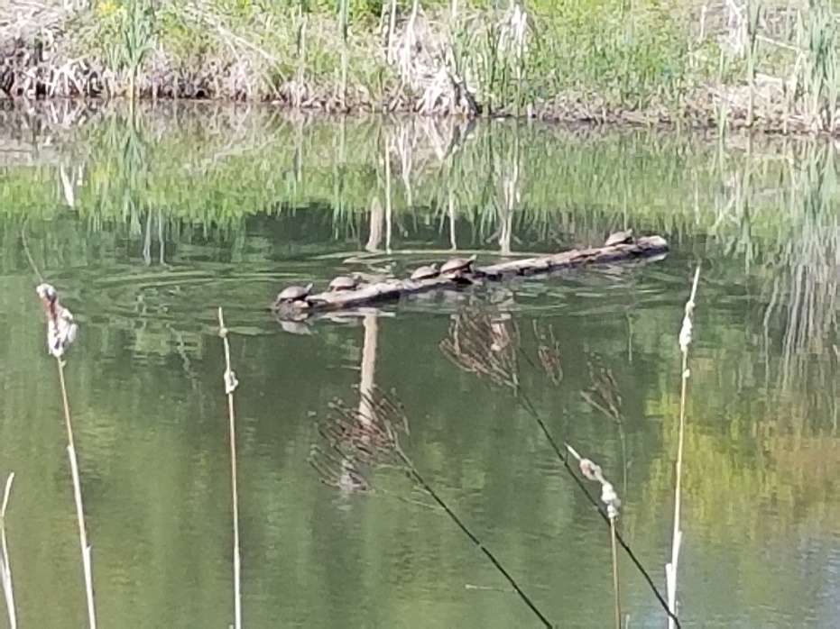
Planning and Implementation
Green infrastructure plans
Traditional stormwater management
Culvert assessments and plans
Stormwater Assessments
Implementation projects include stream culverts, stormwater reduction/improvement, hazard mitigation

Slide 12

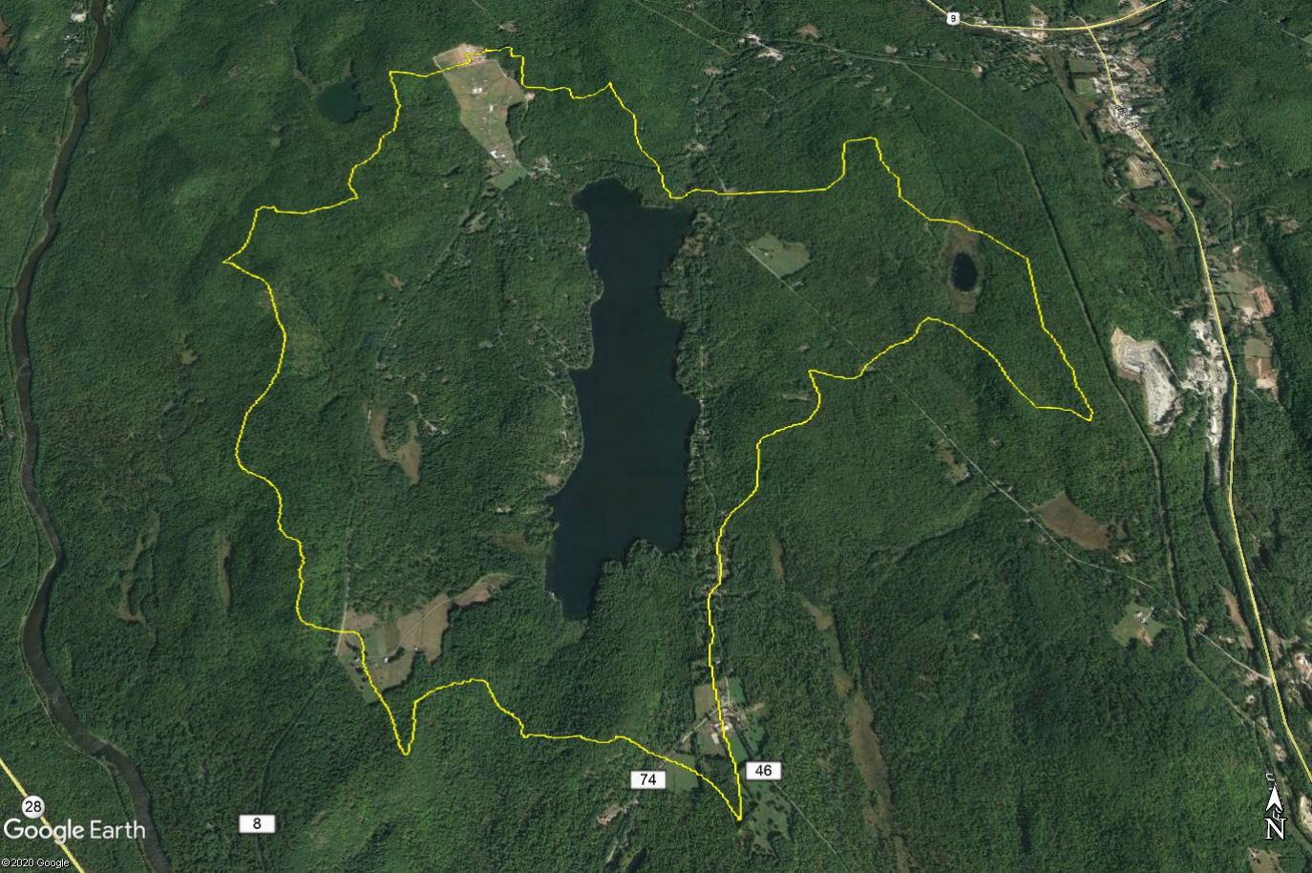
Questions?
Jim Lieberum
Warren County SWCD
518.623.3119
jiml@warrenswcd.org
Special thanks to Dr. Jeremy Farrell at RPI, for developing this presentation and allowing its use.

